Slide 1
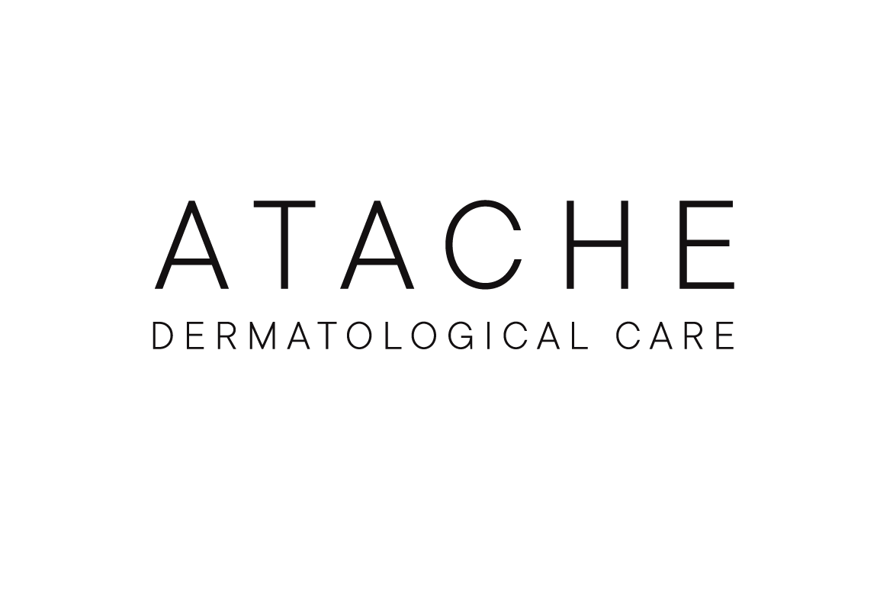

PRO MASK

Slide 2
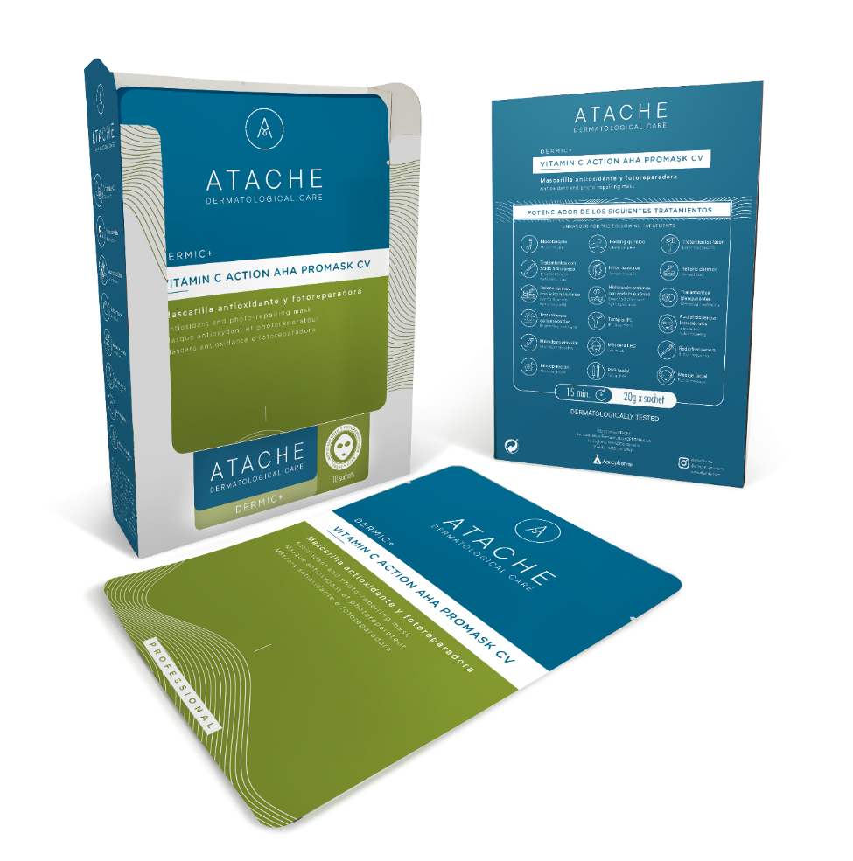
DERMIC + PRO MASK
Atache's professional orientation continues to advance with the new launch of Dermic + ProMask products.
In this sub-line, we present a series of ultra-fine tissue masks for vehiculating and penetrating Atache's best active ingredients in combination with a range of dermatological and aesthetic treatments.
As a complement to the Dermic + ProMeso line of virtual mesotherapy, these four cellulose masks help to soothe and recover the skin, reinforcing the effects of each line of treatment.

Slide 3
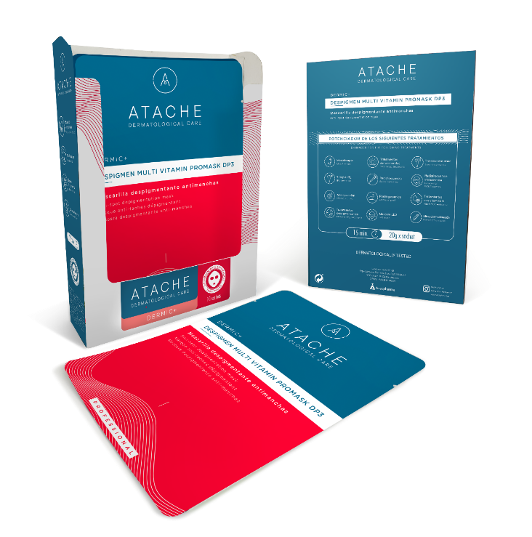
VEGETABLE FIBRE TECHNOLOGY
Ultra-fine weave cellulose masks use specialised technology to facilitate the efficient penetration of actives into the skin. These masks are made from natural cellulose fibres that are incredibly thin and flexible, allowing them to adhere closely to the skin and create an airtight seal.
The ultra-thin cellulose mask structure acts as a temporary barrier that traps moisture and active ingredients against the skin, preventing them from evaporating quickly and allowing them to be absorbed slowly over the application time.
In addition, the use of this material ensures that the mask is comfortable to wear and adapts perfectly to facial contours, thus maximising the contact between the skin and the active ingredients. This technology provides a high quality and effective treatment experience by enabling a controlled and deep delivery of the active ingredients.

Slide 4
DERMIC + PRO MASK

Slide 5
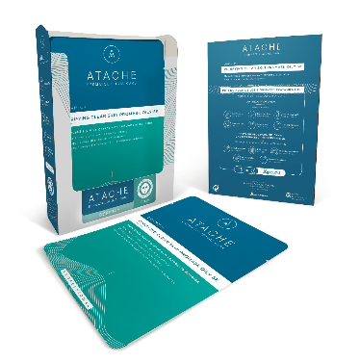
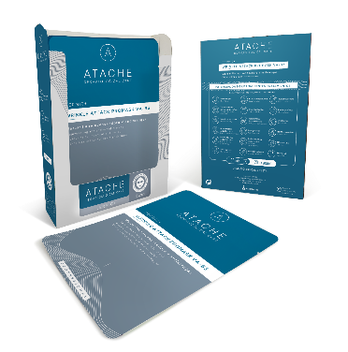


DERMIC + PRO MASK
PURIFYNG CLEAR SKIN PROMASK SK
WRINKLE ATTACK PROMASK VA~B3
VITAMIN C ACTION AHA PROMASK CV
  DESPIGMEN MULTI VITAMIN PROMASK DP3

Slide 6

DESPIGMEN MULTI VITAMIN PROMASK DP3
DEPIGMEN MULTI VITAMIN PROMASK DP3 is an advanced formula that blends pomegranate extract, niacinamide, hyaluronic acid and gluconolactone to effectively target skin pigmentation concerns.
Presentation: 10 sachets / 10 masks 20 grams
Indications: Melasma & Post-Inflammatory Hyperpigmentation
Ingredients: Pomegranate extract, niacinamide, hyaluronic acid and gluconolactone.

Slide 7
DESPIGMEN MULTI VITAMIN PROMASK DP3
Niacinamide:
Vitamin B3, is a versatile skincare ingredient that has been shown to be effective in multiple areas, from reducing hyperpigmentation to strengthening the skin barrier.
In addition to its depigmenting properties, niacinamide has also been shown to be an antioxidant, making it a valuable ingredient in combating premature skin ageing.
By improving the skin's barrier function, it can also reduce skin sensitivity and irritation.
Pomegranate extract:
Rich source of polyphenols, which are antioxidant compounds.
It has been shown to have depigmenting effects by inhibiting excessive melanin production in the skin.
Scientific studies have suggested that pomegranate extract may have an inhibitory effect on the enzyme tyrosinase, which may contribute to its ability to lighten dark spots and promote a more even skin tone.

Slide 8
DESPIGMEN MULTI VITAMIN PROMASK DP3
Gluconolactone:
Gluconolactone is a polyhydroxy acid (PHA) that provides gentle and effective exfoliation for the skin, without causing irritation.
This mild-acting molecule gently removes dead skin cells from the surface of the skin, promoting cell renewal and improving skin texture.
In addition to its exfoliating benefits, gluconolactone exhibits antioxidant properties, helping to protect the skin against oxidative stress and free radical damage.
Hyaluronic acid:
Hyaluronic acid is a naturally occurring polysaccharide known for its ability to retain water.
It acts as a highly effective moisturiser by providing deep hydration to the skin, helping to keep it soft and supple.
In addition to its moisturising properties, hyaluronic acid helps maintain the integrity of the extracellular matrix, which is essential for healthy, youthful skin.

Slide 9

HOW TO USE
Place the mask on a clean or dry face, adjusting it to the level of the eyes and adapting it to the facial contours.
Leave the mask on for 15-20 minutes.
Remove the mask and gently massage in the remaining serum with the fingertips until completely absorbed.

Slide 10

VITAMIN C ACTION AHA PROMASK CV
Cutting-edge antioxidant and photorepairing mask designed to revitalise skin. Its unique formula combines potent ingredients such as vitamin C, niacinamide, hyaluronic acid and gluconolactone to provide deep hydration, improve radiance and fight the signs of ageing.
Presentation: 10 sachets / 10 masks 20 grams
Indications: Revitalising, Antioxidant, Anti-aging
Ingredients: Vitamin C, Gluconolactone, Alpha-hydroxy acids, niacinamide and hyaluronic acid.

Slide 11
INGREDIENTS
Vitamin C (3-O-Ethyl Ascorbic Acid) stands out as a key component, offering exceptional antioxidant protection against free radicals. It also stimulates collagen synthesis, strengthening the skin's structure and reducing the appearance of fine lines and wrinkles. Its ability to inhibit melanin production also makes it an effective ally against hyperpigmentation, leaving skin with a more even and luminous tone.
Niacinamide (vitamin B3): Known for its calming and depigmenting effects, niacinamide works to improve overall skin texture, minimising the appearance of enlarged pores and reinforcing the skin's barrier function. Its ability to regulate sebum production helps control sebum, while its depigmenting action contributes to a more even, radiant complexion.
Gluconolactone: A polyhydroxy acid (PHA) that offers exfoliating and antioxidant benefits. It gently smoothes the skin and removes dead skin cells, and its antioxidant action helps protect the skin against environmental stress.
Hyaluronic Acid: Highly effective moisturiser. With its ability to retain large amounts of water, it provides deep and long-lasting hydration, improving the skin's elasticity and firmness.

Slide 12
INGREDIENTS
Citric acid: Sourced from citrus fruits such as lemons and oranges, it acts as a gentle exfoliant, helping to remove dead skin cells and promoting cell renewal. This results in smoother, more even-toned skin.
Malic acid: found in apples and other fruits, it is known for its antioxidant and exfoliating properties. It helps improve skin texture, reducing the appearance of fine lines and wrinkles, and leaving skin looking younger and more radiant.
Tartaric acid: commonly found in grapes, helps balance the pH of the skin, which can help reduce irritation. It also has antioxidant properties that protect the skin against oxidative stress and signs of premature ageing.
Lactic acid: derived from milk, it is a gentle exfoliant that helps to soften and revitalise the skin. It also has moisturising properties, helping to keep skin looking fresh and radiant.

Slide 13
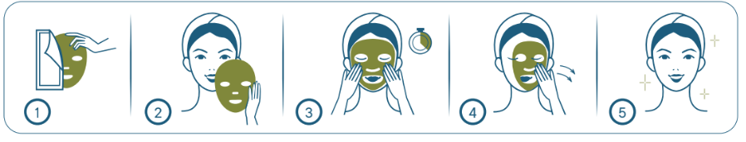
HOW TO USE
Place the mask on a clean or dry face, adjusting it to the level of the eyes and adapting it to the facial contours.
Leave the mask on for 15-20 minutes.
Remove the mask and gently massage in the remaining serum with the fingertips until completely absorbed.

Slide 14

WRINKLE ATTACK PROMASK VA~B3
Rejuvenating and Anti-Wrinkle Mask: WRINKLE ATTACK PROMASK VA~B3, with niacinamide, bakuchiol and hyaluronic acid, strengthens the skin barrier, reduces the appearance of fine lines, wrinkles and dark spots, helps stimulate cell renewal, improves skin texture and restores skin radiance.
Presentation: 10 sachets / 10 masks 20 grams
Indications: Anti-ageing, Anti-wrinkles
Ingredients: Bakuchiol retinol-like, niacinamide, hyaluronic acid

Slide 15
INGREDIENTS
Niacinamide: A powerful multifunctional ingredient that stands out for its ability to stimulate the production of ATP, the fundamental cellular energy molecule. This energetic process revitalises skin cells, promoting skin renewal and repair from within. In addition, niacinamide stimulates the synthesis of ceramides, essential components of the skin barrier, thus strengthening the skin's protective function and minimising the appearance of wrinkles.
Bakuchiol: A natural retinoid that shares structural and functional similarities with retinol. However, unlike retinol, bakuchiol does not have the typical side effects of skin irritation and sensitivity associated with synthetic retinoids. It acts as an anti-wrinkle agent by stimulating collagen and elastin synthesis, thus improving skin firmness and elasticity.
Hyaluronic Acid: High molecular weight, it is included in this formula to increase the hydration levels of the epidermis, maintain skin elasticity and firmness, thus smoothing wrinkles and fine lines.

Slide 16
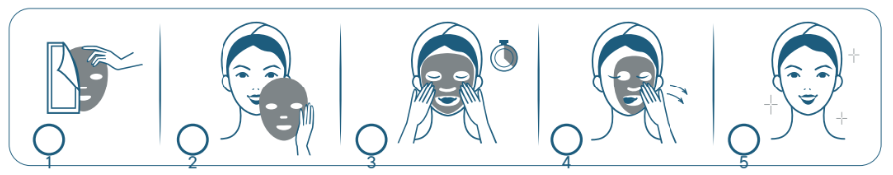
HOW TO USE
Place the mask on a clean or dry face, adjusting it to the level of the eyes and adapting it to the facial contours.
Leave the mask on for 15-20 minutes.
Remove the mask and gently massage in the remaining serum with the fingertips until completely absorbed.

Slide 17

PURIFYNG CLEAR SKIN PROMASK SK
PURIFYNG CLEAR SKIN PROMASK is a mask designed to address the specific needs of oily, acne-prone skin. Thanks to its formulation, it offers a purifying, balancing and sebum-regulating action, reducing pore size and imperfections. In addition, it helps reduce impurities and strengthens the skin's barrier function, providing deep hydration and a silky effect, leaving skin looking fresh and healthy.
Presentation: 10 sachets / 10 masks 20 g
Indications: Oily and/or acne-prone skin.
Ingredients: salicylic acid, bakuchiol, tea tree leaf oil, white willow bark, hyaluronic acid.

Slide 18
INGREDIENTS
Salicylic acid:
Salicylic acid is a fat-soluble beta-hydroxy acid (BHA) that is characterised by its ability to penetrate deep into pores due to its molecular structure. This allows it to effectively exfoliate the skin both on the surface and within the hair follicles.
Its gentle exfoliating action dissolves the bonds between the cells of the horny layer, thus promoting the removal of dead cells and clogged pores. This helps prevent and treat acne, including blackheads and comedones, while improving skin texture.
In addition to its exfoliating function, salicylic acid has anti-inflammatory properties that help reduce redness and inflammation associated with acne, thus relieving skin irritation.
Bakuchiol:
Bakuchiol is a botanical compound that acts like a natural retinol, albeit without the side effects associated with the latter. It has been shown to stimulate collagen and elastin synthesis, which promotes cell renewal and improves skin firmness and elasticity.
By promoting cell turnover, Bakuchiol improves skin texture and helps minimise the appearance of enlarged pores, resulting in smoother, more even and rejuvenated skin.

Slide 19
INGREDIENTS
Tea Tree Leaf Oil:
Tea tree leaf oil is known for its antimicrobial and anti-inflammatory properties. It helps regulate bacterial growth on the skin, which helps keep pores clean and free of impurities.
Its antibacterial action can also help prevent and treat acne, reducing inflammation and promoting skin healing.
White Willow Bark:
White willow bark is rich in naturally occurring salicylic acid, making it an effective exfoliating agent for removing dead skin surface cells and unclogging pores.
In addition to its exfoliating properties, white willow bark has anti-inflammatory and soothing properties that help relieve irritation and soothe the skin, making it especially useful in the treatment of acne and sensitive skin.
Hyaluronic acid: Able to retain water in the skin, it hydrates the epidermis and strengthens the extracellular matrix.

Slide 20
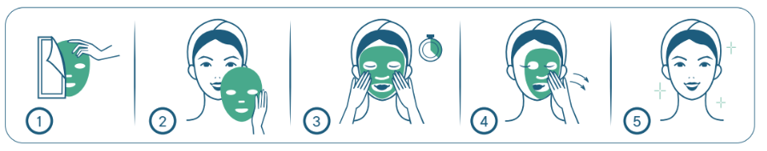
HOW TO USE
Place the mask on a clean or dry face, adjusting it to the level of the eyes and adapting it to the facial contours.
Leave the mask on for 15-20 minutes.
Remove the mask and gently massage in the remaining serum with the fingertips until completely absorbed.

