Slide 1
PRESENTATION

Slide 2
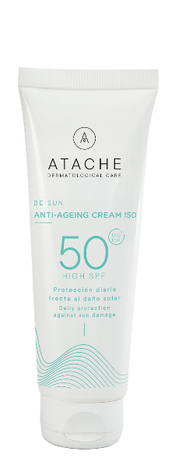
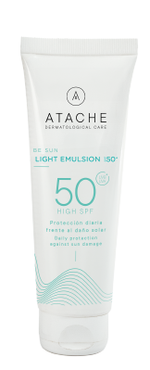
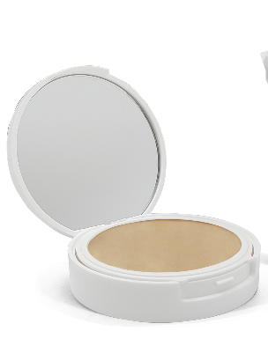
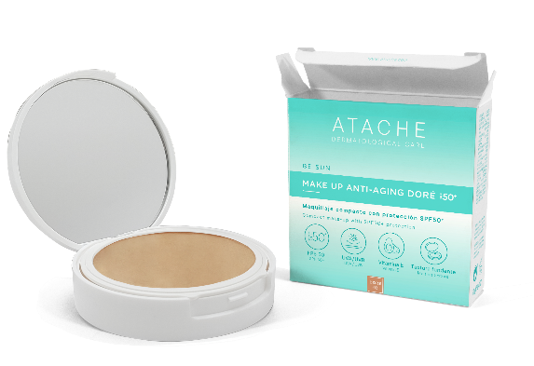
NEW SUN PROTECTION LINE
Be Sun is renewed with a new concept: integral sun protection with antioxidant action.
The key: Antioxidants
Our formula not only protects against harmful UVA and UVB rays through an effective combination of chemical and physical filters, but also fights free radicals and prevents premature skin ageing thanks to the addition of vitamin E and hyaluronic acid.
The new BE SUN line offers a complete range of sunscreens with a high sun protection factor (SPF 50 and SPF 50+) and a novel variety of textures and presentations to suit the needs of all skin types.

Slide 3
BENEFITS
The new range of Be Sun products offers the following advantages:
High sun protection: SPF 50 and 50+ which blocks more than 98% of sunburn-causing UVB rays and helps prevent premature skin ageing.
Physical filters: Increase the level of protection of traditional chemical filters by reflecting and scattering UV rays.
Broad spectrum protection: Protects against UVA and UVB rays, which are mainly responsible for sun damage.
Water and sweat resistant formulas: Film-forming ingredients prevent rapid evaporation and loss of the product applied to the skin.
Anti-ageing ingredients: In addition to antioxidants such as vitamin E, it contains hyaluronic acid and other moisturising and nourishing ingredients to protect the skin and keep it hydrated and smooth.

Slide 4
SUNSCREENS
&
ANTIOXIDANTS

Slide 5
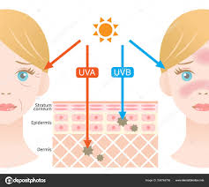
SOLAR RADIATION
UV radiation reaching the earth's surface consists of UVA radiation (95%) and UVB radiation (5%).
UVA rays penetrate deeper into the skin and are associated with premature ageing and long-term cell damage.
UVB rays penetrate the layers of the epidermis and are responsible for causing erythema or sunburn.
Exposure to ultraviolet (UV) radiation from the sun can cause a variety of skin damage, from sunburn to deep cell damage.
To protect against these effects, sunscreens that block both UVA and UVB rays are mainly used.

Slide 6
SOLAR FILTERS
Measuring Efficacy
The efficacy of sunscreens is measured by the Sun Protection Factor (SPF), which indicates the product's ability to prevent skin reddening caused by UVB rays.
Additionally, broad spectrum products must demonstrate their ability to protect against UVA rays, which is reflected in their labelling and specific regulations in some countries.
SPF indicates numerically how many times a sunscreen would extend the time it would take for the skin to burn without photoprotection. Thus, if a skin burns in 10 minutes of sun exposure, a sunscreen with SPF 10 would theoretically increase the time without burning to 100 minutes.
According to the European standard the UVA protection must be at least 30% of the UVB protection and is assessed with the ISO standard 24443 (determination of sunscreen UVA photoprotection in vitro).

Slide 7
SOLAR FILTERS
Chemical and Physical Solar Filters
Chemical filters:
Chemical filters, also called organic filters, are composed of chemical molecules that absorb UV radiation and transform it into heat, which is then dissipated from the skin. These filters are usually organic compounds such as avobenzone, octocrylene, octisalate and homosalate.
Physical filters:
Physical filters, also known as mineral filters, employ compounds such as titanium dioxide and zinc oxide to create a physical barrier on the skin that reflects and scatters UV radiation before it penetrates the epidermis. These compounds act as a shield, effectively blocking both UVA and UVB rays.

Slide 8
ANTIOXIDANTS
Cellular and Molecular Protection
Antioxidants, unlike sunscreens, do not block or absorb UV radiation. Instead, their main function is to reduce or repair the oxidative processes that UV radiation, especially UVA, can induce.
Numerous studies have shown that antioxidants, such as vitamin E, can be effective in preventing erythema and protecting against cell damage. When applied topically in combination with sunscreens, these antioxidants can increase the efficacy of sun protection, providing a more complete defence against UV-induced damage.
Antioxidants neutralise ROS (reactive oxygen species) and help repair cell damage.

Slide 9
INGREDIENTS

Slide 10
CHEMICAL FILTERS
Be Sun's combination of chemical filters broadens the spectrum for full UVB/UVA coverage
Octocrylene: Absorbs UVB and some UVA rays, preventing sun damage. Helps stabilise other sunscreens in the formula.
Ethylhexyl Methoxycinnamate (Octinoxate): Absorbs UVB rays, protecting the skin from sunburn.
Butyl Methoxydibenzoylmethane (Avobenzone): Provides effective protection against UVA rays, responsible for skin ageing.
Ethylhexyl Triazone: A highly effective UVB filter that provides broad spectrum protection.
Diethylamino Hydroxybenzoyl Hexyl Benzoate: Protects against UVA rays, contributing to broad spectrum sun protection.

Slide 11
PHYSICAL FILTERS
Titanium dioxide: A mineral sunscreen
Its main function is to protect the skin from the sun's ultraviolet (UV) rays, both UVA and UVB, through a physical mechanism of reflection and scattering of radiation.
Broad spectrum: Offers protection against a wide range of UV rays, including UVA and UVB, which are considered to be responsible for premature skin ageing and skin cancer.
Photostable: Maintains its protective efficacy even under prolonged sun exposure, unlike some chemical filters that degrade over time.
Safe and well tolerated: Generally considered safe for all skin types, including sensitive or irritation-prone skin.
Water-resistant: Maintains its protection even after swimming or sweating.
Mattifying effect: Helps control sebum production and reduces shine on the skin.

Slide 12
ANTIOXIDANTS
VITAMIN E
Vitamin E, also known as alpha-tocopherol, is a fat-soluble antioxidant widely recognised for its skin health benefits and its ability to protect against free radical damage.
Mechanism of action: Vitamin E acts as a powerful antioxidant by neutralising free radicals,
Cell protection: Vitamin E helps maintain cell membrane integrity and prevent tissue degeneration.
Reduction of inflammation: It may also have anti-inflammatory properties, making it useful for soothing irritated or inflamed skin.
Stimulating cell regeneration: May promote cell regeneration by helping to repair damage caused by oxidative stress,

Slide 13
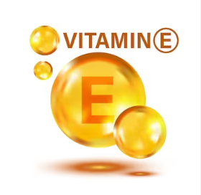
ANTIOXIDANTS
VITAMIN E AS AN ADJUVANT IN SUN PROTECTION
Photoprotective action: Vitamin E may provide some protection against the harmful effects of ultraviolet (UV) radiation from the sun. Although it does not block UV rays directly, its antioxidant action helps prevent UV-induced oxidative damage to the skin.
Sunscreen efficacy enhancer: Vitamin E has been shown to increase the efficacy of sunscreens when used in combination. By acting synergistically with sunscreens, vitamin E can improve the ability to protect against UV rays and reduce the risk of sunburn and skin damage.
Prevention of photo-ageing: By protecting the skin from sun-induced damage, including free radical formation and collagen degradation, vitamin E can help prevent photo-ageing and maintain a younger, healthier appearance.

Slide 14
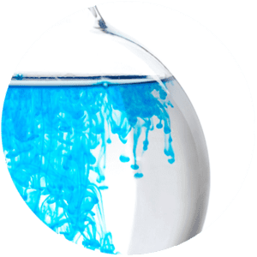
MOISTURISERS
HYALURONIC ACID
Hyaluronic acid is a natural substance that helps to keep the skin hydrated and supple.
Attracts and retains water
Moisturises the skin
Reduces the appearance of fine lines and wrinkles
Increases skin elasticity
Heals wounds
Hyaluronic acid can help prevent sun damage and premature ageing. Sunscreens with hyaluronic acid are suitable for all skin types, even sensitive skin.
ALANTHOTIN: Essential in skin care for its moisturising and protective properties of the skin barrier, promoting cell regeneration and keeping skin soft and healthy.

Slide 15
OTHER INGREDIENTS
ARGAN OIL
Argan oil, also known as ‘liquid gold’, is a natural oil derived from the seeds of the fruit of the argan tree, which grows mainly in south-western Morocco.
- Rich in antioxidants: Contains vitamin E, carotenoids and polyphenols that fight free radicals, help prevent premature ageing and protect the skin from environmental damage.
- Moisturising and nourishing: Contains essential fatty acids, such as linoleic acid and oleic acid, which deeply moisturise skin and hair, restoring elasticity and softness.
- Anti-inflammatory: Helps soothe irritated skin, reduce redness and relieve conditions such as acne and eczema.
- Regenerating: Promotes wound healing and cell renewal.

Slide 16
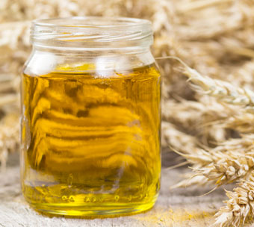
OTHER INGREDIENTS
VEGETABLE OILS: SUNFLOWER SEED - WHEAT GERM - PEANUT - OLIVE
Deep Moisturising
These oils are rich in fatty acids that help to deeply moisturise the skin, keeping it soft and supple even under sun exposure.
Antioxidant Protection
Contain vitamin E and other antioxidants that protect the skin from free radical damage caused by UV radiation, thus reducing oxidative stress and premature skin ageing.
Nutrition and Cell Regeneration
Sunflower, wheat germ, peanut and olive oils provide essential nutrients that promote cell regeneration and help keep skin healthy and radiant.

Slide 17
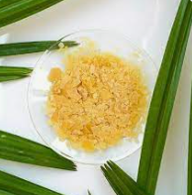
OTHER INGREDIENTS
CARNAUBA WAX
Carnauba wax, also known as Copernicia cerifera cera, is a natural wax obtained from the leaves of the Copernicia prunifera palm, found predominantly in Brazil.
Moisturising: Forms a protective barrier on the skin, helping to retain moisture and preventing dehydration.
Application: Facilitates an even and smooth application of the product on the skin.
Long Lasting: Extends the life of the product on the skin, making it last longer.
Finish: Provides a natural glow, improving the aesthetic appearance of the skin.

Slide 18
OTHER INGREDIENTS
PROTECTIVE FILM
An agent that forms a flexible and durable film on the skin, helping to create a water-resistant barrier. This property makes it ideal in sunscreen products, improving their adhesion to the skin and ensuring they are not easily washed off by water or sweat.
It helps prevent the premature breakdown of sunscreens in water, thus extending their effectiveness.
It also functions as a texture and extensibility enhancing agent for the correct application of the Be Sun range of sunscreens.
It has been confirmed to be non-toxic and non-irritating, making it suitable for various skin care and make-up formulations.

Slide 19
PRODUCTS

Slide 20
FACIAL products BE SUN line
Anti-ageing sunscreen
50 SPF
Moisturising sunscreen
50+ SPF
Sunscreen
Make-up Bronze
50+ SPF
Sunscreen
Make-up Natural
50+ SPF
Sunscreen
sensitive areas
50+ SPF
MIN
WAT
MIN
MIN
MIN
WAT
WAT
C
C
ANTI-AGEING CREAM
LIGHT EMULSION
MAKE UP ANTIAGING DORE
MAKE UP ANTIAGING LIGHT
DELICATE ULTRA PROTECTION

Slide 21
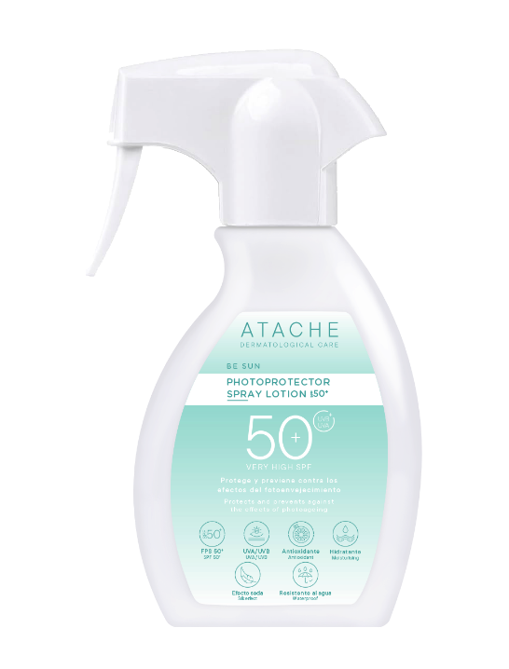
BE SUN BODY products
Protective Lotion
Spray
50+ SPF
Dry Oil
Protective
50 SPF
LEGEND
Physical Filter
Waterproof
Coloured
MIN
WAT
WAT
C
PHOTOPROTECTOR SPRAY LOTION
DRY OIL PHOTOPROTECTOR

Slide 22
Be sun ANTI-AGEING CREAM 50 spf
Description: Anti-ageing facial sunscreen with antioxidant and repairing properties. Protects the skin from the sun, prevents premature ageing and increases cell regeneration, leaving the skin soft and supple.
Indications: For dry and mature skin.
Properties:
UVA/UVB protection
SPF 50
Physical and chemical filters
Colour free
Ingredients: Chemical sunscreens, Titanium Dioxide, Argan Oil, Aloe Vera, Allantoin, Allantoin.
Tube: 75 ml

Slide 23
BE SUN LIGHT EMULSION SPF 50+
Description: Smooth-textured facial sunscreen with moisturising and antioxidant properties. Protects the skin from the sun, repairs oxidative damage and increases the skin's moisture and suppleness.
Indications: Normal to combination skin
Properties:
UVA/UVB protection
SPF 50 +
Chemical Filters
Colour-free
Waterproof
Ingredients: Chemical sunscreens, Vitamin E, Hyaluronic Acid, Protective Film
Tube: 75 ml

Slide 24
BE SUN MAKE UP ANTIAGING DORE SPF 50+
Description: High photoprotection compact make-up that protects and repairs the skin from oxidation caused by sun exposure. Creamy texture for a complete coverage of the face and silky touch with a tanned colour and a luminous touch.
Indications: All skin types
Properties:
UVA/UVB protection
SPF 50 +
Chemical and physical filters
Tan colour
Waterproof
Ingredients: Chemical Sunscreens, Titanium Dioxide, Vitamin E, Mineral Pigment, Carnauba Wax, Mica
Powder case: 12 gr

Slide 25
BE SUN MAKE UP ANTIAGING LIGHT SPF 50+
Description: High photoprotection compact make-up that protects and repairs the skin from oxidation caused by sun exposure. Creamy texture for a complete coverage of the face and silky touch with a light colour and a luminous touch.
Indications: All skin types
Properties:
UVA/UVB protection
SPF 50 +
Chemical and physical filters
Light colour
Waterproof
Ingredients: Chemical Sunscreens, Titanium Dioxide, Vitamin E, Mineral Pigment, Carnauba Wax, Mica
Powder case: 12 gr

Slide 26
BE SUN DELICATE ULTRA PROTECTION SPF 50+
Description: Broad spectrum sunscreen formulated with antioxidant and nourishing active ingredients. Especially indicated for the most sensitive and sun-exposed areas with a stick format for quick and easy reapplication of the product.
Indications: Sensitive areas of the face
Properties
UVA/UVB protection
SPF 50 +
Chemical and physical filters
Colour free
Ingredients: Chemical Sunscreens, Titanium Dioxide, Vitamin E, Sunflower Seed and Olive Vegetable Oils.
Stick: 25 gr

Slide 27
BE SUN PHOTOPROTECTOR SPRAY LOTION SPF 50+
Description: Body spray sunscreen with moisturising and antioxidant properties that protects and prevents the effects of photoaging.
Indications: All skin types
Properties:
UVA/UVB protection
SPF 50 +
Chemical Filters
Colour free
Waterproof
Ingredients
: Chemical sunscreens, Vitamin E, Hyaluronic Acid, Protective Film
Spray: 200 mL

Slide 28
BE SUN DRY OIL PHOTOPROTECTOR SPF 50
Description: Protective body oil with a dry touch and a high antioxidant and reparative power. It has a great extensibility and non-greasy feel to improve the application and coverage of the body area.
Indications: All skin types
Properties:
UVA/UVB protection
SPF 50
Chemical Filters
Colour free
Ingredients: Chemical sunscreens, Vitamin E, Vegetable Oils from sunflower seed, wheat germ and peanut.
Bottle: 200 ml

