Slide 1
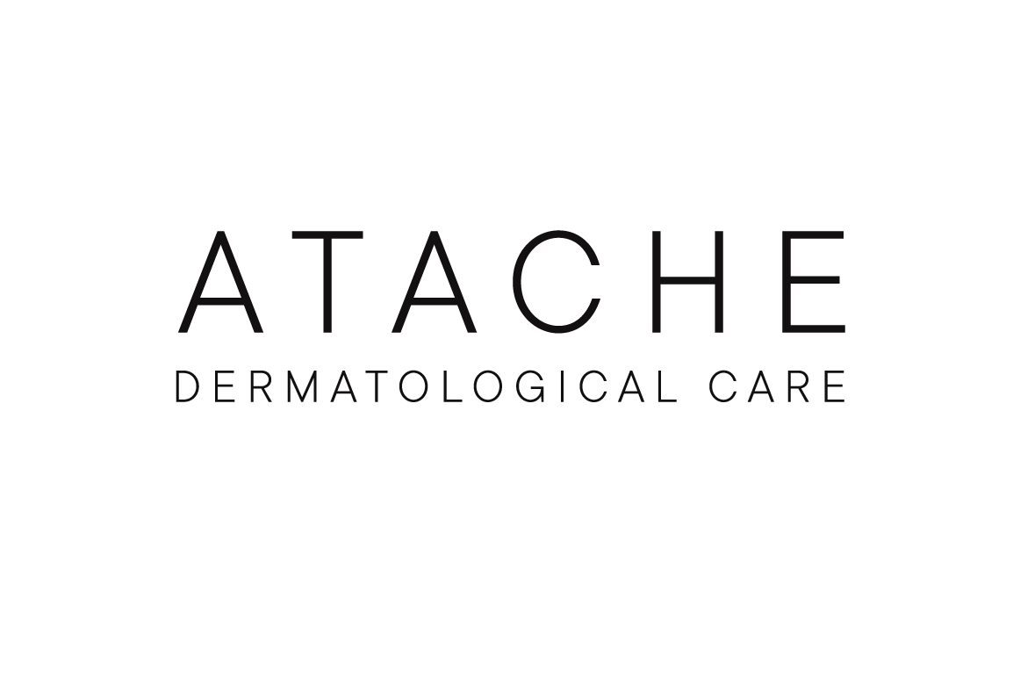
TRAINING

Slide 2
INDEX
PRESENTATION VITAL AGE
SKIN AGING: wrinkles
INGREDIENTS
HOME CARE PRODUCTS
PROESSIONAL PROGRAM
2

Slide 3
PRESENTATION

Slide 4
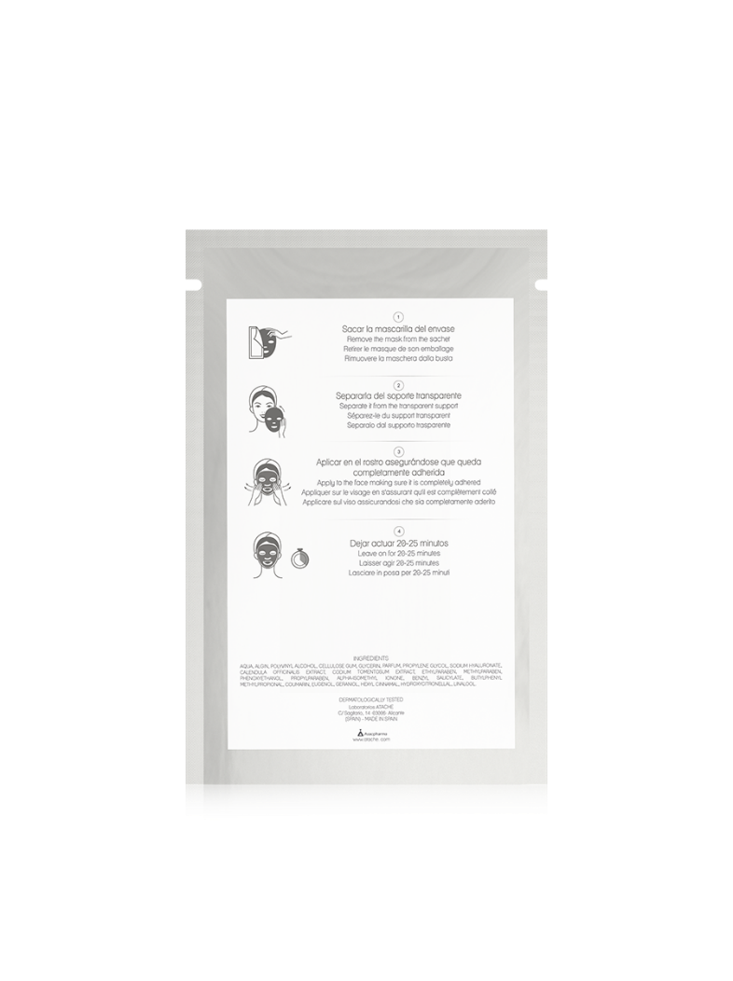
Vital age - PRESENTATION
A full anti-wrinkle treatment which associates pure RETINOL with Q10 Con-enzyme, thus obtaining an extra powerful action, against free radicals. This perfect combination increase the action of the RETINOL and increases the production of energy in skin cells, enhancing its normal function. Moreover, it smoothes out lines of expression and attenuates wrinkles of the face, neck and décolletage.
.

Slide 5
SKIN AGING: WRINKLES

Slide 6
THE SIGNS OF AGING
Wrinkles.
Dark spots.
Epidermis fine and brittle.
Loss of skin’s ability to retain hydration.
Flaccidity.
Dehydration.
Lack of luminosity due to the slowing of the cell renewal process. Wrinkles cause an irregular light reflection by the formation of wrinkles or furrows.
Loss of elasticity.

Slide 7
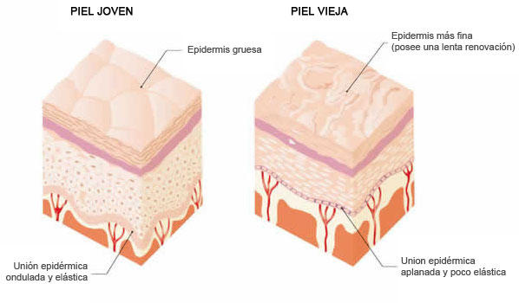
WRINKLES
Wrinkle is a folding or furrows in skin or any other membrane produced, by diminution of deeper fat layer, by reduction of number of cells in dermis or by non proper fonctioning of them.
Essetially with passage of time, an alteratio of elastine fibers is produced (loss of elasticity) and collagen (loss of firmness) located in dermis , reduction of water content, skin produces less fat compound and external layer (epidermis) become less smoother and dryer.
The first wrinkles that appear are the so-called expression wrinkles that are produced by the repeated action of the muscles of the face to perform the facial expressions.

Slide 8
TYPES OF WRINKLES
WRINKLES BY SUN DAMAGE
UV-B rays penetrate in cellular layers of epidermis and provoke damages in DNA of keratinocytes and melanocytes, forerunner of most skin cancers.
UVA rays penetrate in dermis and are the main cause of immune supression and early skin AGEING, produce destruction of collagen and elastineL.
IR rays create Reactive Oxygen Species (ROS), as a consequence destruction of collagen and elastic fibers of dermis, that leads to early AGEING of skin.
EXPRESSION WRINKLES
These are wrinkles that appear as a result of the way that muscles work to control our facial expressions. They are characterised by their appearance from middle age and are evident when we laugh, when we are surprised, when we are annoyed or cry, they disappear when we are relaxed, but with the passing of the years if they are not treated then they will leave marks on the skin.
GRAVITY WRINKLES
These are wrinkles that appear as a result of the chronological ageing process and the effect of gravity with the dropping of the skin on the face and neck, and the flaccidity of the facial muscles. The effects of gravity become evident from the age of 50 onwards, which is when the firmness and elasticity of the skin reduces significantly.

Slide 9
EYE WRINKLES
The eyes is the most expressive area of the face. It is a very important area in the
female aesthetics so great attention is paid to it. But also, it is the place of the face where the signs of aging are first manifested. In the area of the eye contour not only the signs of time are manifested but also stress, fatigue, lack of sleep...
The eye socket is one of the most fragile and delicate areas of the face:
It is in constant motion (about 15,000 blinks daily).
Its physiology is different from that of the rest of the face (less thickness of the skin, no muscles that support the skin and has decreased levels of protective sebum and hydrolipid film.
There are three basic problems: wrinkles (crow’s feet), bags and dark circles.

Slide 10
VITAL AGE PROPERTIES
It reduces the appearance of existing wrinkles, prevents the appearance of new ones, and protects against premature skin ageing.
It stimulates the synthesis of collagen and elastin.
It increases the cellular renewal of the epidermis.
It activates cellular energy, improves the functions of skin cells.
It neutralises reactive oxygen species (ROS).
It strengthens the skin’s anti-oxidant defence system.
It improves the skin’s hydration levels.

Slide 11
INGREDIENTS

Slide 12
Ingredients
Retinol in the skin
It acts as a growth regulator of epithelial tissue. It produces protein synthesis in ribosomes, stabilizes lysosomal membranes, regulates the epithelial mitotic index and affects the metabolism of mucopolysaccharide acids. Therefore, its deficit causes a dry and wrinkled skin. From a cosmetic point of view, the application of Vitamin A is especially useful in winter.

Slide 13
Ingredients
Retinol benefits
Strengthens the skin's natural defense mechanism, fighting free radicals.
Increases cell regeneration, enhances cell renewal
Stimulates the synthesis of collagen and elastin.
Reduces skin wrinkles and fine lines.
Helps in fading of spots
Acts as an exfoliant and stimulant of cell regeneration

Slide 14
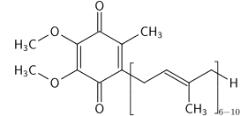
Ingredients
Coenzyme Q10 on the skin
The term coenzyme Q or Ubiquinone refers to a derivative of fat-soluble quinones that participate in the cellular respiratory chain where they can react with ROS preventing direct damage to biomolecules and the beginning of lipid peroxidation.
The aging process is associated with an increase in cellular oxidation.
CQ10 is effective against stress oxidative caused by UVA radiation and has a significant suppression of the expression of the collagenase in the dermal fibroblasts.

Slide 15
Ingredients
Benefits of CQ10
Coenzyme Q10 plays a role in scavenging oxygen free radicals
Inhibits collagenase, an enzyme that is responsible for the deterioration of collagen fibers.
Natural Q10 levels drop dramatically after age 40. It is related to the aging process.
Coenzyme Q10 reinforces the action and effects of RETINOL.

Slide 16
INGREDIENTS
Niacinamide
Vitamin B3, niacin or nicotinamide, is a multifunctional vitamin that is among the first options of the latest cosmetic formulations.
This group B vitamin is involved in the formation of the coenzyme NADH which is necessary for the production of cellular energy and activates the synthesis of ATP molecules, the large energy stores involved in all energy transactions, therefore, it is of vital importance for the proper functioning of cellular respiratory processes.
It is known for its anti-aging, depigmenting, protective, seborregulating and soothing role.

Slide 17
INGREDIENTS
Niacinamide
Anti-aging effect
The vitamin B3 derivative has antioxidant properties and protects the skin from free radicals. This prevents premature aging of the skin. This substance also stimulates the production of lipids and the formation of collagen and elastin. The result is a firmer and softer complexion that gains elasticity.
Strengthens the skin’s protective function and moisturizes
Studies have shown that this substance has a regenerative effect on a damaged skin barrier. Vitamin B3 increases the synthesis of lipids and ceramides, which are essential for the skin’s protective function. An intact skin barrier ensures that the skin loses less moisture and becomes more resistant to external influences. Therefore, products containing niacinamide are also ideal for dry skin.

Slide 18
INGREDIENTS
Niacinamide
Depigmenting effect
By inhibiting the transfer of the melanosome from melanocytes to keratinocytes and is an ingredient with antiglycation function of proteins, thus improving skin tone by preventing it from acquiring a yellow color.
Reduces impurities, minimizes pores and calms
Improves skin texture and the appearance of pores. It relaxes skin and facial redness, homogenizing skin tone and improves the appearance of marks and scars.
Anti-pollution effect
It protects the skin from the damage of everyday life and the factors to which the skins are exposed on a daily basis such as pollution, UV radiation or tobacco.

Slide 19
INGREDIENTS
Other ingredients
Hyaluronic acid: In addition to moisturizing, hyaluronic acid improves the surface appearance of the skin and increases its elasticity and firmness. Another of its advantages is that it provides volume in the dermis producing a "filling" effect that softens wrinkles and fine lines.
Panthenol or provitamin B5, is a precursor of vitamin B5, which when applied to the skin is able to penetrate the epidermis and metabolize quickly. It has synergistic action with niacinamide in its action against skin aging.
It is a repairing ingredient that promotes skin regeneration processes by helping to repair barrier function and thus reduce your water loss. It is also able to attract and retain water so it increases its moisturizing properties. Finally it has a calming effect.

Slide 20
INGREDIENTS
Retinol palmitate
It increases cell regeneration and stimulates collagen and elastin synthesis, increasing the elasticity and smoothness of the skin and reducing the depth of wrinkles and expression lines. It provides an exfoliating effect that helps to fade the stains. In addition, it has a powerful effect neutralizing free radicals that provides protection against photoaging.
Shea butter
Ingredient with powerful nourishing properties, softening and restoring skin balance. In addition, it is a powerful cell regenerator of natural origin. It provides vitality and luminosity and improves the skin barrier thus avoiding excessive dehydration and protecting it from climatic aggressions and pollution. It is very effective regenerating aged, dry, dehydrated, irritated and dull-colored skin
Hypericum Perforatum: known as St. John's wort, it can help reduce swelling and soothe irritated skin. It also has antioxidant properties, which means it can help protect the skin from premature ageing. In addition, Hypericum perforatum oil has a positive effect on skin regeneration, which can improve the appearance and overall health of the skin.

Slide 21
HOME CARE PRODUCTS

Slide 22
Products VITAL AGE LINE
Double intensive anti-wrinkle serum with Retinol and CoQ10
Smoothing anti-ageing serum
Anti-aging cream at night
Moisturizer that blurs expression lines
Eye contour, wrinkle corrector
SERUM 2
ANTIAGE V-B3
WRINKLE ATTCK NIGHT
WRINKLE ATTACK DAY
EYE WRINKLE ATTACK

Slide 23
Serum 2
Intensive anti-wrinkle treatment in dual-phase formula
Pure retinol 0.3%
Molecular film
Coenzyme Q10 0.2%
liposome
Fine molecule that ensures its stability and favors its penetration into the deepest layers of the skin
Promotes penetration into the deepest layers of the epidermis, providing stability of the assets

Slide 24
Serum 2
DOUBLE SERUM 30ml Anti-Wrinkle Action
INDICATION: Skins that show deficiencies due to aging, Ideal in the 40 years.
ACTION:
Anti-aging: Reduces wrinkles and fine lines, and minimizes skin roughness. Its low molecular weight contributes to a greater penetration, stimulating the collagen and elastin of the skin.
Moisturizing: It helps to improve the hydration of the facial skin, improving its texture and balancing the production of fat.
Clarifying action: Due to the action of retinol, it softens the spots and prevents the accelerated formation of new ones.
Cellular renovator: It acts as a stimulator of cell regeneration, reactivating cell energy and preventing its wear.
HOW TO USE: Night: One squeeze on the palm of the hand, mix and apply to the face and décolleté. Two pumps for dry skin.
TYPE OF SKIN: All

Slide 25
Serum 2
FEATURES
Container:
Dispenser: Double dosed opening to expel the necessary amount of both formulas in one application.
Body: Transparent bottle with two ingredient separator tubes to maintain their stability and purity.
Airless: Maintains the stability of the products
Colour: Yellow characteristic of the active ingredients
Touch: Immediate absorption that creates a sensation dry and silky durably

Slide 26
ANTIAGE V-B3
Anti-aging Smoother serum Retinol + Niacinamide
DESCRIPTION
Creamy serum with smoothing effect that promotes cellular energy and corrects expression lines. It manages to stimulate collagen and elastin smoothing fine wrinkles and has high moisturizing and repairing properties in the skin barrier.
INDICATIONS
Skins seeking a dual-effect anti-aging treatment: an internal regeneration thanks to its action as a promoter of cellular energy and a smoothing effect correcting wrinkles
INGREDIENTS: Liposomal retinol (0,2%), vitamin B3 (3%), hyaluronic acid, provitamin B5

Slide 27
Wrinkle attack day
DAY CREAM 50ml Anti-Wrinkle Action
INDICATION:
Skins that show deficiencies due to aging, Ideal from 35 years of age.
ACTION:
Blurs expression lines and wrinkles, making the skin soft, without leaving a greasy feeling. Potentiates the effects of serum at night
INGREDIENTS: Retinol Palmitate, Interference Pigments and Sunscreens
HOW TO USE:
Day: Apply in the morning, after cleaning.
TYPE OF SKIN: All

Slide 28
Eye wrinkle attack
SERUM C 15ml Anti-Wrinkle Action
INDICATION:
Visible signs around the eye, Ideal from 35 years.
ACTION:
Corrects wrinkles, lines of expression, irregularities and loss of luminosity in the contour of the eye.
INGREDIENTS: Coenzyme Q10, Pure Retinol, MDI Complex ® , Eyeseryl ®
HOW TO USE:
Day and night: Apply in the morning and at night, using small touches, focusing especially on wrinkles and expression lines
TYPE OF SKIN: All

Slide 29
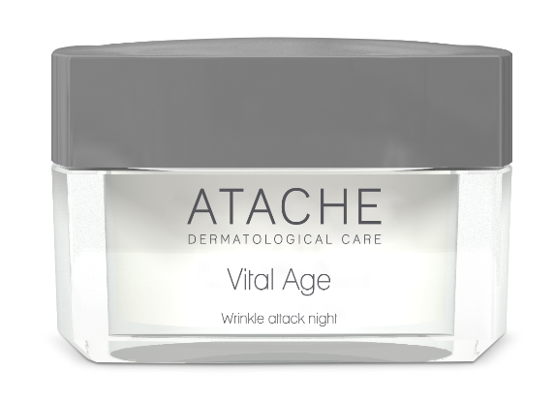
wrinkle attack NIGHT
Cream anti-aging night and intensive treatment enhancer Serum two
Description:
Cream night based on Vitamin A (Retinol Palmitate) and butter Shea that reduces expression wrinkles, protects brakes photoaging, nourishes and regenerates. Its assets increase cell renewal, providing luminosity, vitality and improving the appearance of the skin.
Indications:
Indicated on skins from 40 years, dry or aged that seek to reduce wrinkles, expression lines, nourish and repair their skin. In addition, it protects thephotoaging.
Ingredients:
Vitamin A (Retinol Palmitate), butter shea.

Slide 30
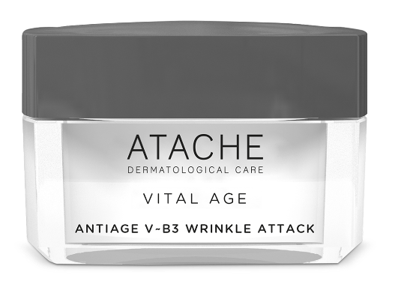
Antiage v_b3 Wrinkle attack
An intensive, anti-ageing recuperator that acts on the latest signs of ageing
Description:
An exceptional anti-ageing CREAM containing a combination of active ingredients that work together to reduce the appearance of wrinkles and expression lines, improve the skin's hydration and suppleness, reduce the appearance of dark spots, and leave skin looking more radiant and luminous.
Indications:
“VITAL AGE ANTIAGE VB_3 WRINKLE ATTACK” cream is suitable for all skin types, particularly those showing signs of ageing, such as wrinkles, expression lines, a lack of luminosity and reduced suppleness. This cream can be beneficial to dry skin, mature skin, dull skin lacking luminosity, and hyperpigmented skin.
Ingredients: Liposomal Retinol, Niacinamide, Hypericum Oil, Hialuronic acid, Marine Colagen.

Slide 31
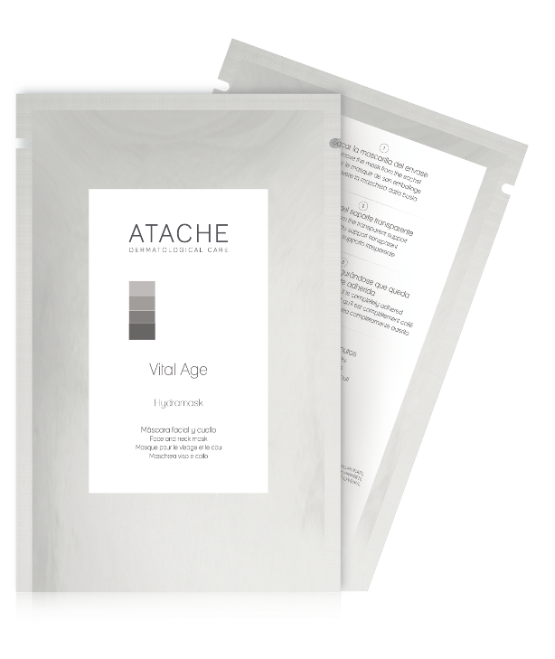
HYDRAMASK
Description:
Face mask single-use for face and neck with anti-wrinkle and nourishing properties. It is ideal for weekly use in order to complement the Vital Age treatment routine and / or other anti-aging, firming and moisturizing treatments
Ingredients:
HyaluronicAcid, codium tomentosum extract, candela extract officinalis.

Slide 32
PROFESSIONAL PROGRAM

Slide 33
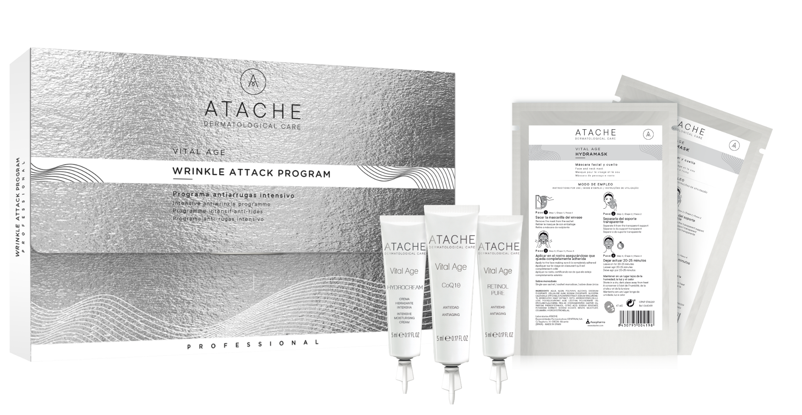
VITAL AGE WRINKLE ATTACK PROGRAM

Slide 34
VITAL AGE WRINKLE ATTACK PROGRAM
PROFFESIONAL TREATMENT
Reduce the appearance of wrinkles and delay their appearance. The vital age Retinol treatment can begin at any time during the year; it must be applied on a continuous basis, and can be uses as many times as the professional sees necessary.
Vital age Retinol is designed to fit all types of skin, especially those exposed to internal and external factors which cause the pre-empted appearance of wrinkles.
When to begin treatment?
As preventative treatment; begin use before wrinkles caused by expression lines begin to appear on face.
As reduction treatment; at any moment to reduce the appearance of current wrinkles.

Slide 35
RETINOL PURE
High concentration of RETINOL that guarantees and imporves penetration of pure Vitamin A by reducing notably thw wrinkles in face, neck and neckline.
Active ingredients:
Pure Retinol
Instructions for use:
Mix the necessary amount of RETINOL7 and COENZYME Q108 in a small bowl. Apply the mixture by massaging into the wrinkle or expression line area. Finish applying any remaining product to the face, neck and décolletage by massaging in until fully absorbed.

Slide 36
COQ10
High concentration of COENZYME Q10, that strengthen the action and the effects of RETINOL.
Active ingredients:
Coenzime Q10
Instructions for use:
Mix the necessary amount of RETINOL7 and COENZYME Q108 in a small bowl. Apply the mixture by massaging into the wrinkle or expression line area. Finish applying any remaining product to the face, neck and décolletage by massaging in until fully absorbed.

Slide 37
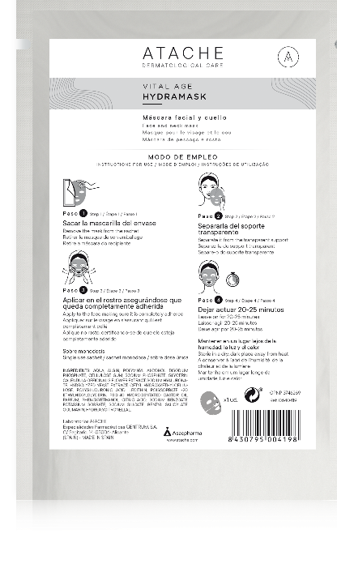
HYDRAMASK
Innovatve mask with hydrogel technology, that combines active ingredients with moisturizing and nutritive effect and prolonged duration.
Active ingredients:
Sodium hyaluronate
Codium tomentosum:
Calendula officinalis:
Instructions for use : Remove the two “face and neck” masks. Remove the protective film and adjust the masks, using the gel part, to the face and neck until perfectly attached. Leave on for 20 minutes then remove..

Slide 38
HYDROCREAM
Developed to finalise the cabin session, attenuates the expression lines and provides softness to the skin without leaving greasy sensation.
Active ingredients:
Hyaluronic acid, sodium PCA, glycerin, hydrolyzed jojoba esters and jojoba oil.
Instructions for use:
Apply HYDROCREAM by gently massaging into the face, neck and décolletage until fully absorbed.

