Slide 1
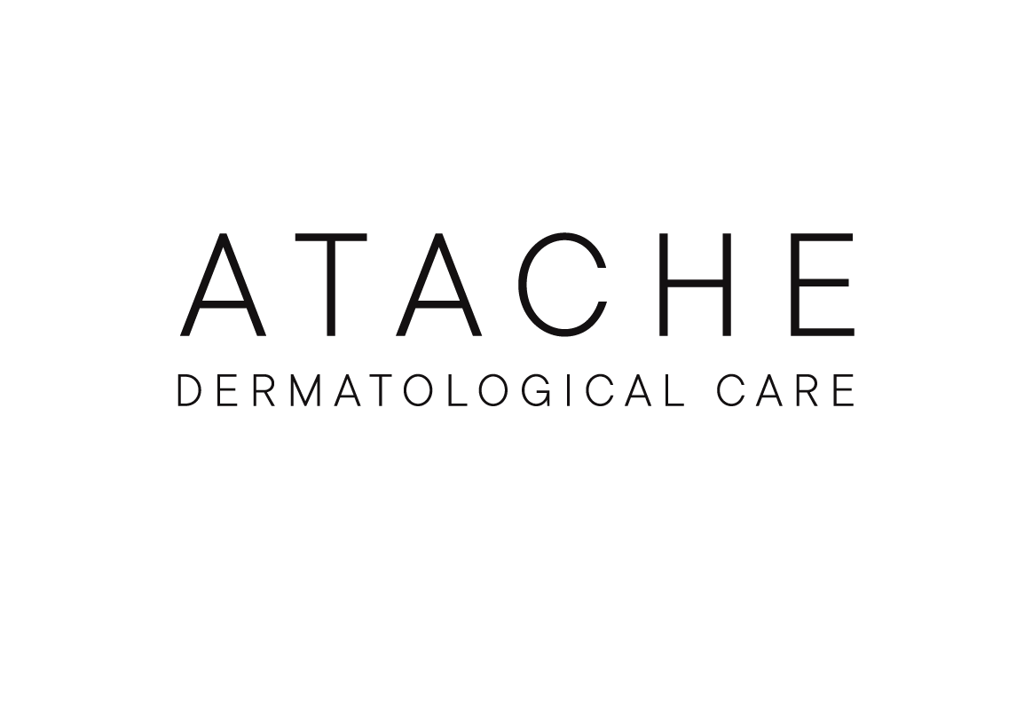


TRAINING

Slide 2
INDEX
PRESENTATION CVITAL
SKIN AGING: OXIDATION
INGREDIENTS
HOME CARE PRODUCTS
PROESSIONAL PROGRAM
NEW GENERATION OF ANTIOXIDANTS
2

Slide 3

PRESENTATION

Slide 4
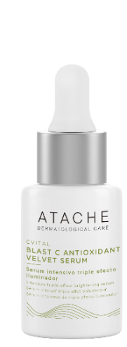
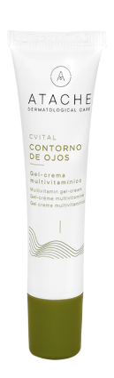
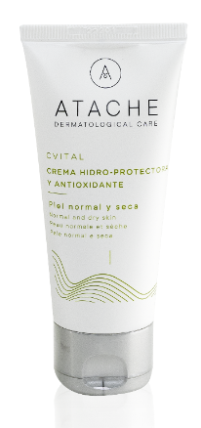
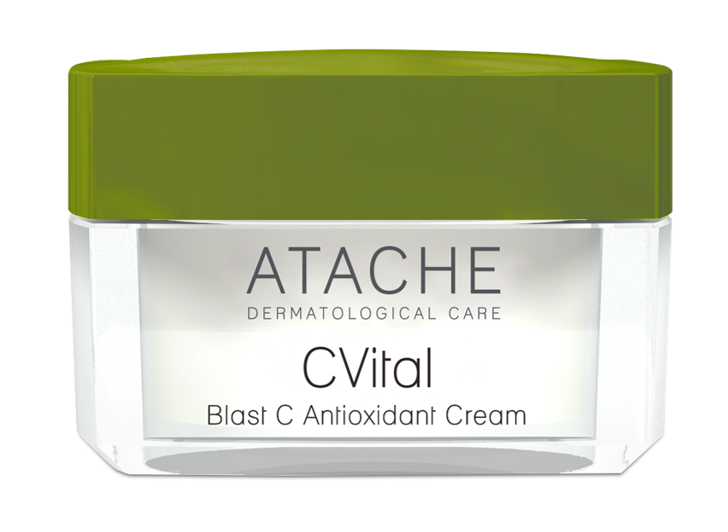
Cvital - PRESENTATION
Stress, pollution, too much sun, abrupt temperature changes produce free radicals that damage skin cells accelerating the appearance of sings of premature ageing in the form of wrinkles, expression lines, loss of elasticity, and luminosity.
The line C VITAL help us, to prevent and repair, at the natural form and direct, the visible signs of skin ageing. Extreme comfort during and after treatment providing instant luminosity and vitality.

Slide 5
SKIN AGING: OXIDATION

Slide 6
WHY DO WE AGE?
SKIN AGING is a process primarily caused by FREE RADICALS that are produced by multiple factors, including:
Intrinsic Factors: Metabolism (the organism’s own processes linked to breathing and the combustion of food), genetic inheritance and the passage of time.
Extrinsic Factors: Sun exposure, tobacco, alcohol, environmental pollution, excessive sport and sudden changes in temperature.
WE AGE because we OXIDIZE, due to the decrease of our Natural Antioxidant Defense ability against free radicals over time.
INCREASED PRODUCTION OF FREE RADICALS
REDUCTION OF NATURAL ANTIOXIDANT DEFENSE
OXIDATIVE STRESS
Cells modify their structure and function, resulting in alterations that can lead to cell death.

Slide 7
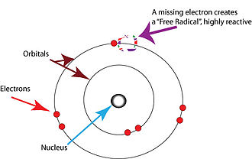
FREE RADICALS
The free radicals have unpaired electrons in their external orbital. That circumstance make them highly reactive by giving up or capturing electrons from other surrounding molecules. Therefore they act as oxidant agent.
The term “oxygen free radicals” or “reactive oxygen species (ROS)” includes radicals derived from the oxygen (as superoxide O2- or hydroxyl OH-), hydrogen peroxide (H2O2), ozone (O3), etc.
Because of their high reactivity usually the shelf life of the free radicals is very short (milliseconds).
To combat the noxious effects of these radicals, the skin has a defense system constituted by antioxidants

Slide 8
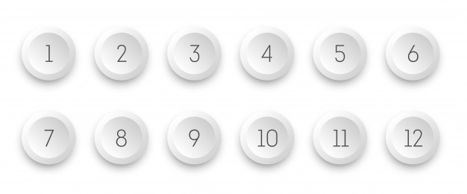
THE ROL OF ANTIOXIDANTS
Substances capable of neutralizing or eliminating free radicals. They strengthen the body’s antioxidant system and delay skin aging.
There are two types of antioxidants
Enzymatic
Non enzymatic
Antioxidants are proteins found inside the cells, and are manufactured by the body. To exert their action they need the presence of a metal, such as copper, iron, magnesium, zinc, or selenium.
For this reason, it is very important to take foods that contain these minerals; a lack of any of them can affect the function of these enzymes.
Antioxidants are found inside and outside the cell. A difference with the previous group is that the non enzymatic antioxidants are consumed after reacting with the free radical, thus, they have to be replaced constantly.
Some of them are synthesized by the body, while others have to be obtained through diet.

Slide 9
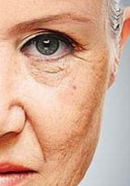
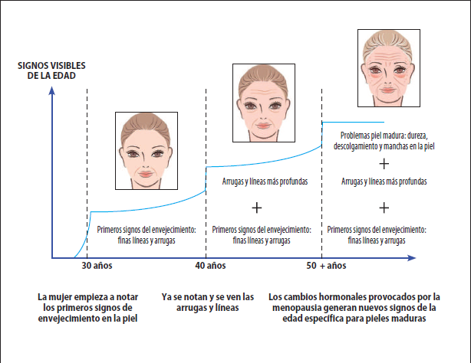


THE MOST SIGNIFICANT CHANGES TO AGING SKIN
Marked increase in opacity.
Increase in spotted hyperpigmentation.
Increased loss of elasticity.
Increase in the wrinkles.
Loss of luminosity and vitality.
Loss of hydration.
Loss of firmness.
VISIBLE SIGNS
OF THE AGE
Mature skin problems: hardness, unhooking and spots on the skin
Deeper lines and wrinkles
Deeper lines and wrinkles
First signs of aging: fine llines and wrinkles
First signs of aging: fine llines and wrinkles
First signs of aging: fine llines and wrinkles
The first signs of aging are beginning to show
Wrinkles and lines are already noticeable and visible
The hormonal changes caused by menopause generate new signso age specific for mature skin

Slide 10
CVITAL PROPERTIES
Gives the skin all its radiance and vitality.
Restores and enhances the antioxidant defense mechanism.
Protects the skin from premature aging.
Reactivate the cellular renewal.
It provides firmness and elasticity.

Slide 11
INGREDIENTS

Slide 12
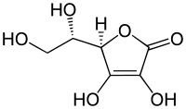
MAIN INGREDIENTS: PURE AND STABLE VITAMIN c
Vitamin C (water-soluble antioxidant)
Vitamin C is a chemical form of the ascorbic acid. It is a vitamin water soluble, with great antioxidant action.
Vitamin C is very labile and oxidizes very easily both in cooking by temperature and by air and sunlight.
Skin levels of vitamin C cannot be increased with ingestion, but with topical application.

Slide 13
MAIN INGREDIENTS: PURE AND STABLE VITAMIN c
Benefits of Vitamin C
Helps reduce both endogenous and exogenous ROS production.
Stimulates dermal fibroblasts to synthesize collagen
Decrease damage oxidative DNA and damage oxidative of proteins
Decreases the hyperpigmentation of the skin

Slide 14
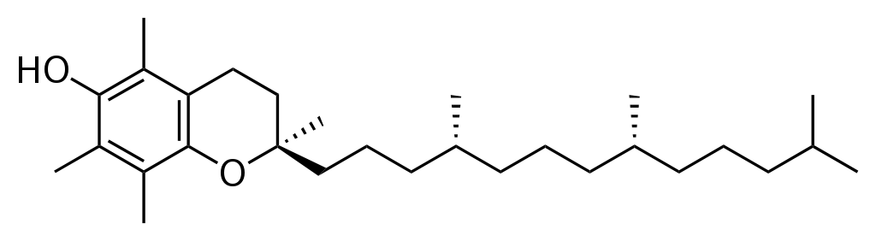
MAIN INGREDIENTS: VITAMIN E
Vitamin E (fat-soluble antioxidant)
Vitamin E acts as an antioxidant, eliminating free radicals. It is normally found in the stratum corneum, especially in its lower layers.
The esters of vitamin E, especially acetate, are promising, since they have a protective role against UV radiation, which in this form is easily assimilated by the skin and penetrates and is well absorbed.

Slide 15
MAIN INGREDIENTS: VITAMIN E
Benefits of vitamin E
Natural protector against oxidation of cell membranes
Increases skin microcirculation improving elasticity
Good protector against UV and IR radiation
Enhances the antioxidant effect of Vitamin C

Slide 16
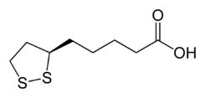
MAIN INGREDIENTS: LIPOIC ACID
Lipoic acid (Antioxidant hydro-liposoluble)
It is considered the universal antioxidant, this means that it can exert its protective effect both in the aqueous phase and in the lipid phase. That is why alpha lipoic acid crosses membranes easily, providing antioxidant protection in all parts of the body. In addition, alpha lipoic acid has an antioxidant effect both in its oxidized form (acidalpha-lipoic, LA) and reduced form (DHLA, acid dihydrolipoic).

Slide 17
MAIN INGREDIENTS: LIPOIC ACID
Lipoic acid benefit
It enhances the positive effects of other antioxidants such as vitamin E, C and CQ10. It helps to regenerate these vitamins in the body.
Lipoic acid improves cell function.
Enhances the absorption of Vitamin C in the dermis.
Improvement of skin microcirculation.
Strengthens the barrier function of the skin and prevents pigmentation.

Slide 18
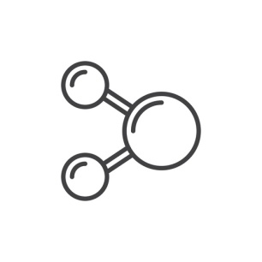
TRIPLE ANTIOXIDANT COMBINATION
More effectiveness
Pure Vitamin C 5%
Ascorbic acid
Vitamin E (Tocopherol) 2%
2% lipoic acid
Water Soluble Antioxidant Serum
Liposoluble Antioxidant Fluid (Vitamin E) + Universal (Lipoic Acid)

Slide 19
HOME CARE PRODUCTS

Slide 20
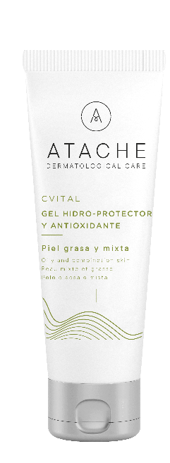

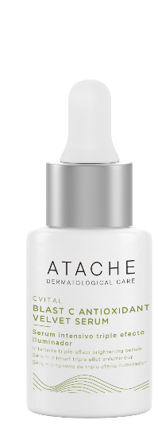

CVITAL line - positioning
Triple Serum Intensive Antioxidant
Serum Triple
Iluminator Antioxidant
Antioxidant Protector Complex
Hydroprotective and antioxidant cream and gel
Multivitamin eye contour
BIOLOGICAL TRIPLE ANTIOXIDANT
BLAST C VELVET SERUM
BLAST C ANTIOXIDANT CREAM
GEL/ HYDROPROTECTIVE CREAM
MULTIVITAMIN CONTOUR

Slide 21
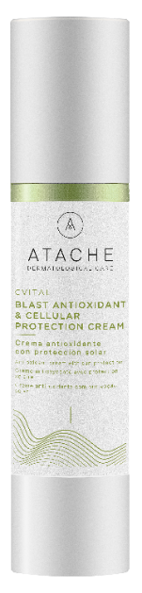
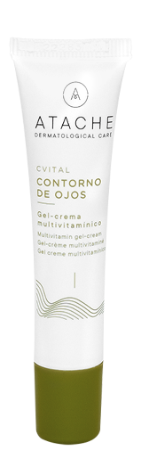
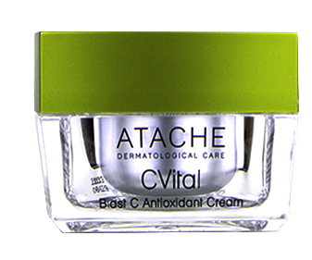
CVITAL line products
Triple Serum Intensive Antioxidant
Serum Triple
Iluminator
Antioxidant
Antioxidant Protector Complex
Antioxidant Crema with sun protection
Hydroprotective and antioxidant cream and gel
Multivitamin eye contour
BIOLOGICAL TRIPLE ANTIOXIDANT
BLAST C VELVET SERUM
BLAST C ANTIOXIDANT CREAM
Blast antioxidant celular protection
GEL / CREMA
HIDROPROTECTOR
CONTORNO MULTIVITAMÍNICO

Slide 22
index
Biological triple antioxidant np - cvital
SERUM 30ml + FLUID 15ml Antioxidant Action
INDICATION:
Skins that show deficiencies due to oxidation. Devitalized skins. Ideal from the age of 20. (Do not use on sensitive skin)
ACTION:
Antioxidant: The antioxidant power of vitamin C is enhanced by its combination with vitamin E and lipoic acid, the entire cell is protected from oxidation.
Combination or oily skin: Vitamin C balances the pH and enhances the defense action of the skin.
Skin with spots and dark circles: They benefit from its depigmenting action.
Dry skin: Provides lighting and vitality, especially if it is accompanied with lipoic acid.
Aged skin: The photoprotective and antioxidant action of vitamin E in conjunction with vitamin C, is enhanced by lipoic acid.

Slide 23
Biological triple antioxidant np - cvital
BIOLOGICAL TRIPLE ANTIOXIDANT NP - CVITAL
HOW TO USE:
Night normal to dry skin: Two squeezes of the serum + three squeezes of the fluid, mix evenly and apply
Night combination to oily skin: One squeeze of the serum + two squeezes of the fluid, mix evenly and apply.
TYPE OF SKIN: All except sensitive
Container: Independent bottles that allow to keep on one side the vitamin C in a stable way for a longer time and complementing the treatment with the external mixture of the ingredients
Airless: Maintains the stability of the products, prevents oxidation.
Colour: Transparent serum - Fluid white
Touch: Immediate absorption that creates a sensation silky. Immediate luminosity

Slide 24

Gel hydroprotective day
DAY GEL 50ml Antioxidant Action
INDICATION: Hydration from mixed to fat. First signs of aging
ACTION: It accelerates the cell renewal of the skin performing a protective action against the signs of the passage of time.
INGREDIENTS: *Orange Extract 2%, Lipoic Acid 0.5%, *Acid glycolic Ph 5.5 20%, Vitamin E 0.4%
HOW TO USE: Day: Apply in the morning, after cleaning.
TYPE OF SKIN: Mixed to fat
* Acid glycolic has an exfoliating action eliminating dead cells that accumulate on the surface and has the ability to maintain the skin's own hydration.

Slide 25

Cream hydroprotective day
DAY CREAM 50ml Antioxidant Action
INDICATION: Ultra hydration for normal to dry skin. First signs of aging
ACTION: It accelerates the cell renewal of the skin performing a protective action against the signs of the passage of time.
INGREDIENTS: Orange Extract 2%, *Jojoba Oil 0.5%, Lipoic Acid 0.5%, Vitamin E 0.2%, Acid Glycolic ph 5.5 4%
HOW TO USE: Day: Apply in the morning, after cleaning.
TYPE OF SKIN: Normal to dry
* Jojoba oil concentrates large amounts of ceramides, oily substances that promote deep hydration of the skin without leaving a greasy feeling

Slide 26

Multivitamin eye contour
GEL - Contour CREAM 15ml Antioxidant Action and dark circles
INDICATION: First signs of aging, reduction of bags and dark circles
ACTION: Specific antioxidant treatment that regenerates, nourishes and hydrates the area around the eye. Prevents and protects against premature aging.
INGREDIENTS:Orange Extract 0.5%, Vitamin A 0.20%, Vitamin E 0.25%, MDI complex® 1%, Alpha-Bisabolol 0.5%, Caffeine 2%, Interference Pigments
HOW TO USE: Day and night: Apply small touches to the contour of the eye.
TYPE OF SKIN: All
* The alpha bisabolol acts as a decongestant, reducing contour bags
* Caffeine acts as draining, decreasing the shadow of the contour

Slide 27
NEW GENERATION
OF ANTIOXIDANTS

Slide 28

BLAST C ANTIOXIDANT
Blast C antioxidant is born, integrated into the line Cvital, as a solution not only in the struggle to slow down the aging process skin, but to maintain and optimize your principal functions active.
I has a global preventive approach, with the aim of anticipating and/or repairing the signs of aging from different points of view, although synergistic.
Blast C antioxidant Cream is a combination of Intensive Triple Antioxidant Complex and Pro Blast System. It works, on the one hand, neutralizating ROS and on the other hand, restoring the quality of the skin, through the optimization of its vital functions.
It also presents active ingredients free and liposomal, achieving to act both on the surface and in the deeper layers of the epidermis, with a greater power, efficiency and duration of its activity.

Slide 29
INGREDIENTS
Vitamin C Liposome
Penetrates to greater depth
Crosses the membrane of the cell
Progressive release, longer duration of action
Vitamin C Stabilized
It acts on the most superficial layers of the epidermis.
Increased bioavailability (degree and speed)
Increases the duration of your activity.
It resists high temperatures.
Less oxidation against pure and stable VC
Ferulic acid
Powerful antioxidant
Improves collagen and elastin production
Able to stop the action of UVA and UVB rays, preventive in terms of sun damage.
Liposome: Progressive release, deep penetration (x12 versus free and increased bioavailability.

Slide 30
INGREDIENTS
Rhodiola extract
Excellent antioxidant, slows the action of ROS.
Protects structural proteins and prevents their breakdown.
Reduces water loss (retains and improves the function of other assets).
Defence against external factors
Multivitamin pump
It collaborates with the correct course of skin cellular processes.
ProBlast System
It is based on a cocktail of probiotics that enhance the skin’s natural ability to renew itself quickly and effectively, by accelerating and improving the process of renewal and natural regeneration of the skin.
In addition, it provides proteins and essential enzymes that improve cell cohesion, protecting the skin and avoiding transdermal water loss.
Strengthens the skin microbiota, increasing or restoring the protective power of the acid mantle (accelerated recovery of species richness). The contribution of Pro Blast System recovers and improves the microbiota, allowing the cell membrane to recover and maintain its quality and efficiency.

Slide 31
INGREDIENTS
Tranexamic acid
Tranexamic acid is an active substance that has been shown to be effective in the treatment of melasma. This substance has been used in medicine to improve coagulation and its depigmenting properties have been discovered only a few years ago, when it is proven that applied topically helps combat all types of stains, and especially those produced by the sun.
According to studies, tranexamic acid also acts within the surface layers of the skin to make it more resistant to sun exposure. In other words, tranexamic acid helps to prevent the formation of stains and also to treat existing ones.
It acts in different ways to prevent and treat stains:
On melanocytes, avoiding and reducing the formation of spots.
On keratinocytes, interrupting the inflammatory process that can favor stains.
On the cells of the blood vessels, reducing the vascularization that can occur in spots such as melasma.

Slide 32
BLAST C ANTIOXIDANT CREAM
ANTIOXIDANT CREAM (Fluid and silky texture)
INDICATION: Ideal treatment for skin showing signs of aging
premature, seeking to regain vitality, luminosity and improve health
facial.
DESCRIPTION: Blast C Antioxidant Cream is a combination of the Triple Antioxidant Intensive Complex and the Pro Blast System. It works on the one hand in the neutralization of the ROS and on the other in the restoration of the quality of the skin, through the optimization of its vital functions.
INGREDIENTS: Liposome vitamin C, stabilized vitamin C, liposome ferulic acid,
rhodiola extract and probiotic complex
HOW TO USE: Day and night: Apply all over the face, neck an decollete and gently massage
TYPE OF SKIN: All

Slide 33
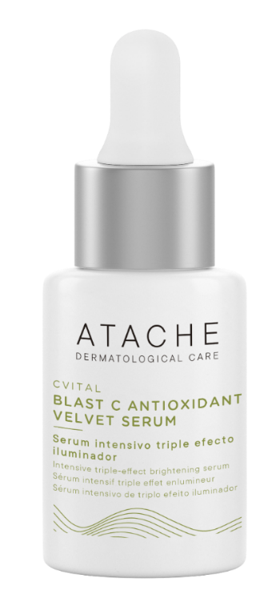
VELVET ANTIOXIDANT SERUM
Triple Illuminating Effect Serum - Silky Texture
DESCRIPTION:
Illuminating Triple Antioxidant Serum with a global preventive approach to anticipate and/or repair the signs of aging. Its free-form and liposome assets intervene by unifying and whitening the face. The combination of its triple illuminator effect and the Pro Blast System provides an illuminated and velvety skin.
INDICATION:
Ideal treatment for skins that show signs of premature aging, seeking to recover vitality, luminosity and improve the health of the face. Ideal to prevent and help correct the effects of pigmentation and sun damage.
INGREDIENTS: Liposomal vitamin C, liposomal ferulic acid, tranexamic acid, hialuronic acid and probiotic complex

Slide 34
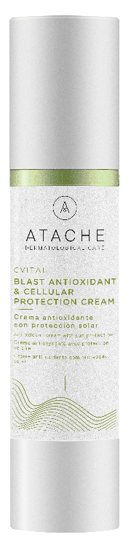
Blast antioxidant & cellular protection cream 50 ml
Antioxidant cream with sun protection
Description:
Antioxidant cream with liposomal vitamin C and niacinamide, which helps reduce fine lines and wrinkles, improves texture and protects skin from environmental damage and the effects of everyday skin stress.
Indications:
Has antioxidant properties, helps to reduce the appearance of fine lines and wrinkles, improves skin texture and protects against environmental stress.
Thanks to its filters, it protects the skin from UV rays and blue light emitted by electronic devices. Ideal for all skin types.
Ingredients: Liposomed vitamin C and niacinamide, Polypodium rhizome extract, Pro Blast System and interference filters and SPF 15.
Airless
50 mL

Slide 35
PROFESSIONAL PROGRAM

Slide 36
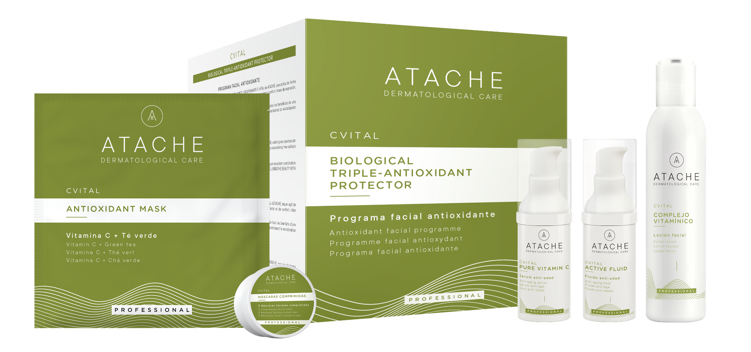
CVITAL ANTIOXIDANT PROGRAM

Slide 37
CVITAL ANTIOXIDANT PROGRAM
PROFFESIONAL TREATMENT
Innovative treatment based on an effective combination of VITAMIN C (L-ASCORBIC ACID) with LIPOIC ACID and VITAMIN E, which enhances the anti-aging and antioxidant action of each of them, neutralizing and preventing the harmful effects of free radicals, responsible for accelerating the process of skin aging.
RECOMMENDED TO:
Neutralizing free radicals, responsible for the oxidant action causing loss of elasticity, firmness and skin luminosity.
Protecting skin from premature ageing and activating collagen synthesis.
C Vital treatment can be started any time of the year, as a continuous treatment, as many times that the professional deems necessary

Slide 38
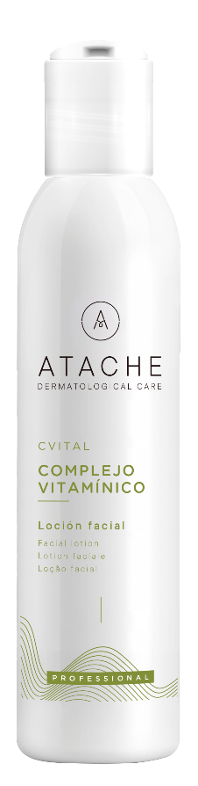
Vitamin complex (facial lotion)
Lotion Rich in vitamins avoids excessive queratinization of the skin and helps it maintain appropriate hydration levels. Gives you and immediate sensation of freshness and well-being.
Active ingredients:
Vitamins ( A, B, C, E, B5 )
Extracts ( Focus y Asculum )
Instructions for use: put into the dossifies 20 ml, then introduce Compressed Facial Mask

Slide 39
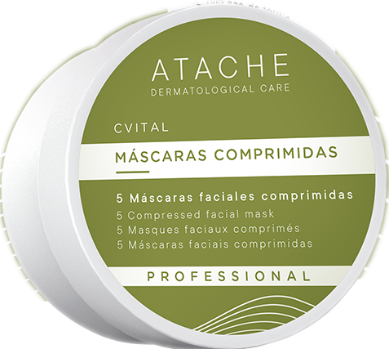
COMPRESSED FACIAL MASK
Made of extendible compressed Mask material.
Instruction use: Introduce one mask in the mixture of the vitamin complex and serum.
Extend and application on the face, wetting several times the brush in the vitamin Solutions.
.

Slide 40
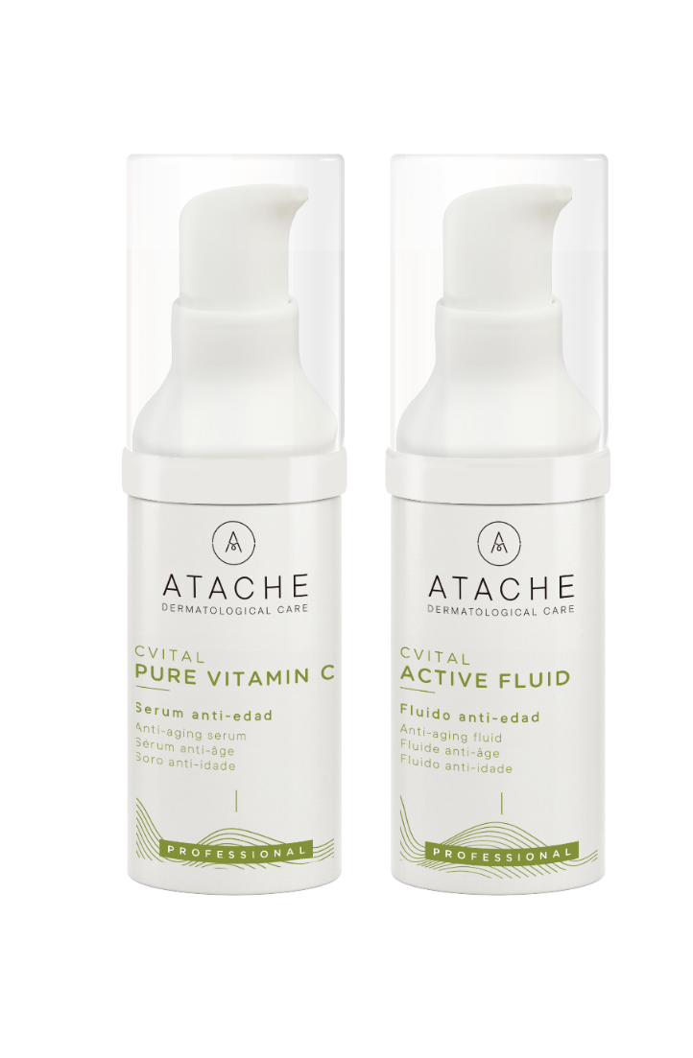
SERUM PURE VITAMIN C
Serum pure stable vitamin C, formulated for the stability of the same. Protects the skin against the action of free radical.
Reactivating Celle metabolism and giving the face immediate luminosity.
Active ingredients:
Vitamin C Pure Stable
Instructions for use: add 2 puff into the dossifies and mix with Vitamin Complex.
Then, mix 12 puff of Serum with 12 puff of Active fluid and massage in the face, neck and décolletage until completely absorbed.
.

Slide 41
ACTIVE FLUID (VITAMIN E + LIPOIC ACID)
Emulsion rapidly absorbed. transmits a revitalized and luminous appearance to skin.
Active ingredients:
Lipoid Acid
Vitamin E
Instructions for use : Mix 12 puff of Active Fluid with 12 puff of Serum and massage appropriate to skin type and face volume into skin to complete absorption.
.

Slide 42
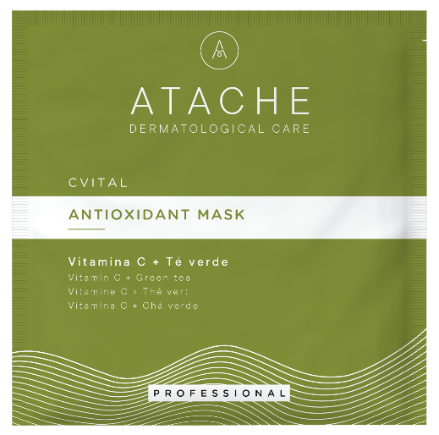
ANTIOXIDANT MASK
Powder based mask, helps the skin regain all its suppleness and prevents the formation of free radicals.
It enhances the action of the programs active ingredients, helping penetration.
.
Active ingredients: Green tea
Instructions for use: Pour 30 grow of powder into a bowl, oxygenate.
And add 90-110 ml of water.
Mix until you have a smooth paste. Now apply the antioxidant mask on top of the face, including the neck and décolletage with spatula.15’-20’

