Slide 1


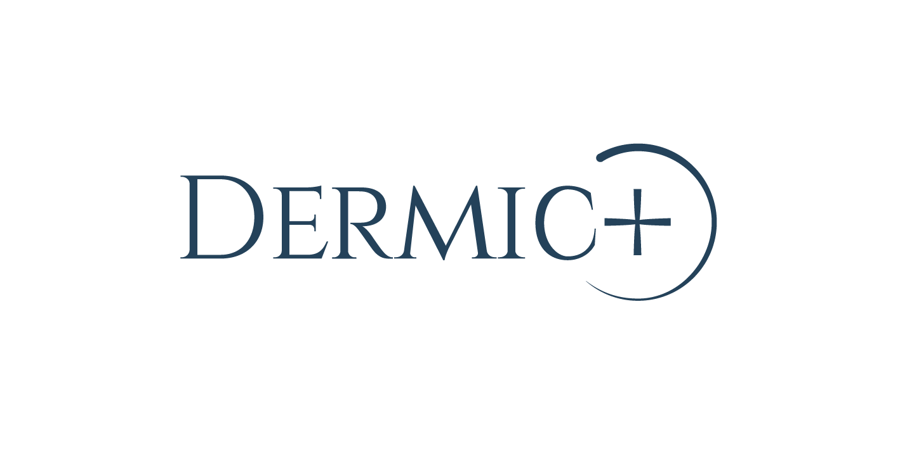
PEELING TRAINING

Slide 2
WHAT IS A PEELING?
Skin exfoliation or "peeling" is a dermatological act intended to modify the skin surface to obtain a regeneration dermal, epidermal or both.
INDICATION
Deep cleansing
Nutrition
Hydration
Astringency
Reducing the effects of photoageing
Acne and its aftermath
Depigmentating

Slide 3
TYPES OF PEELING
They can be classified into different types. The main division is between peelings by physical or chemical means.
PHYSICAL PEELINGS
Natural-Heliopeeling: Result of intense solar radiation
Criopeeling: Can be done with anhydrous CO2 or carbonic snow
Photopeeling: Monochromatic light- Laser

Slide 4
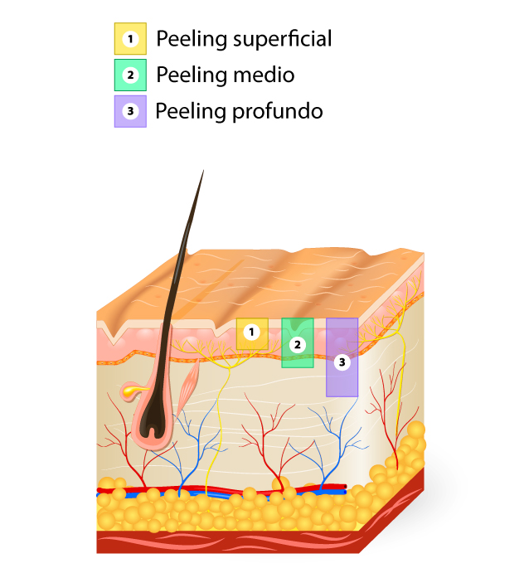
TYPES OF PEELING
CHEMICAL PEELINGS
It is an option that helps maintain healthy skin, its use is intended for treatment.
Depending on the depth of action of the substance used, the peel may be:
Very Superficial
Superficial to Media
Deep

Slide 5
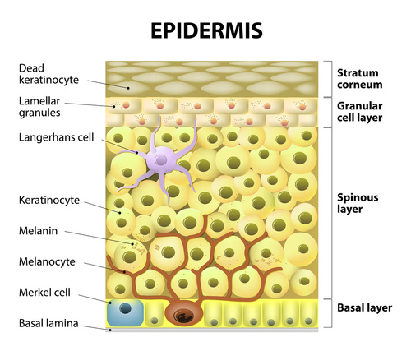
VERY SUPERFICIAL
Place
Corneal layer
Granular layer
Spiny top layer
Reaction
Erythema very faint
Pseudofrost
Minimum peeling (1-2 days) or absent
Itching and Tension
DERMIS

Slide 6
SUPERFICIAL TO MEDIA
Place
Spiny layer
Granular layer
Papillary dermis
Reaction
Bright red erythema
Frost
Moderate flaking
Burning sensation
DERMIS

Slide 7
DEEP
Place
Reticular dermis
Hypodermis*
Reaction
Intense erythema
Significant frost
Marked scaling
Burning sensation
DERMIS

Slide 8
PEELING FACTORS
CONCENTRATION OF THE ACTIVE INGREDIENTS
Higher concentration = Higher power
Depending on the pathology, the degree of it and what you want to achieve
PH OF THE PEELING
pH is the scale on which the acidity or alkalinity of a solution is expressed
pH = 7 Neutral
pH less than 7 acid
Ph greater than 7 alkaline
The lower pH the greater depth and action, the higher pH decreases the degree of exfoliation

Slide 9
VEHICLE / PEELING TEXTURE
Solution: Depth of peeling related to the amount of solution and the number of layers applied.
Pressing can accentuate the penetration of the peel
Gel: Contact time related depth of the peel
Requires washing to neutralize
Slow and uniform penetration: less irritation
Massaging can accentuate the penetration of the peel

Slide 10
CONTRAINDICATIONS
ABSOLUTE
Continued exposure to the sun
Acute dermatitis, allergies, acute diseases
Treatment with oral isotretinoin
Pregnancy and breastfeeding
RELATIVE
Recurrent facial herpes

Slide 11

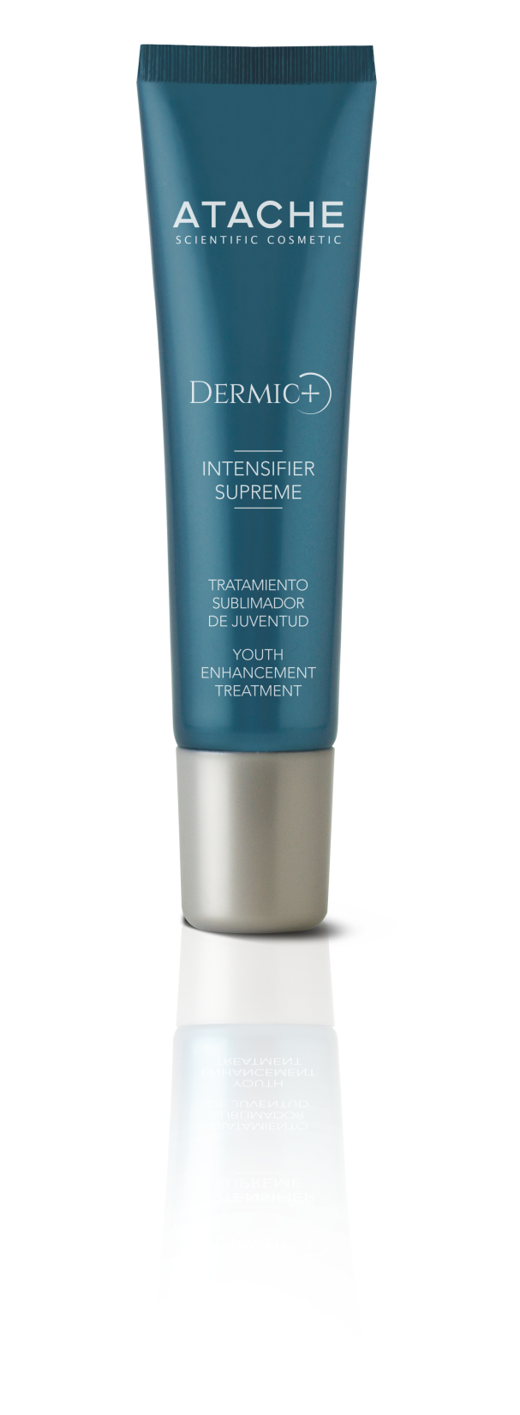
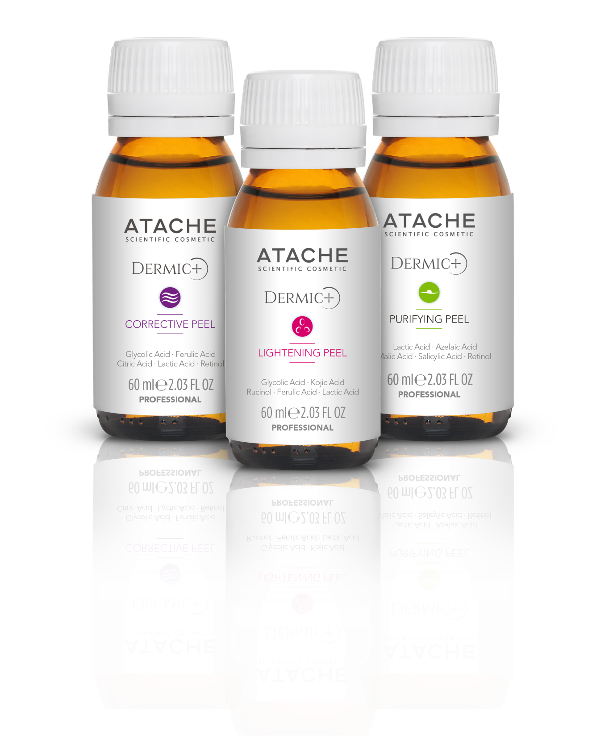

Slide 12

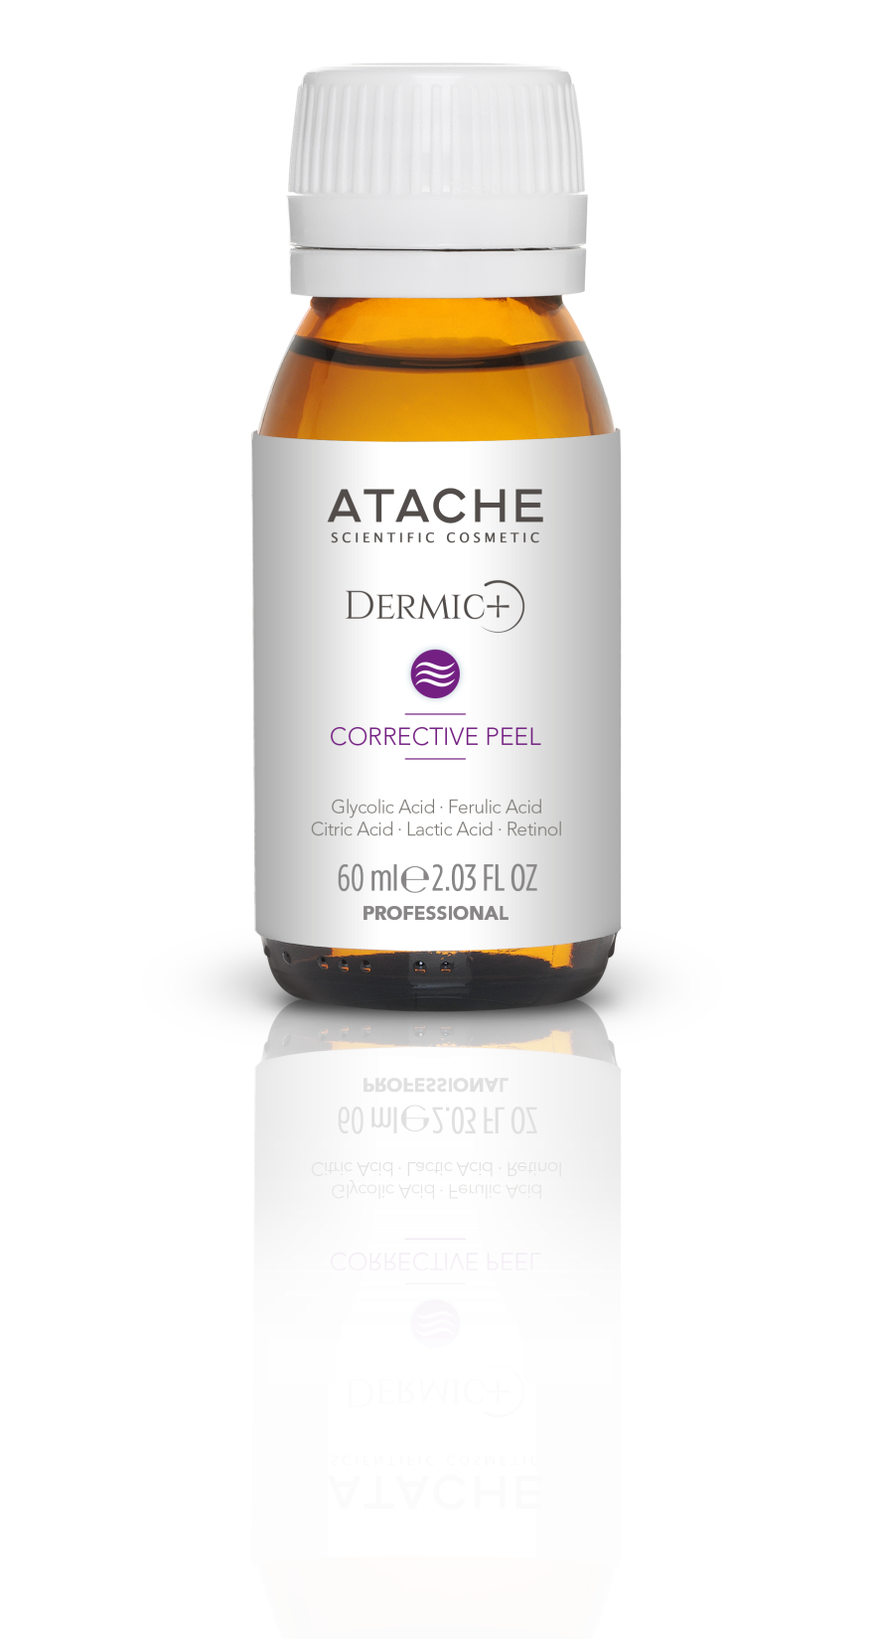
CORRECTIVE PEEL DERMIC+
Glycolic acid 7,5 %
Citric acid 2,5 %
Lactic acid 2,5 %
Ferulic acid 3,0 %
Retinol 0,2 %
GEL texture
pH= 3,5
Its combination of acids allows to improve the appearance, vitality and quality of global skin

Slide 13
CORRECTIVE PEEL DERMIC+
ACID | FEATURES | EFFECT
Glycolic acid 7.5 per cent | - AHAs -It has a small molecule: greater penetration capacity - Does not usually cause flaking | 1.Exfoliation: removes dead cells and stimulates cell replacement 2. Epidermolysis: destroys epidermal cells 3. New deposits of collagen.
Citric acid 2,5% | -AHAs -Favours the penetration of other assets | 1. Antioxidant: protects the skin from free radicals 2. Bactericidal: creates a more acidic environment to slow down bacterial growth 3. Inhibits the formation of tyrosinase
Ferulic acid 3.0% | - Plant origin, derived from phenol | 1. Antioxidant: protects the skin from free radicals and enhances the effects of vitamins C and E 2. Controls tyrosinase activity: clears stains 3. Protection against UV radiation, Protects Cellular DNA
Retinol 0.2% | - Retinoid precursor of retinoic acid | 1. Normalizes keratinization: Improves the appearance and quality of the skin. 2. Stimulates collagen synthesis: decreases the depth of wrinkles 3. Normalizes melanocyte activity: clears stains

Slide 14


LIGHTENING PEEL DERMIC+
Glycolic acid 7,5 %
Lactic acid 2,5 %
Ferulic acid 2,5 %
Niacinamide 2%
Tranexamic acid 2%
4,n-butylresorcinol 1 %
Undecineloil phenylalanine 1,5 %
GEL texture
pH=3,5
Its combination of acids allows in a specialized way to lighten stains, improve tonality and uniformity.

Slide 15
LIGHTENING PEEL DERMIC+
ACID | FEATURES | EFFECT
Glycolic acid 7,5 per cent | - AHAs -It has a small molecule: greater penetration capacity - Does not usually cause flaking | 1.Exfoliation: removes dead cells and stimulates cell replacement 2. Epidermolysis: destroys epidermal cells 3. New deposits of collagen.
Lactic acid 2.5% | -AHAs -Helps maintain the acid mantle of the skin -In gel form the acid penetrates slowly, decreasing the irritation of the lactic. | 1.Hydrating: attracts water molecules to the stratum corneum and stimulates the synthesis of ceramides, improving barrier function. 2.Clarifying: promotes the homogeneous dispersion of melanin, inhibits the action of tyrosinase.
Ferulic acid 2,5% | - Plant origin, derived from phenol | 1. Antioxidant: protects the skin from free radicals and enhances the effects of vitamins C and E 2. Controls tyrosinase activity: clears stains 3. Protection against UV radiation, Protects Cellular DNA
Tranexamic acid 2% | -It works by inhibiting melanogenesis in different ways | 1. It is claimed to have whitening effects especially for ultraviolet-induced hyperpigmentation including melasma
4.n-butylresorcinol 0.3% | -Rucinol | 1.Depigmentating agent inhibiting tyrosinase and TRP-1 2. Inhibits melanin formation in melanoma cells b16
Undecineloil phenylalanine 0.5% | -Melanotropine hormone antagonist (α-MSH) | 1. Prevents both the fixation of the hormone and the consequent cascade of reactions that stimulate melanogenesis.

Slide 16

PURIFYING PEEL DERMIC+
Salicylic acid 2.0%
Malic acid 3.0%
Lactic acid 5.0%
Azelaic acid 3.0%
Retinol 0.2%
GEL texture
pH= 3,5
Combination of acids that allows to purify and improve the uniformity of oily skin, with acne or sequelae.

Slide 17
PURIFYING PEEL DERMIC+
ACID | FEATURES | EFFECT
Salicylic acid 2% | It is safe, without risk of burn, in general acne lesions respond quickly to treatment. | 1.Keratolitic, comedolitic 2.Anti-inflammatory drugs (inhibits the synthesis of prostaglandins) 3. Anti-pruritic, antiseptic, astringent, antimicrobial (reduces propinobacterium acnes) 4. Has derivatives that absorb the RUVB
Malic acid 3% | -AHAs Penetration capacity similar to glycolic acid Recommended on sensitive skin | 1.Antiseptic 2. Depigmentation: inhibits tyrosinase formation
Lactic acid 2.5% | -AHAs -Helps maintain the acid mantle of the skin -In gel form the acid penetrates slowly, decreasing the irritation of the lactic. | 1.Hydrating: attracts water molecules to the stratum corneum and stimulates the synthesis of ceramides, improving barrier function. 2.Clarifying: promotes the homogeneous dispersion of melanin, inhibits the action of tyrosinase.
Azelaic acid 3% | Saturated dicarbolylic acid | 1.Normalisation of keratinisation 2. Bacteriostatic seborregulating action 3. Inhibitor of proliferation of reactive oxygen species 4. Pigmentation rgulator
Retinol 0.2% | - Retinoid precursor of retinoic acid | 1. Normalizes keratinization: Improves the appearance and quality of the skin. 2. Stimulates collagen synthesis: decreases the depth of wrinkles 3. Normalizes melanocyte activity: clears stains

Slide 18
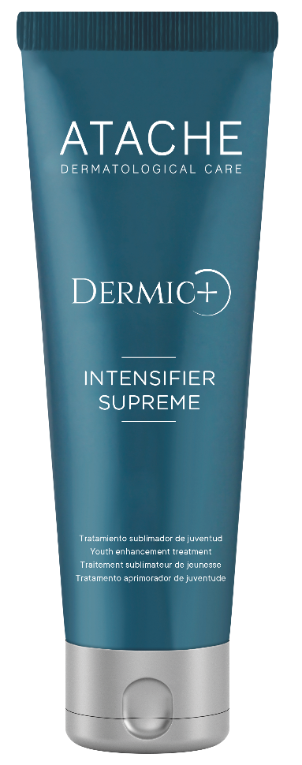
INTENSIFIER SUPREME
Retinol free 0.5%
Retinol liposome 0.5%
Cream texture
NANOTECHNOLOGY

Slide 19
INTENSIFIER SUPREME
PRODUCT DESCRIPTION
1% retinol cream (0.5% free, 0.5% liposomed) indicated as a sealer, post-treatment and enhancer of any superficial and medium peeling treatment, as well as other depigmenting facial procedures or for acne-prone skin. Retinol has a powerful regenerating and repairing action on the skin, stimulates the synthesis of collagen and elastin, reducing the depth of wrinkles and expression lines and increasing the smoothness and elasticity of the skin. It also has a whitening effect by normalising melanocyte activity and protects against photoaging.
INGREDIENTS
Retinol 1% The active ingredient is 0.5% free and 0.5% liposomed. The free retinol acts on epidermal turnover, while the liposome fraction acts deeper in the functions of cell stimulation and repair. Thanks to the nanotechnology of the liposomes, we increase the capacity for absorption, release and stabilisation of the active ingredient, enhancing its results.

Slide 20
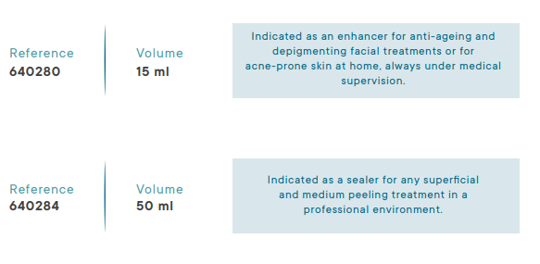

INTENSIFIER SUPREME
INDICATIONS
INTENSIFIER SUPREME is suitable for sealing all superficial and medium peeling treatments.

Slide 21
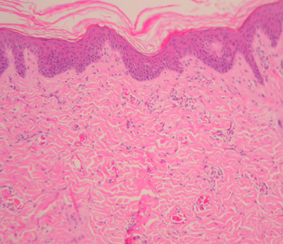
retinol
RETINOL FREE 0.5%
RETINOL LIPOSOME 0.5%
RENOVATION
Epidermal replacement
REPAIR-RESTRUCTURING
Collagen stimulation & repair
MOISTURIZING & SOOTHING BASE

Slide 22
POST-TREATMENT
Avoid sun exposure and UVA rays.
Use of moisturizing cream and/or skin regenerator.
Use of HIGH SPF PHOTOPROTECTORS
Avoid exposure to heat sources, sauna, SPA, jacuzzi, or vigorous exercises.
Home treatment in line with professional treatment performed.

Slide 23
MODE OF EMPLOYMENT
STEP 1: Cleaning of the area.
STEP 2: Uniform application in the area, with a peeling brush (between 3ml and 5ml). Leave on for 15 to 30 minutes.
STEP 3: Neutralize with water.
STEP 4: Seal with Intensifier Supreme (leave on for at least 8 hours)
PROFESSIONAL
Apply Intensifier Supreme for two days in a row during the same week.
Apply the remaining intensifier suppresses 1 time per week.
HOUSE

Slide 24
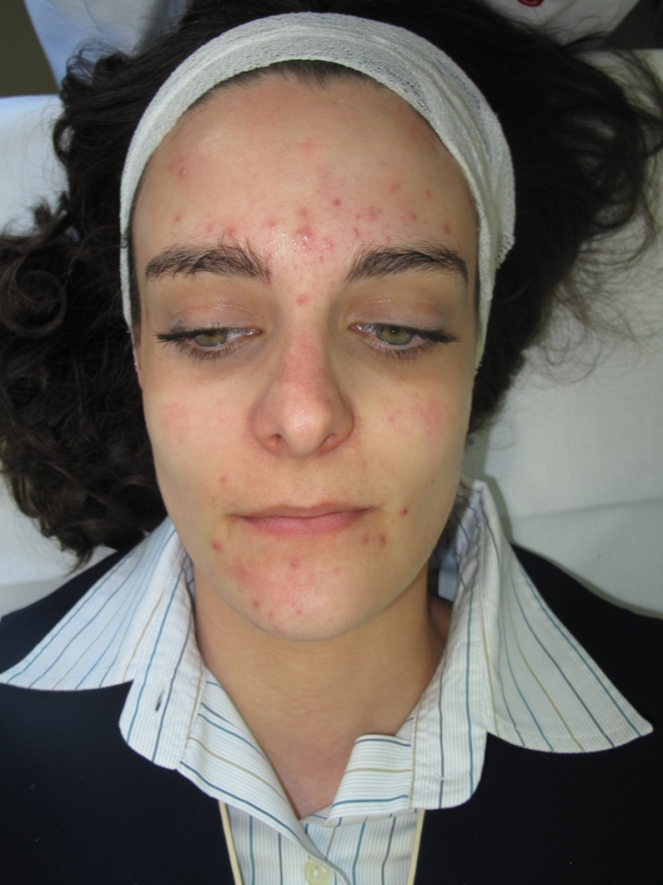
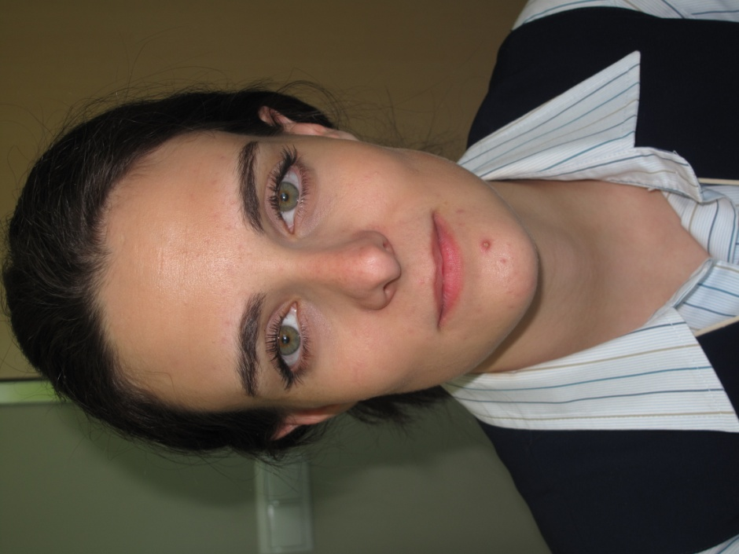
IN VIVO TEST
REAL CASE: Clinical study conducted under dermatological control, in two sessions during 30 days of treatment. Acne treatment PURIFYING PEEL + INTENSIFIER SUPREME.
BEFORE AFTER

Slide 25
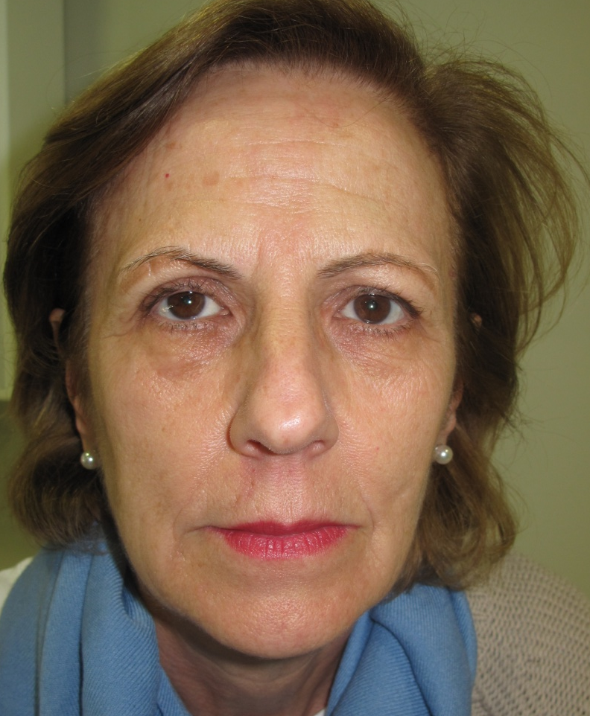
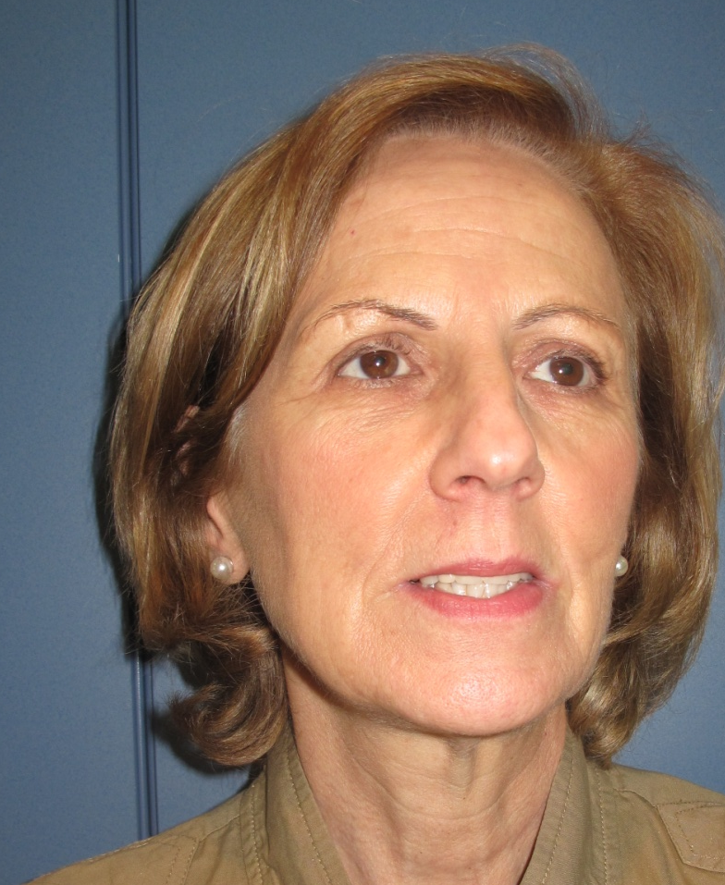
IN VIVO TEST
REAL CASE: Clinical study conducted under dermatological control, in two sessions during 30 days of treatment. Anti-aging treatment CORRECTIVE PEEL+ INTENSIFIER SUPREME.
BEFORE AFTER

Slide 26
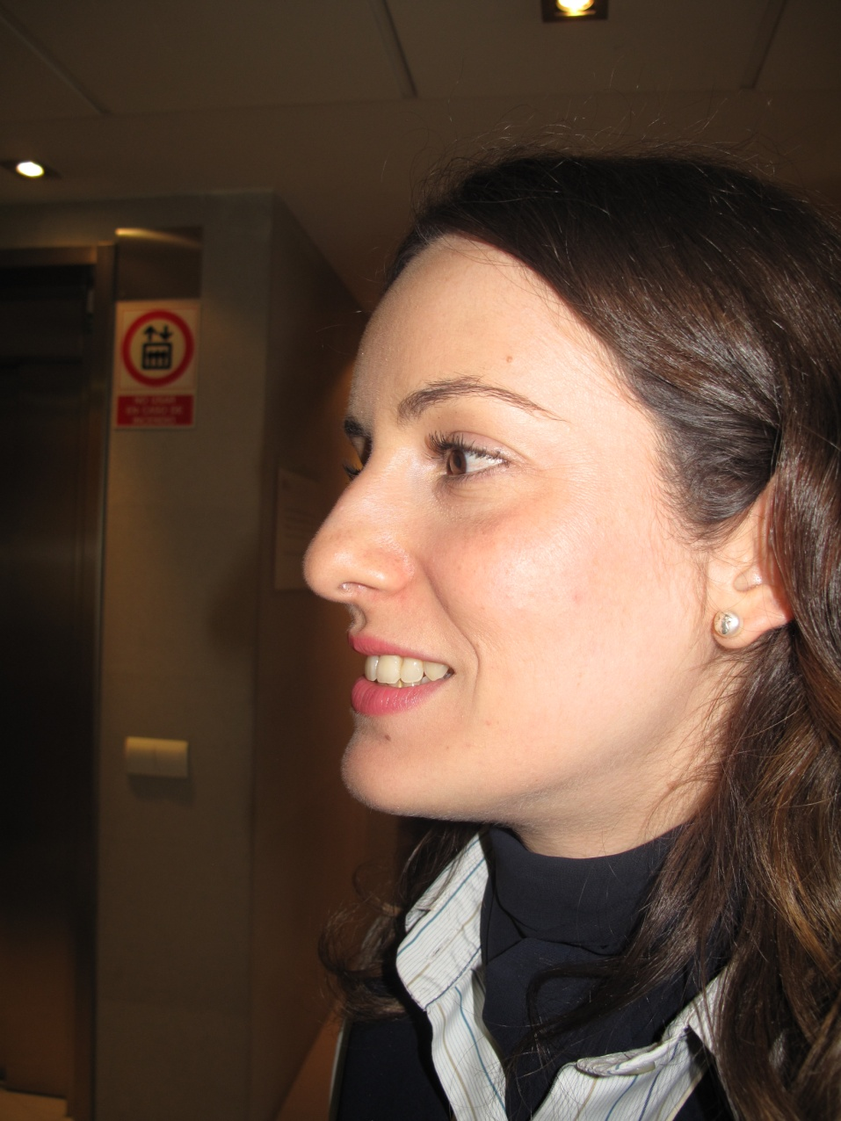
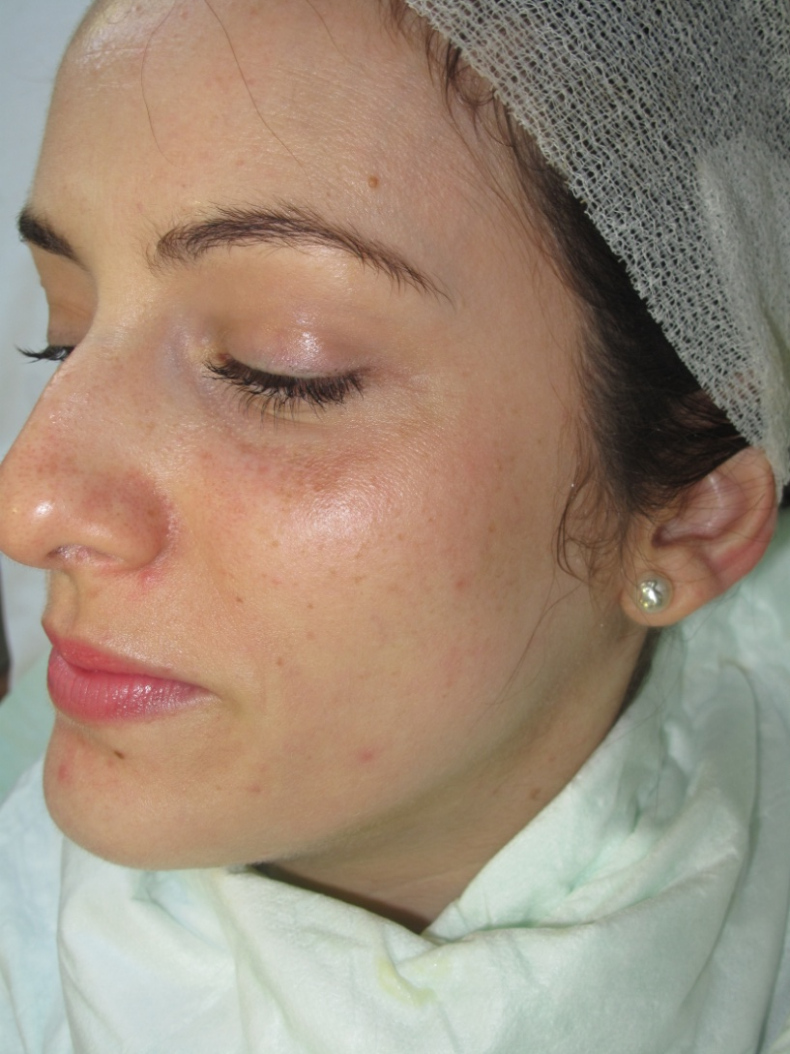
IN VIVO TEST
REAL CASE: Clinical study conducted under dermatological control, in two sessions during 30 days of treatment. LIGHTENING PEEL+ INTENSIFIER SUPREME depigmenting treatment
BEFORE AFTER

