Slide 1


TXA EXO
Serum DP3
Intensive depigmenting treatment with biomimetic exosomes
Despigmen p3

Slide 2

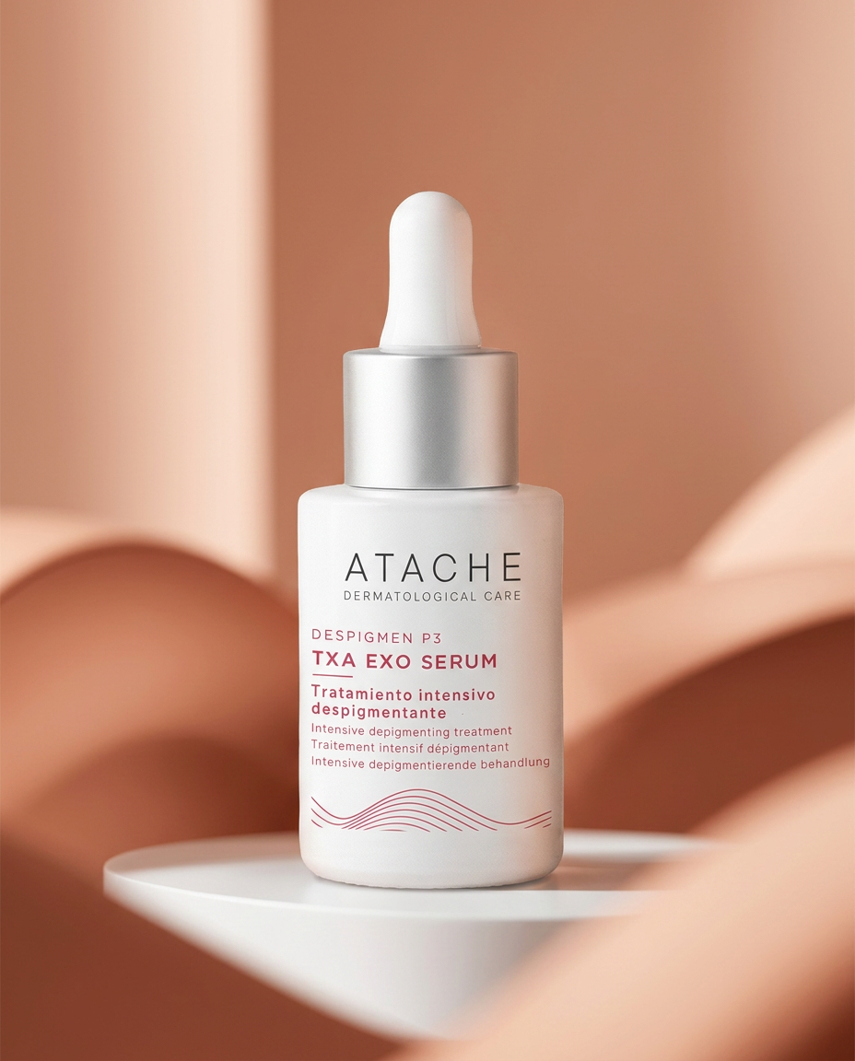
TXA EXO SERUM DP3
Intensive depigmentation
Technology with biomimetic exosomes for a more precise depigmenting action
TXA EXO Serum DP3 is a new-generation intensive treatment designed to address the main phases involved in hyperpigmentation. A daily-use serum with biomimetic exosomes that deliver tranexamic acid and advanced high-efficacy depigmenting actives, acting on the pigmentation process.

Slide 3
TXA EXO SERUM DP3
New-generation intensive depigmentation
Its formula combines latest-generation delivery technologies — biomimetic exosomes and liposomal actives — that optimize the penetration, bioavailability and efficacy of each ingredient. Suitable for all skin types, including combination or oily skin and sensitive skin when introduced progressively.
Biomimetic exosome
Multilayer action
High tolerance
Nanometric vesicles inspired by natural cell communication to support targeted delivery of depigmenting actives.
Helps modulate melanin production, its transfer and the signals associated with the inflammatory process.
Designed for progressive incorporation, even in sensitive skin or skin undergoing intensive routines.

Slide 4



Depigmenting system
Targeting multiple pathways
Hyperpigmentation involves much more than an overproduction of melanin. Based on the concept of the Depigmenting Triple Combo, or Renewed Kligman Triad, this system combines tyrosinase-inhibiting actives, exfoliating agents and inflammation-modulating ingredients to address pigmentation through its main biological pathways.
Renewed Kligman triad
keratolytic
Tyrosinase inhibitor
Anti-inflammatory
Regulates intracellular redox balance
Enhanced absorption through the stratum corneum
Controlled-release profile for prolonged action

Slide 5
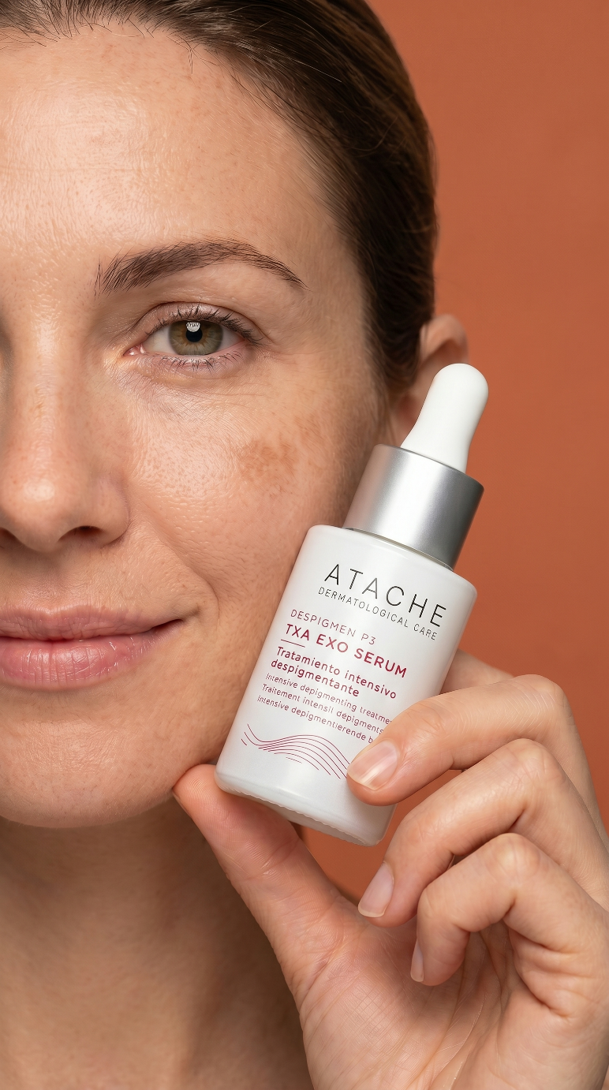



TXA EXO Serum DP3
An advanced solution for hyperpigmentation
TXA EXO Serum DP3 is the technological evolution of Despigmen P3: a pharmaceutical-laboratory serum that combines actives encapsulated in biomimetic exosome technology with supportive liposomal actives to address visible dark spots and uneven tone through a more precise strategy.
THE CHALLENGE
THE SOLUTION
Better-delivered actives
Tranexamic acid, kojic acid, niacinamide and licorice extract encapsulated in biomimetic exosome technology
Persistent dark spots
Uneven tone requires more than radiance: it needs action on different phases of the pigmentation process
THE FORMULA: FOUR DEPIGMENTING ACTIVES IN BIOMIMETIC EXOSOMES

Slide 6
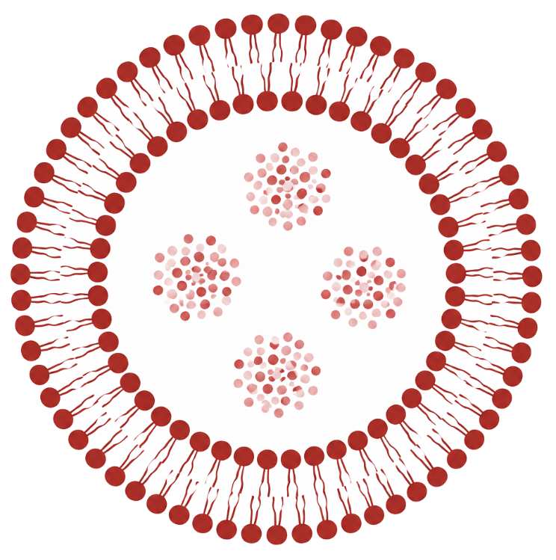
TXA EXO Serum DP3
The depigmenting formula
TXA EXO Serum DP3 delivers four depigmenting actives in biomimetic exosomes together with liposomal support actives for antioxidant support, visible renewal and hydration, to work on visible dark spots and uneven tone through a more complete and progressive strategy.
TRANEXAMIC ACID
KOJIC ACID
Helps modulate the pigmentation signal involved in visible dark spots and uneven tone.
Helps modulate melanin production and reinforces depigmenting action.
NIACINAMIDE
LICORICE EXTRACT
Promotes a more even-looking tone and improves visible radiance.
Botanical-origin depigmenting and soothing support. Suitable for sensitive skin.
Four depigmenting actives delivered in biomimetic exosomes for a more targeted action on the pigmentation process

Slide 7
TECHNOLOGICAL SYNERGY
Precise depigmenting action
TXA EXO Serum DP3 combines two delivery systems with distinct and complementary functions: the biomimetic exosome, which delivers the four key depigmenting actives, and the liposomal system, which protects and optimizes the delivery of support actives.
BIOMIMETIC EXOSOME system
Liposomal system
Four active ingredients delivered via vesicles
A biomimetic nanovesicle inspired by the architecture of exosomes
Contains transmembrane and surface proteins for enhanced cellular affinity
Promotes membrane fusion and more efficient, sustained delivery
Delivers tranexamic acid, kojic acid, niacinamide and liquorice extract
Delivery systems for active ingredients
A lipid bilayer that protects the active ingredient and enhances its bioavailability
Promotes the gradual release of the ingredient into the epidermal layers
Improves the stability of active ingredients susceptible to oxidation or degradation
Delivers alpha arbutin, retinol and vitamin C + ferulic acid + glutathione

Slide 8

Biomimetic exosome technology
Advanced biomimetic delivery
TXA EXO Serum DP3 incorporates biomimetic exosomes: nanometric vesicles that act as intelligent vehicles to transport actives in a targeted way. In this formula, they deliver tranexamic acid, kojic acid, niacinamide and licorice extract, creating a high-precision depigmenting complex.
The difference is not only in size: these nanovesicles incorporate protein material that improves their affinity with target cells and promotes membrane fusion. Their controlled release helps improve tolerance, even in sensitive skin.

Slide 9
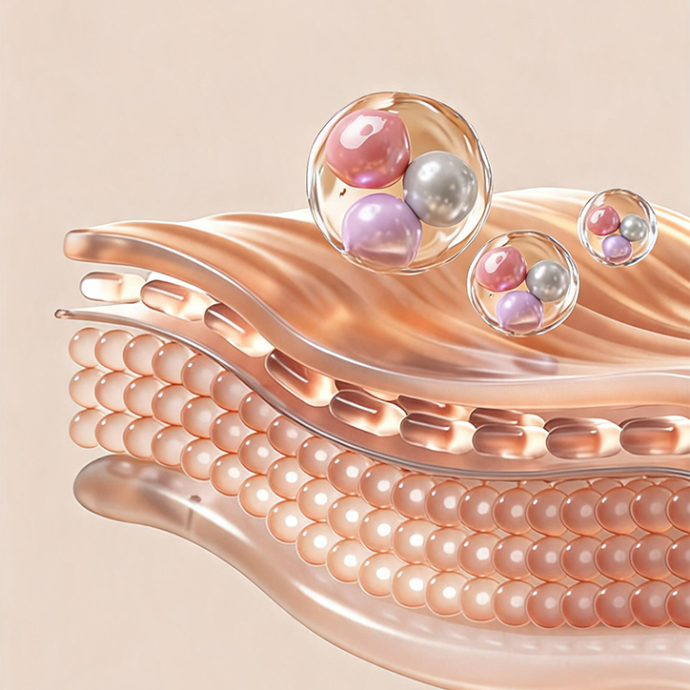
BENEFITS
Biomimetic exosome technology
Advanced biomimetic delivery
  Exosome-type biomimetic nanovesicles.
  Delivery of four depigmenting actives in a single nanovesicle.
  Greater affinity with cellular structures.
  Progressive and sustained cosmetic action.
  System complementary to classic liposomal delivery.

Slide 10
Tranexamic acid
Modulation of the inflammatory pathway without irritation
It does not act by directly inhibiting tyrosinase. It acts earlier: on the signal that activates it.
  Modulates communication between keratinocytes and melanocytes
  Reduces inflammatory signals that activate melanogenesis
  Especially effective in melasma, PIH and inflammatory dark spots
  Interferes with melanin transfer toward the surface
The biomimetic exosome supports more precise
delivery of the active.
  Supports targeted action toward the layers involved in the pigmentation process.
  Improves active bioavailability.
  Helps improve tolerance in progressive routines, even in sensitive skin.

Slide 11
Kojic acid
Direct tyrosinase inhibition
Blocks melanin synthesis at its enzymatic origin
  Copper chelation at the active site of tyrosinase
  Antioxidant activity against UV-induced free radicals
  Support in routines for sun spots, melasma and PIH
  Direct blocking of melanin synthesis
The biomimetic exosome helps protect the active and support its deposition in key skin layers
  ×1.24 more active in the stratum corneum
  ×8.25 more active in the basal layer
Source: Depigmentation Efficacy Study — Free Kojic Acid vs. DDS-Kojic. Human skin explants, phototype III. Graph values are proportional approximations based on the study’s published data. The studies refer to the active ingredient, not to the finished TXA EXO Serum DP3 product.

Slide 12
Niacinamide
Blocking melanin transfer
It acts in the final phase: preventing melanin from reaching the surface.
  Blocks melanosome transfer to keratinocytes
  Reduces skin reactivity — anti-inflammatory effect
  Strengthens the barrier — increases ceramide production
  Indirect tyrosinase inhibition
The biomimetic exosome supports active delivery in key melanocyte-keratinocyte interaction areas
  Indicated for sensitive skin and in combination with retinol.
  Sebum-regulating: contributes to sebum balance.
  Indication: routines for melasma, PIH, uneven tone and sensitive skin in intensive treatments.

Slide 13
Licorice extract
Direct tyrosinase inhibition
Blocks melanin synthesis at its enzymatic origin
  Anti-inflammatory action — reduces melanogenic mediators
  Plant-origin tyrosinase inhibitor
  Antioxidant activity against UV-induced free radicals
  Soothing, high-tolerance profile.
The biomimetic exosome supports targeted delivery of glabridin toward the layers involved in pigmentation
  Sensitive skin: helps soothe reactivity and improves formula tolerance.
  PIH and inflammation: helps reduce the inflammatory signal associated with post-inflammatory hyperpigmentation.
  Inflammatory melasma: acts on inflammation before it activates the pigment response.

Slide 14




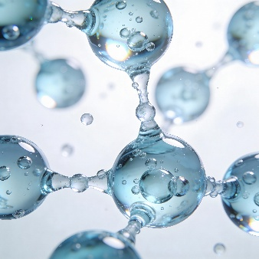
FORMULA ECOSYSTEM
Ingredients that optimize the formula
Liposomal
alpha-arbutin
Complements the formula’s depigmenting approach and reinforces work on uneven tone.
Liposomal vitamin C + ferulic + glutathione
Provide antioxidant support and radiance, helping protect the skin against oxidative stress.
Liposomal
retinol
Promotes visible skin renewal and helps improve skin texture and quality.
Polypodium
leucotomos
Provides antioxidant support against photoinduced oxidative stress.
Hyaluronic
acid
Provides hydration, comfort and barrier support during active cosmetic routines.

Slide 15

Liposomal alpha-arbutin
Direct tyrosinase inhibition
Acts on tyrosinase with greater stability and a more targeted action toward the layers involved in pigmentation.
Synergy with the formula
With TRANEXAMIC ACID
Dual action: alpha-arbutin inhibits tyrosinase while tranexamic acid reduces triggering inflammation.
With KOJIC ACID
Action on tyrosinase is multiplied by acting on complementary points of the enzymatic pathway.
With niacinamide
Helps modulate melanogenesis and improve visible dark spots and uneven tone.
Acts as a direct inhibitor of melanogenesis, reducing the formation of new dark spots and brightening existing ones

Slide 16

LIPOSOMAL VITAMIN C + FERULIC ACID + GLUTATHIONE
High-efficacy antioxidant network
They work in synergy to reinforce antioxidant protection against UV-induced oxidative stress, helping preserve radiance and tone uniformity.
LIPOSOMAL VITAMIN C
Helps modulate the oxidative process associated with pigmentation and adds radiance. Supports skin quality.
LIPOSOMAL FERULIC ACID
Enhances vitamin C stability and efficacy. Helps protect against UV-induced oxidative stress.
LIPOSOMAL GLUTATHIONE
Intracellular antioxidant that complements the antioxidant network and promotes a more balanced skin environment.

Slide 17

LIPOSOMAL RETINOL
Cellular renewal and depigmenting boost
Promotes cellular renewal and helps reduce the accumulation of pigmented cells, with a more stable, controlled and progressive action thanks to liposomal encapsulation.
Cellular renewal
Stimulates the removal of pigmented cells. Creates a more receptive environment for depigmenting actives.
Anti-aging action
Stimulates collagen and elastin synthesis. Improves firmness and elasticity. Especially valuable in combination or oily skin.
synergy
With liposomal vitamin C: protects new cells from oxidative damage. With hyaluronic acid, helps maintain hydration and comfort during the routine.
Accelerates the elimination of pigmented cells and boosts the action of depigmenting actives.

Slide 18

Hyaluronic acid
Support for the barrier and skin balance
Helps maintain skin balance during treatment by reinforcing the barrier, reducing water loss and compensating for the possible drying effect of retinol.
Skin barrier
Strengthens the barrier and reduces transepidermal water loss. Helps reduce factors associated with post-inflammatory pigmentation.
tolerance
Compensates for the possible drying effect of liposomal retinol. Improves comfort during high-active-density treatments.
penetration
Promotes a more comfortable skin environment for the action of actives delivered in biomimetic exosomes and liposomes.

Slide 19

Polypodium leucotomos
Antioxidant support and protection
Provides photoprotective, antioxidant and anti-inflammatory support against UV-induced oxidative stress, acting as a complementary biological shield and helping reduce factors associated with post-inflammatory hyperpigmentation after acne, irritation or aesthetic procedures.
Photoprotection
anti-inflammatory
Reduces UV-induced free radicals. Biological shield complementary to sunscreen.
Helps reduce factors associated with post-inflammatory hyperpigmentation.
TYROSINASE INHIBITION
ANTIOXIDANT SYNERGY
Supports the overall depigmenting action of the formula.
Complements the antioxidant network alongside vitamin C, ferulic acid and glutathione.

Slide 20

Evermat
Sebum regulation in a depigmenting treatment
In skin with an oily tendency or visible pores, Evermat provides a differentiated benefit within a depigmenting routine: it helps reduce excess sebum, shine and the appearance of pores, reinforcing the formula’s balancing profile.
Sebum-regulating action
Helps reduce excess sebum, shine and the appearance of pores.
VISIBLE PORES AND TEXTURE
Helps improve the appearance of pores and skin texture.
synergy
Complements the balancing action of niacinamide within the same formula.

Slide 21
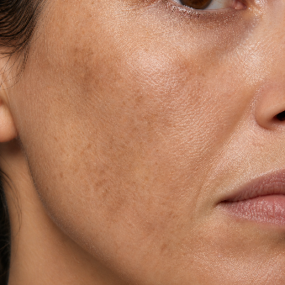

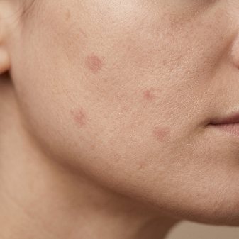

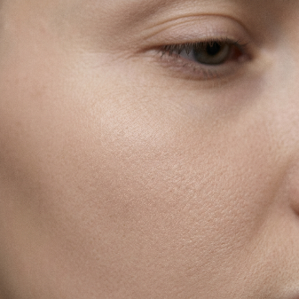
Skin profiles
Key needs in depigmenting routines
Visible dark spots
Sun spots, localized pigmentation and areas with more intense tone that require a more specific and continuous response.
Uneven tone
Visible unevenness, lack of homogeneity and tone variations that make the skin appear less uniform and balanced.
Post-blemish marks
Residual marks after blemishes, altered tone and localized irregularities that affect the overall appearance of the skin.
Photoexposed skin
Skin subjected to accumulated sun exposure, with a tendency to pigmentation, loss of uniformity and a less luminous appearance.
Radiance
Uniformity
Skin lacking radiance, with a tired appearance or dull tone, needing to recover clarity, freshness and a more homogeneous appearance.

Slide 22
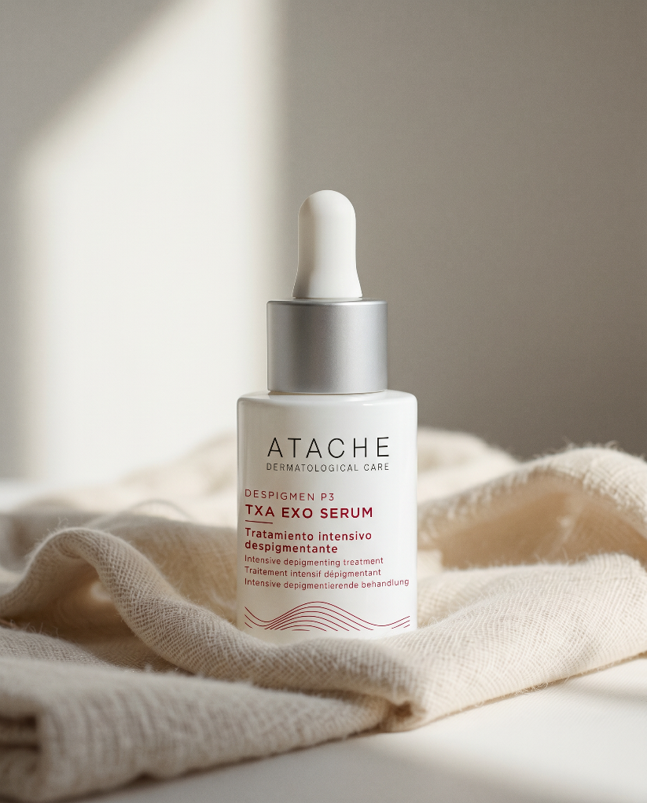
Day routine
Key steps in depigmenting routines
Morning routine
1
640862 · Soft Derm Sensitive Cleanser or
640265 · Oily SK Cleansing Gel
2
TXA EXO Serum DP3
3
640872 · DP3 Day Cream
4
640074 · Be Sun Despigmen Shield Protector SPF50 (recommended)

Slide 23
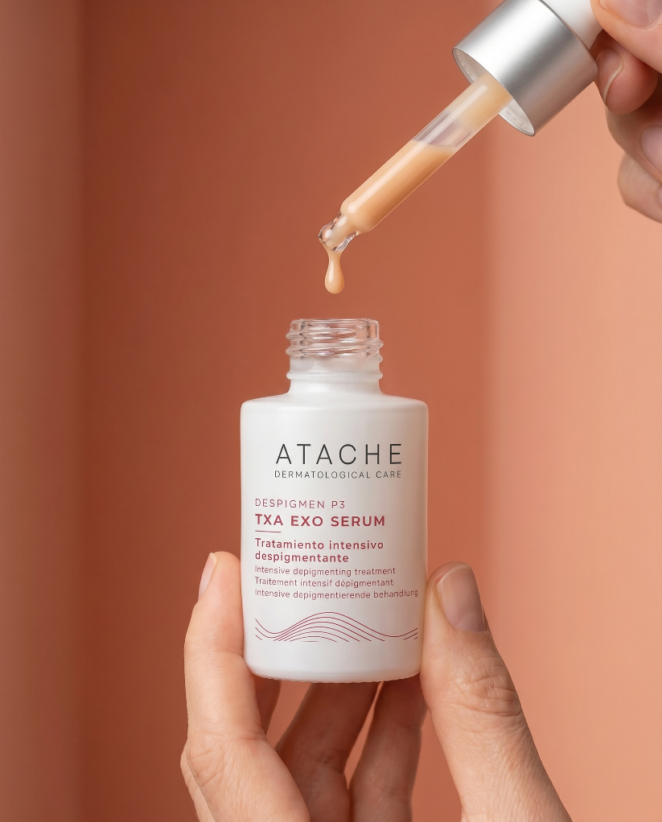
Night routine
Key steps in depigmenting routines
Night routine
1
640862 · Soft Derm Sensitive Cleanser or
640265 · Oily SK Cleansing Gel
2
TXA EXO Serum DP3
3
640871 · Punctual Cream
4
ATACHE moisturizer if needed

Slide 24

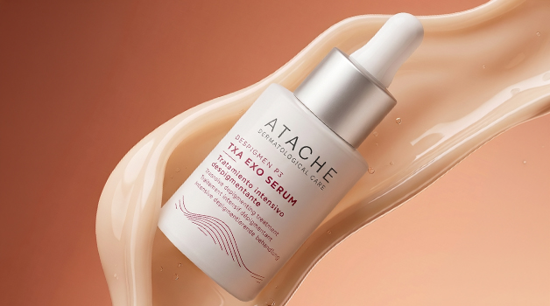

Precision multiactive depigmenting technology for a more complete treatment of visible hyperpigmentation.

Slide 25

FROM THE LAB TO THE SKIN

