Slide 1



TRAINING

Slide 2
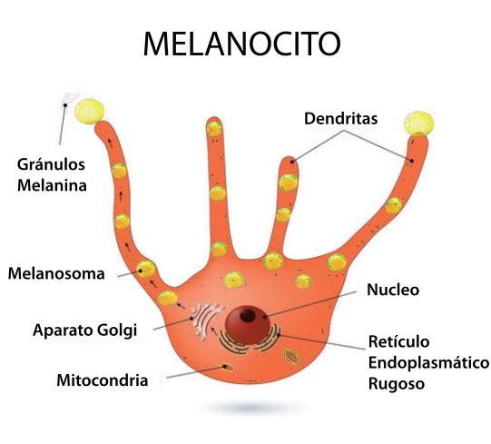
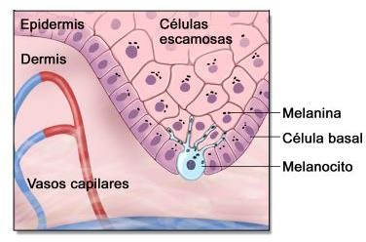
CAUSES OF PIGMENTATION
Skin gets its colour from a combination of factors, such as red caused by oxyhaemoglobin, blue by reduced haemoglobin, yellow by carotene and beige by melanin.
Melanin, the skin’s natural pigment, is synthesised in melanocytes in different concentrations depending on skin type (genetic predisposition) and environmental factors. Melanocytes are cells found in the basal membrane of the epidermis. Ultraviolet light stimulates them in the basal layer, causing them to divide more quickly. Melanocytes also produce larger quantities of melanin when stimulated by ultraviolet light.
Melanin is transported into the keratinocytes, where it becomes visible, turning skin brown.

Slide 3
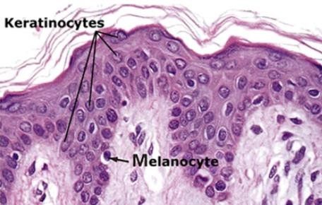
CAUSES OF PIGMENTATION
Regardless of skin colour, human skin has roughly the same number of melanocytes.
Skin colour is largely dependent on the quantity and type of melanin produced (eumelanin (black) or pheomelanin (yellow to reddish-brown). Asians and light-skinned people have less eumelanin than dark-skinned individuals who have little protection against the effects of sunlight. People with red hair have more pheomelanin pigmentation which gives little or no protection from the sun.
Melanin distribution in the skin is also variable. In the case of pale- skinned people, most melanin is in the basal layer, whilst in darker skins, melanin is evenly distributed, including inside the stratum corneum.

Slide 4
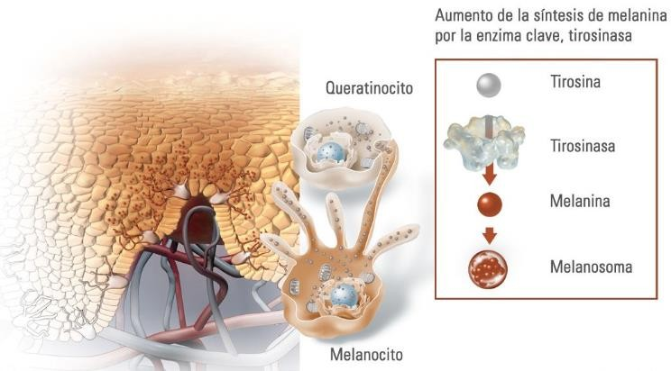
CAUSES OF PIGMENTATION
Tyrosinase is an enzyme with an important role in melanin synthesis. It is activated when exposed to ultraviolet light, and induces several intermediate stages in pigmentation formation.

Slide 5
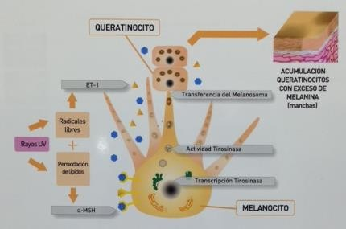
CAUSES OF PIGMENTATION
Tyrosinase has been shown to use both the substrate and divalent metal ions in its catalytic activity. The processes currently used to inhibit melanin synthesis to lighten skin use substances that interact directly with tyrosinase, or indirectly control its activity, for example, complicating the necessary metal ions (copper) such as, for example, with vitamin C or EDTA.

Slide 6
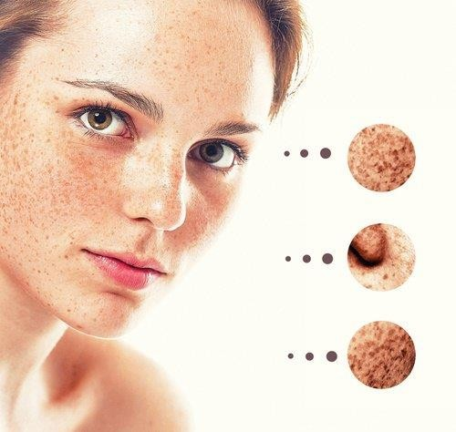
CAUSES OF hyperPIGMENTATION
Uneven skin colour is called dyschromia. Dyschromia caused by uneven melanic pigmentation (excess or lack of pigment) is called hypermelanosis or hypomelanosis, respectively. Hyperpigmentation means the change in the colour of the skin or mucous membranes caused by melanin deposit, and is located in the epidermis or in the dermis.
Hyperpigmentation has several causes:
An increased number of melanocytes
Increased in melanin production (melanocyte hypermelanosis)
Increased longevity of highly-pigmented
keratinocytes.

Slide 7
WICH FACTORS INFLUENCE hyperPIGMENTATION
The main causes of dark spots or marks are basically the following:
Risk factors
Predisposition | Exogenous | Physical: Ultraviolet light (UVA and UVB) Infrared Mechanical trauma, friction
 |  | Chemical: Cosmetics Dermal cleansers
 | Endogenous | Sex Skin colour (phototypes II to V) Age. Genetic tendency (mixed race) Hormonal factors: pregnancy, gynaecological, thyroid, adrenal
Aggravating factors | Medications Friction

Slide 8
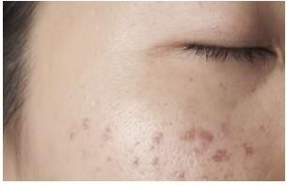
POST-INFLAMMATORY HYPERPIGMENTATION (PIH)
Post-inflammatory hyperpigmentation manifests as flat dark coloured spots. These can be any colour from pink to red, beige to black, depending on skin done and the depth of colour change. They may look like small, different coloured freckles or darker spots, which may be light or look like ‘new’ skin.
PIH often affects people who suffer from acne and can sometimes be triggered by cosmetic treatments such as dermal abrasion, chemical peels and laser therapy. Although all skin types are at risk of post-inflammatory hyperpigmentation, it is more common in darker skins.
Men and women are equally vulnerable to post- inflammatory hyperpigmentation.

Slide 9
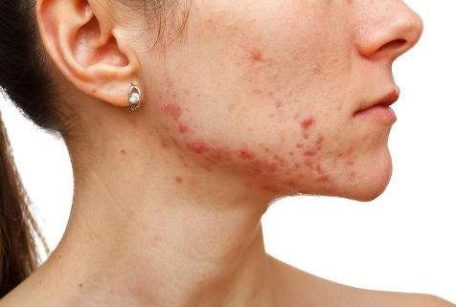
POST-INFLAMMATORY HYPERPIGMENTATION (PIH)
Post-inflammatory hyperpigmentation caused by inflamed acne lesions can go unnoticed.
PIH marks can start out as totally insignificant papillae or spots above more serious lesions. In other words, the more serious the lesion, the more noticeable the HPI in terms of size and colour. If spots are squeezed or popped, there is a greater risk HPI appearing.
The sun can aggravate the symptoms, darkening spots and causing the dark colour to remain for longer.

Slide 10
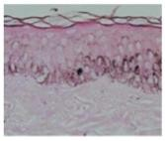
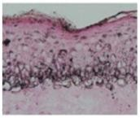
MELASMA
Melasma is epidermal hyperpigmentation by the melanocytes. In other words, it is caused by an increased number of melanocytes in the epidermis.
Melasma is a very common pigmentation disorder and the cause for many clinical consultations. It affects most women, and is primarily associated with pregnancy and hormone administrations. When the melasma are exposed to sunlight, it tends to exacerbate the process.
Normal skin
Melasma has many clinical characteristics and can be classified into three types.
Central location pattern (common): dull coloured macular lesions on both cheeks, nasal dorsum, upper lip and jaw.
Cheekbonepattern: cheeks and nasal dorsum.
Jawline pattern
Skin with melasma

Slide 11
MELASMA
There are different mechanisms and types of melasma hyperpigmentation:
Clinical-pathological correlation
Type | Normal light | Wood's Lamp | Histology
Epidermal | Light coffee | Highlights colour contrast | Melanin deposit in the basal and suprabasal layers of the epidermis
Dermal | Grey-blue | Does not highlight contrasting colour | Macrophages full of melanin in a perivascular location found in the superficial and middle layer of the dermis
Mixed | Dark coffee | Highlights colour contrast in some areas but not in others | Melanin deposits are found in the epidermis and the dermis.
Indeterminate | Grey-blue and unknown | Skin types 5 and 6 | Melanin deposits are found in the dermis.
The Wood lamp is particularly useful to establish the depth of the pigment and classify the melasma as superficial, deep or mixed.

Slide 12
MELASMA
The Melasma Area and Severity Index (MASI) is particularly useful. It divides the face into four areas: forehead, right and left malar that each account for 30% of the surface and the chin and upper lip (the remaining 10%).
The MASI score indicates the size, severity/intensity and evenness of pigmentation.
A. Size: from 1 to 6
-0 no pigmentation
Affects less than 10%
Affects between 10% and 30%
Affects between 30% and 50%
Affects between 50% and 70%
Affects between 70% and 90%
Affects all skin in the region
D. Evaluation of the severity or intensity compared with surrounding healthy skin.
Absent
Light
Medium
Significant
Severe
H. Evenness of the pigmentation. The same as D.

Slide 13
DEPIGMENTING AND PROTECTIVE AGENTS
Photoprotection: Solar radiation is one of the main features of hyperpigmentation. It is essential to use sunscreens that provide protection from both UVB and UVA light, which should be substantive and must be cosmetically acceptable. Vitamins C and E also provide protection.
Medical treatment with depigmenting agents: There are two groups of depigmenting agents:
Those that work by inhibiting or blocking the melanin formation process. They are limited to eliminating pigmented deposited in the epidermis.
Those that work by modifying both melanin production and by exfoliation (chelator effect).
Keratolytic and anti-inflammatories: These are not depigmenting agents, but they are complementary and boost cell renewal.
The peeling effect of keratolytic agents helps to eliminate pigmented cells.
Anti-inflammatory reduce swelling and irritation associated with dark marks.

Slide 14
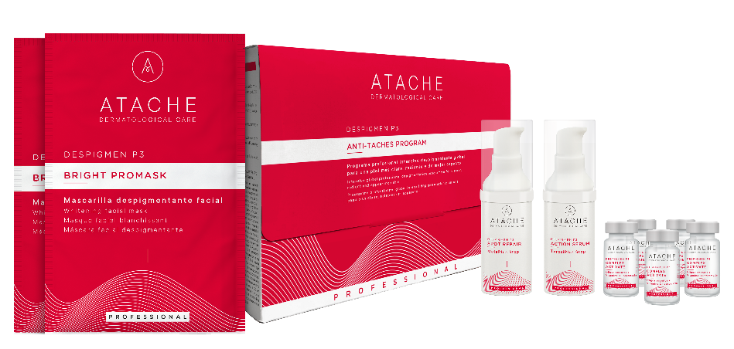
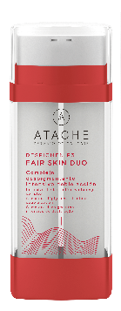
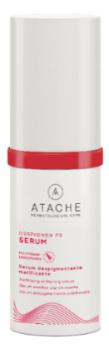
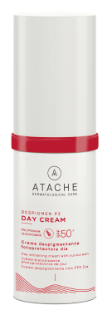
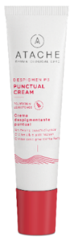
DESPIGMEN P3

Slide 15

INGREDIENTS

Slide 16
DESPIGMEN P3
The despigmen P3 formula has stood out for its effectiveness since its first launches, always fulfilling the precept of the Triple Depigmenting Combo or "Renewed Kligman Triad". As we already know, this formulation is based on combining tyrosine-inhibiting active ingredients, exfoliating agents and inflammation-reducing active ingredients to tackle the problem of pigmentation from a global perspective.
KLIGMAN TRIAD
A trio of depigmenting active ingredients:
Hydroquinone inhibits tyrosinase
Corticoids have an anti-inflammatory effect Retinoids have a powerful exfoliating and regenerating effect (keratolytic effect).
Keratolytic
Tyrosine-inhibiting
Anti-inflammatory

Slide 17
ACTIVE INGREDIENTS
BASED ON THE KLIGMAN TRIAD
Interferes with the melanogenesis process
Keratolytic
Anti-inflammatory
Tranexamic acid
Niacinamide
Arbutin
Liquorice extract
Vitamin C
Lactic acid
Ferulic acid
Retinol
Lactic Acid
Vitamin E
Polypodium Leucotomos
Liquorice extract
Niacinamide
Repairing and regenerative
Hypericum Perforatum
Retinol
Hyaluronic Acid
Soluble Collagen

Slide 18
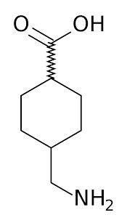
Tranexamic acid
Tranexamic acid is a medication known for its ability to promote blood clotting, thereby aiding in the prevention of bleeding. This has made it a widely used component in medicine for preventing excessive bleeding.
Recently, it has gained recognition in the fields of cosmetics, dermatology and aesthetic medicine due to an additional benefit supported by clinical studies: its ability to regulate the formation of dark spots on the skin.
Several clinical studies and reviews have evaluated the efficacy and safety of tranexamic acid in various concentrations for treating skin hyperpigmentation, including melasma.
Although the exact dosage may vary depending on the patient and the specific condition being treated, concentrations ranging from 1.5% to 5% have been observed to be effective in achieving significant results in reducing pigmentation and improving skin appearance.

Slide 19
Tranexamic acid
Its mechanism of action as a depigmenting agent is explained by the fact that it inhibits the production of plasmin, an enzyme that triggers melanin synthesis. By blocking this process, tranexamic acid reduces the formation of dark spots and hyperpigmentation.
Melanogenesis - Melanin Synthesis
TYROSINE
x
Enzyme activator
PROSTAGLANDINA E
TYROSINASE
DOPA
ARACHINODIC ACID
TYROSINASE
DOPAQUINONE
PLASMINE
x
TYROSINASE
MELANIN
PLASMINOGEN ACTIVATOR
Melanocyte
Keratinocyte

Slide 20
Ácido tranexámico
Tranexamic acid is a proven option to combat skin pigmentation. In a nutshell:
Regulates the activity of melanocytes, the cells responsible for melanin production: By modulating the cellular mechanisms involved in excessive melanin production, tranexamic acid helps prevent and reduce the formation of spots.
Intervenes in the inflammatory process associated with skin pigmentation: Chronic inflammation can trigger melanocyte activation and excessive melanin production, which contributes to the development of skin blemishes. By inhibiting this inflammatory process, tranexamic acid reduces the formation and intensity of spots, especially after external aggressions or skin lesions such as acne.
Effects on skin vascularisation: Melasma and other forms of hyperpigmentation are often associated with increased local vascularisation, which contributes to their persistence and resistance to treatment. By reducing this excessive vascularisation, tranexamic acid helps to improve the appearance of spots and prevent their recurrence.

Slide 21
NIACINAMIDe
Niacinamide, also known as vitamin B3, is an active ingredient with numerous benefits, including its depigmenting properties. Its mechanism of action involves several key processes in the skin:
1. inhibition of Melanin Transfer: niacinamide inhibits the transfer of melanin from melanocytes to keratinocytes, resulting in reduced skin pigmentation and fading of dark spots.
2. Blocking Melanosome Transfer: In addition, niacinamide interferes with the transfer of melanosomes (melanin-containing organelles) from melanocytes to keratinocytes, which helps prevent the formation of new pigment spots.
3. Reduction of Post-inflammatory Hyperpigmentation: Niacinamide can also reduce post-inflammatory hyperpigmentation by helping to inhibit the inflammatory response and excessive melanin production during the healing process.

Slide 22
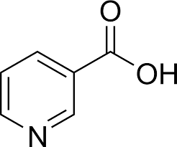
NIACINAMIDE
Depigmenting Benefits:
Dark Spot Reduction: Helps reduce the appearance of dark spots, including those caused by sun exposure, ageing and acne.
Skin Tone Evenness: Promotes a more even and radiant skin tone.
Compatibility with All Skin Types: Niacinamide is known to be a mild and well-tolerated ingredient, making it suitable for all skin types, including sensitive skin. In addition, its sebum-regulating action makes it an ideal choice for oily skin.

Slide 23
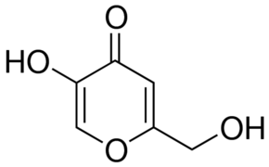
KOJIC ACID
Kojic acid is a natural compound extracted from the Aspergillus oryzae fungus, renowned for its depigmenting function
This quality stems from its ability to inhibit the enzyme tyrosinase, which plays a crucial role in melanin production during melanogenesis. By interfering with this process, kojic acid helps reduce melanin synthesis, resulting in decreased skin pigmentation and a more uniform appearance.
In addition to its depigmenting effect, kojic acid also exhibits antimicrobial properties. This antimicrobial action makes it a valuable ingredient in skincare products, as it not only helps lighten the skin but also contributes to combating bacteria and other microorganisms that can cause issues such as acne or other skin conditions.

Slide 24
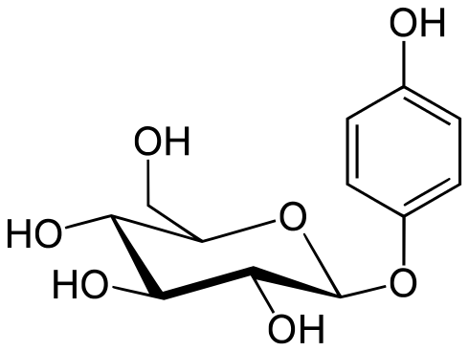
Alfa arbutine
Arbutin, a hydroquinone derivative, is noted for its efficacy in the treatment of skin hyperpigmentation. Acting as an inhibitor of tyrosinase, the key enzyme in melanin synthesis, arbutin reduces the production of the pigment responsible for skin colour.
In addition to its depigmenting action, studies have shown that arbutin has anti-inflammatory properties, which contributes to its ability to block tyrosinase enzyme activity.
Importantly, arbutin exists in two isomers, with the alpha form being the more stable. This isomer, preferred in skin lightening, is more effective at inhibiting tyrosinase and reducing melanin production than other depigmenting agents such as kojic acid and ascorbic acid.

Slide 25

Glycyrrhiza glabra
Liquorice extract, obtained from the root of the Glycyrrhiza glabra plant, is recognised for its various skin benefits.
One of its most prominent components is glabridin, an oil-soluble compound derived from liquorice extract, which has been shown to be an effective tyrosinase inhibitor. This mechanism of action reduces melanin production in the skin,
In addition, glabridin also exhibits anti-inflammatory properties, which can help soothe the skin and reduce irritation.
Another important component of liquiritin extract is liquiritin, which has been shown to have significant benefits in the treatment of melasma. Liquiritin acts similarly to glabridin by inhibiting tyrosinase activity and reducing melanin production in the skin.

Slide 26
Lactic acid
Lactic acid is an alpha hydroxy acid (AHA) with exfoliating and renewing properties.
Inhibits tyrosinase. By reducing tyrosinase activity, lactic acid helps to decrease melanin production, which can lead to a reduction in hyperpigmentation and an improvement in skin tone.
Exfoliates and promotes cell renewal: Lactic acid gently exfoliates the outer layer of the skin, removing dead skin cells and promoting cell renewal. This helps to rejuvenate the skin and reduce the appearance of dark spots and uneven pigmentation.
Stimulates collagen production: In addition to exfoliating the skin, lactic acid stimulates the production of collagen, a structural protein important for skin firmness and elasticity.

Slide 27
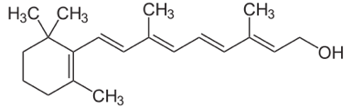
retinol
Retinol, a vitamin A derivative, plays a crucial role in depigmentation treatments.
It interferes with the transfer of melanosomes: it reduces the accumulation of melanin in the skin, improving tone and reducing hyperpigmentation.
Increases keratinocyte renewal: Accelerates the process of skin cell desquamation, promoting fresher, more luminous skin.
Inhibits tyrosinase transcription: Reduces melanin production by inhibiting the activity of the enzyme tyrosinase, improving uneven skin pigmentation.
Exfoliating action: Acts as a keratolytic agent, eliminating dead skin cells and improving its texture and luminosity.

Slide 28
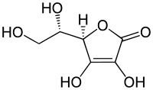
Vitamin c
Vitamin C, ascorbic acid, is an essential vitamin for skin health, thanks to its powerful antioxidant action. In addition to its role in cell protection, vitamin C has been shown to be an effective ally in the fight against hyperpigmentation and dark spots on the skin.
Ascorbic acid exerts a significant influence on the biochemical processes that regulate melanin synthesis. On the one hand, it reduces the conversion of DOPA to L-dopaquinone, a critical step in melanin production, resulting in decreased pigmentation.
On the other hand, by interacting with copper, it facilitates the activation of tyrosinase, a key enzyme in melanin synthesis, which contributes to a more precise regulation of pigment production.
In addition, it has an effect on melanocyte morphology that reduces pigment transfer to the superficial layers of the skin, thus promoting a more even and luminous skin tone.

Slide 29
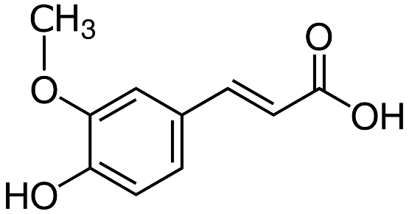
Ferulic acid
Ferulic acid is a phenolic compound that works synergistically with other ingredients in the depigmenting formula, through various functions:
Antioxidant: Protects the skin against free radicals, preventing premature ageing. Boosts the antioxidant action of vitamins C and E.
Depigmenting: Controls tyrosinase activity, helping to lighten dark spots and reduce hyperpigmentation, achieving a more even skin tone.
Cellular DNA protection: Offers protection against damage caused by UV radiation, protecting cellular DNA and reducing the risk of sun damage.

Slide 30

POLYPODIUM LEUCOTOMOS
Polypodium Leucotomos is a fern that contains a variety of bioactive compounds, including polyphenols, flavonoids and phenolic acids, which confer antioxidant and anti-inflammatory properties.
Photo-protective and antioxidant action: Protects against DNA damage by UVB and reduces UVA-induced free radicals.
Anti-inflammatory action: both the extract alone and the extract combined with vitamins exhibit anti-inflammatory activity.
Immunostimulatory activity.
Recent studies show that Polypodium Leutotomos has an important adjuvant role in the treatment of melasma, as increased efficacy was observed in patients who were given Polypodium Leucotomos together with topical depigmentant and sunscreen.

Slide 31
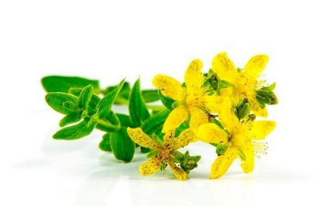
HYPERICUM PERFORATUM
Hypericin is a chemical compound found in the extract of Hypericum perforatum, known as St John's wort. Its specific effects on the skin have several potential benefits:
Regenerative activity: Stimulates cell regeneration, promoting wound healing and improving overall skin health.
Collagen and elastin stimulation: Promotes the production of these key proteins, which improves skin elasticity and firmness, reducing wrinkles and fine lines.
Antioxidant action: Protects skin from free radical damage, helping to prevent premature ageing and maintaining healthier skin.
Anti-inflammatory effect: Reduces inflammation in the skin, benefiting conditions such as acne and dermatitis, and promoting calmer, more balanced skin.

Slide 32
HIALURONIC ACID A6 SOLUBLE COLLAGEN
Hyaluronic acid is a polysaccharide found naturally in the skin and functions as an important component of the dermal extracellular matrix. Its unique chemical structure allows it to retain large amounts of water, which contributes to skin hydration and elasticity.
In addition, by keeping the skin well hydrated, hyaluronic acid can help reduce the appearance of fine lines and wrinkles, as well as improve the overall texture of the skin.
Collagen is a structural protein found in the skin that is responsible for its firmness, elasticity and resilience. In its cosmetic formulations, soluble collagen is used to improve skin firmness and resilience, which can help reduce the appearance of fine lines and wrinkles and improve overall skin texture.
In addition, soluble collagen can also help stimulate the production of endogenous collagen in the skin, thus promoting younger, more radiant skin.

Slide 33

HYDROLYSED WHEAT FLOUR
Wheat flour hydrolysate has multiple functions in skin care, acting as a whitening, brightening and anti-ageing agent..
Its action is directed towards the inhibition of melanogenesis, specifically targeting the enzyme tyrosinase and TRP-1, as demonstrated in in vitro tests.
In addition, this ingredient shows effectiveness in preventing UV-induced discolouration, as observed in ex vivo tests.
It also stands out for its speed compared to arbutin in lightening the skin, as evidenced by in vivo tests. These results support its use in skincare products, offering a comprehensive solution to combat uneven pigmentation, promote radiance and prevent the signs of skin ageing.

Slide 34
PRODUCTS

Slide 35
DESPIGMEN P3 ANTIATACHES PROGRAM: FoRMULA
New Depigmenting and Anti-Aging Formula
ACTION SERUM
SPOT REPAIR
Ingredients | Properties
Tranexamic Acid | Depigmenting
Alfa-Arbutin Liposome | Depigmenting
Ferulic Acid Liposome | Antioxidant
Polypodium Leucotomos | Photo-protector
Hialuronic Acid | Moisturising
Ingredients | Properties
Niacinamide | Depigmenting
Lactic Acid | Keratolytic
Retinol | Keratolytic
Hypericum Perforatum | Regenerating
Soluble Collagen | Firmness

Slide 36
FAIR SKIN DUO: CHARACTERISTICS
INDICATION: Depigmenting and anti-ageing treatment for skin showing pigmentation irregularities and signs of ageing.
INGREDIENTS:
Pure Glow: Tranexamic Acid, Liposomed Alpha-Arbutin, Liposomed Ferulic Acid, Polypodium Leucotomos, Hyaluronic Acid.
Luminex Complex: Niacinamide, Lactic Acid, Liposomal Vitamin E, Retinol, Hypericum Perforatum, Soluble Collagen.
ACTION: Depigmenting - Anti-ageing - Repairing
INSTRUCTIONS FOR USE: Day and Night: Apply two pumps of each and spread over the face with a gentle massage at least twice a day, increasing the frequency if necessary.
SKIN TYPE: All skin types

Slide 37
FORMULA BENEFITS
New depigmenting Atache’s formula offers a complete and effective solution to improve skin's appearance, addressing both hyperpigmentation and signs of ageing, and providing hydration, protection and regeneration for radiant, healthy skin.
Holistic Treatment Addresses hyperpigmentation problems and signs of ageing
Proven Effectiveness: Formulated with clinically proven ingredients
Ingredient Synergy: Combination of active ingredients work in synergy.
Cell Renewal: Stimulates cell renewal and skin exfoliation
Deep Moisturising: Helps to keep skin soft and supple.
Protection and Regeneration: Ingredients offer antioxidant protection and regeneration.

Slide 38
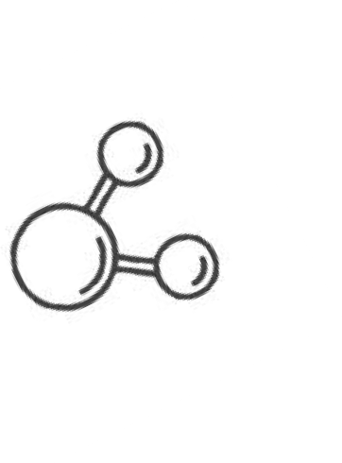
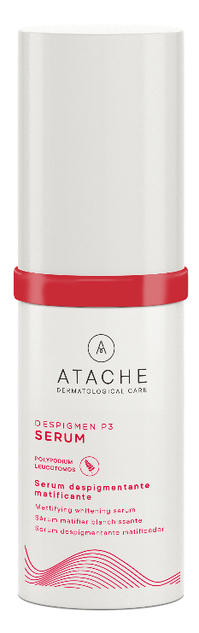
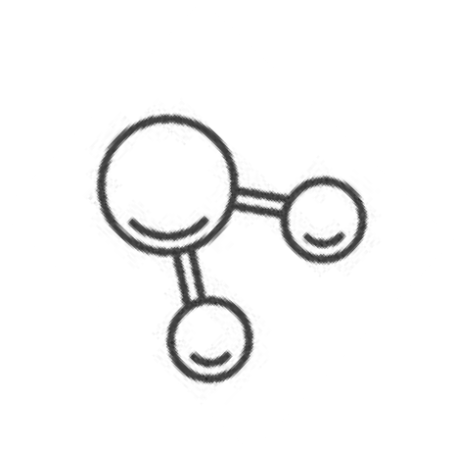
SERUM DESPIGMEN P3
Depigmenting treatment with liposomated active ingredients and Polypodium
Polypodium leucotomos extract
0.40%
Liquorice extract 0.60%
The formula is synchronised with the regenerating action of PLE and with a high capacity for hydration.
Vitamins C 0.16% and A
0.15%+E.
Liposomated.
Active ingredients are absorbed by deeper layers
of the epidermis with antioxidant, keratolytic (vitamin A) and regenerating (vitamin E) properties.
Kojic acid 0.03% and Arbutinand
0.40%
Liposomated.
Penetrate the epidermis, homogenising and
bleaching the skin tone

Slide 39
PRODUCT: SERUM DESPIGMEN P3
MATTIFYING DEPIGMENTING SERUM 30ml Depigmenting effect.
INDICATION:
Skins with irregular pigmentation.
EFFECT:
Antioxidant: Helps to restrain the effect of free radicals with concentrated vitamins and
Polypodium leucotomos extract.
Lightening action: Lightens dark spots and evens out skin tone with depigmenting agents
such as kojic acid and arbutin, among others.
Cellular renewal: Presents "peeling effect" by the action of certain assets such as vitamin A. Moisturising: hydrates the skin without leaving an oily sensation thanks to its mattifying effect.
INSTRUCTIONS:
Day and Night: Massage in gently at least twice a day, increasing the frequency if necessary.
SKIN TYPE: All

Slide 40
PRODUCT: SPF 50+ DAY CREAM
PHOTOPROTECTIVE DEPIGMENTING DAY CREAM 30ml depigmenting effect with sunscreen
INDICATION:
Skins with irregular pigmentation.
EFFECT:
Day cream with ingredients that whiten and even out skin tone, combined with protective sunscreens and polypodium. Features the anti-pollution function of beeswax and jojoba esters.
INGREDIENTS: Retinyl Palmitate, kojic acid, arbutin, Polypodium leucotomos extract, EDTA, vitamins C and E, sunscreens 50+, beeswax and jojoba esters
INSTRUCTIONS:
Day: Use 30 minutes before exposure to the sun. Apply evenly, covering all skin exposed to the sun, even on cloudy days. It is recommended you reapply at least every 60 minutes and always after the swimming, sweating or drying yourself.
SKIN TYPE: All

Slide 41
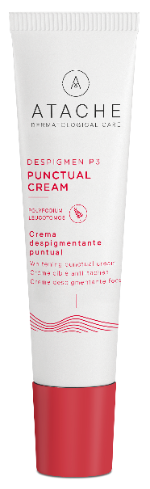
PRODUCT: PUNCTUAL CREAM
SPECIFIC DEPIGMENTING CREAM 15ml Specificdepigmenting effect.
INDICATION:
Skins with irregular pigmentation.
EFFECT:
Specific mattifying cream with highly concentrated liposomated ingredients that penetrate the deeper layers of the epidermis. Whitening effect with antioxidant compounds of Polypodium leucotomos extract.
INGREDIENTS: Vitamins C and E, kojic acid , arbutin, Polypodium leucotomos extract, EDTA, liquorice extract, retinyl palmitate and jojoba esters.
INSTRUCTIONS:
Day and night: Apply at least three times daily with light pressure on dark spots and theiredges.
SKIN TYPE: All

Slide 42
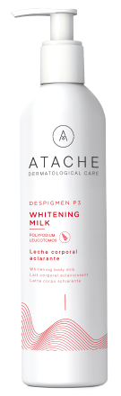
Despigmen p3 whitening milk
DEPIGMENTING BODY MILK 250 ML
INDICATION:
Skins that show pigmentation irregularities.
ACTION:
Body milk with a lightening, moisturizing and antioxidant action, with a light texture and fast absorption. Its formula is based on the effective active ingredient AXOLIGHT that acts on the mechanisms of the blemish through an innovative double inhibition of the melanin synthesis process.
INGREDIENTS : Hydrolyzed Wheat Flour, Lactic Acid, Glycerin, Sodium PCA, Vitamin E, Polypoidum leucotomos extract
HOW TO USE:
Day and night: Apply twice a day all over the body with a gentle massage until completely absorbed.
SKIN TYPE: All

Slide 43
PROFESSIONAL PROGRAMME

Slide 44
DESPIGMEN P3 ANTIATACHES PROGRAM
A unique and innovative new professional treatment designed to effectively treat skin pigmentation irregularities, offering a complete and advanced solution for a more even and radiant complexion. Includes four powerful products formulated with selected ingredients of the highest quality.

Slide 45

COMPLEX ACTIVATE
DESCRIPTION
Base lotion with liposomed ascorbic acid (vitamin C) that fights blemishes and promotes skin radiance. Pidolates of trace elements and minerals (Zn, Ca, Mg) keep the skin balanced and moisturised. The formula is complemented with liposomal ferulic acid which provides synergistic antioxidant power to ascorbic acid.
INGREDIENTS: Vitamin C, Calcium, Magnesium, Zinc and Pyrrolidine Carboxylic Acid, Ferulic Acid.
PRESENTATION: 5 vials of 5 mL
INSTRUCTIONS FOR USE: Apply one vial in each session and activate manually, virtual mesotherapy, radiofrequency or lonisation.

Slide 46
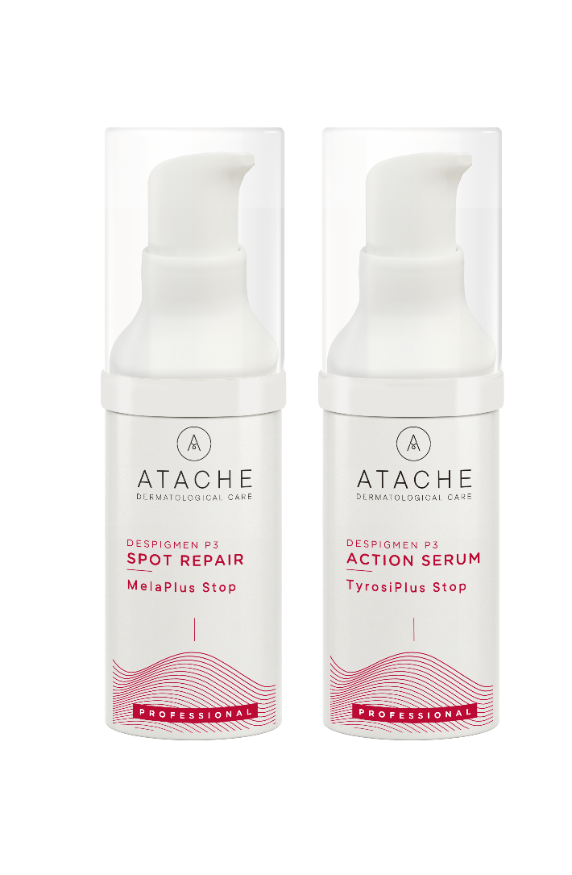
ACTION SERUM
DESCRIPTION
Silky depigmenting serum formulated with tranexamic acid and liposomed alpha arbutin. In addition, Polypodium extract acts as an antioxidant shield and hyaluronic acid provides deep hydration to the epidermis, resulting in more turgid skin.
INGREDIENTS: Tranexamic Acid, Liposomed Alpha-Arbutin, Liposomed Ferulic Acid, Polypodium Leucotomos, Hyaluronic Acid.
PRESENTATION: Airless 30 mL
INSTRUCTIONS FOR USE: Apply 20 pulses all over the face and massage in, especially in the most pigmented areas.

Slide 47
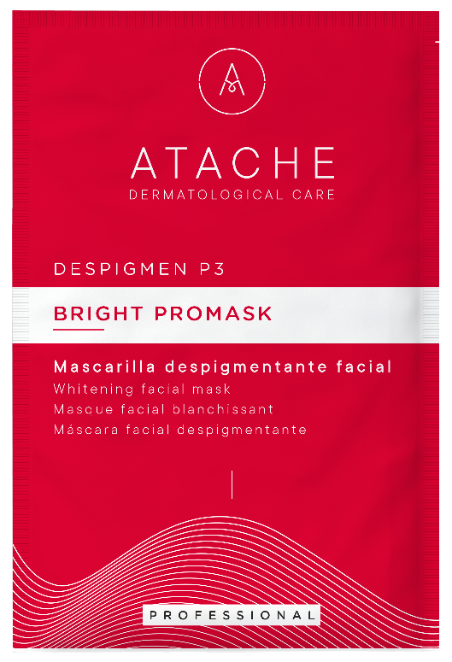
BRIGHT PROMASK
DESCRIPTION
Depigmenting alginate mask that combines the gentle exfoliating action of diatomaceous earth with the lightening properties of liquorice extracts for velvety, even skin.
INGREDIENTS: Glycyrrhiza glabra, diatomaceous earth
PRESENTATION: Sachet 5 uns x 30 gr
INSTRUCTIONS FOR USE: Pour the contents of the sachet into a bowl and add 90 mL of water. Stir with a spatula to create a homogeneous paste and apply to the face. Remove after 15 minutes when the mask has set.

Slide 48
SPOT REPAIR
DESCRIPTION
Treatment finishing cream, which coordinates regenerating agents (retinol, Hypericum extract, collagen), moisturising agents (hyaluronic acid) and finally vitamin B3 which smoothes the skin tone and relaxes the skin.
INGREDIENTS: Niacinamide, Lactic Acid, Liposomed Vitamin C, Retinol, Hypericum Perforatum, Soluble Collagen.
PRESENTATION: Airless 30 mL
INSTRUCTIONS FOR USE: Apply 20 pumps all over the face and massage until completely absorbed as a final step.

