Slide 1

ESSENTIELLE
GREEN TEA POSTBIOTIC

Slide 2
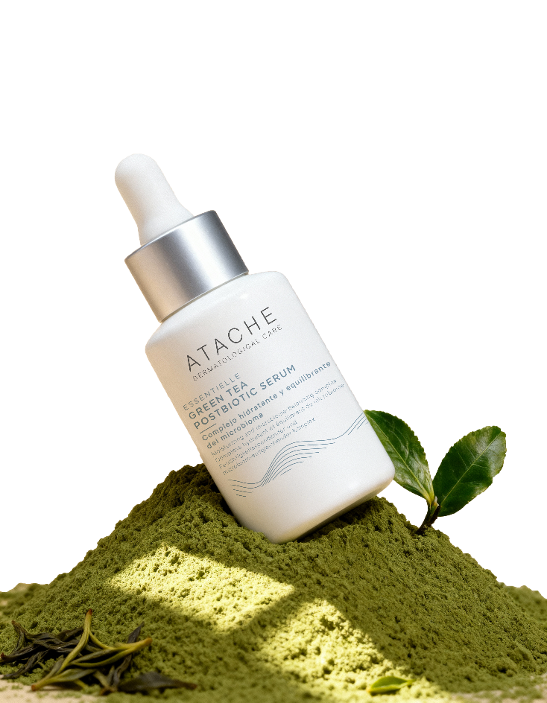
ESSENTIELLE GREEN TEA POSTBIOTIC
The antioxidant power of green tea + Postbiotic Technology
The same antioxidant benefits of green tea and postbiotics that promote health from within now work from the outside to protect and rejuvenate the skin.

Slide 3
GREEN TEA POSTBIOTIC: An essential line
🍃 Main Concept
Green Tea as the star ingredient: A powerful natural antioxidant that protects, soothes and revitalises the skin against ageing and environmental aggressions.
Reinforced with Postbiotics: Innovative technology that balances the microbiome and strengthens the skin barrier for more resistant and healthier skin.
Atache's Green Tea Postbiotic line is a natural evolution of the successful green tea mask. It becomes a daily skincare routine with two key products, a serum and a cream. The goal: to protect the skin from urban ageing, deeply moisturise and strengthen its microbiome to keep it balanced, luminous and strong against external aggressions.

Slide 4
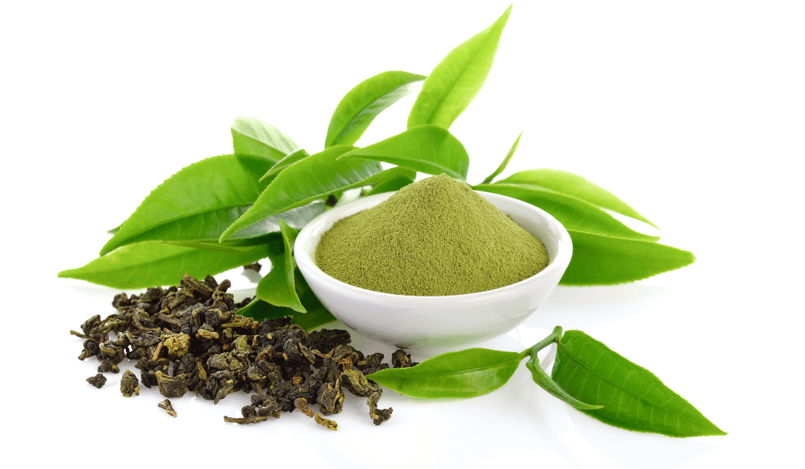
NATURE AND INNOVATION
Naturally sourced ingredients + State-of-the-art postbiotic technology

Slide 5
INSPIRATION: GREEN TEA
Why Green Tea?
Green tea is one of the most studied and recognised natural antioxidants. Its high polyphenol content, especially epigallocatechin gallate (EGCG), makes it a powerful free radical neutraliser. Studies show that it reduces transepidermal water loss (TEWL), soothes the skin and improves its resistance to pollution and UV radiation. It also has anti-inflammatory and anti-pollution properties, making it ideal for urban consumers.
Rich in polyphenols and catechins - Nature's most powerful antioxidants
Protection against free radicals - Combats daily oxidative stress
Anti-inflammatory action - Soothes and reduces redness
Natural UV protection - Complements photoprotection
Trend ingredient - Recognised and valued by consumers

Slide 6
TECHNOLOGY: POSTBIOTICS
Postbiotics are derived from beneficial bacteria which, unlike probiotics, do not need to be alive to be effective. This makes them safer, more stable and immediately effective on the skin.
BENEFITS
Lactococcus lactis lysate
+185%
Increase in natural antimicrobial peptides in the skin
They balance the skin microbiome
They strengthen the protective barrier
Stimulate cell renewal
Improve defence capacity
Increase resistance to stress
Just as probiotics care for the gut, postbiotics care for the skin's ecosystem, keeping it balanced, protected and stronger against daily aggressions.

Slide 7
INDICATION
Who is Green Tea Postbiotic Line for?
Main Profile
Women and men aged 20-45
Concerned about premature ageing
Urban lifestyle
Exposed to pollution and stress
Seeking natural products
Aware of skin care
Needs it meets
Daily antioxidant protection
Deep, non-greasy hydration
Microbiome balance
Ageing prevention
Soothing and comfort
Radiance and vitality

Slide 8
INDICATION
Skin types
✓ Combination and normal skin
Perfect texture, balanced hydration
✓ Dehydrated skin
Restores comfort and softness
✓ Sensitive skin
Soothes, protects and strengthens
✓ First signs of ageing
Prevents and revitalises

Slide 9
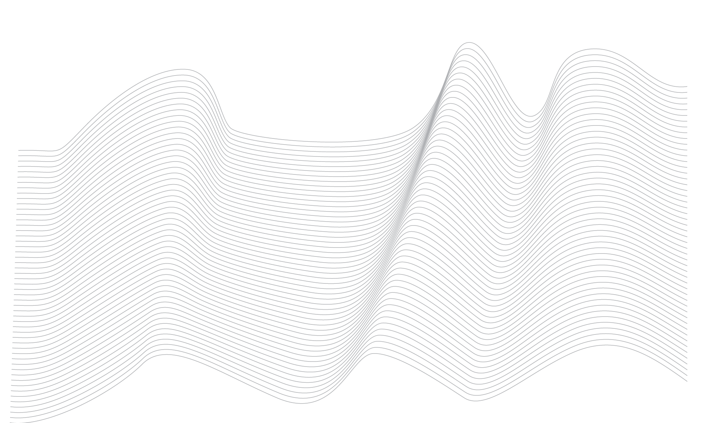
CLINICAL SUPPORT
KEY ACTIVE INGREDIENTS

Slide 10
GREEN EXTRACT: Camellia Sinensis Leaf Extract
Bioactive Composition
Polyphenols (30-40% of dry extract)
Antioxidant Activity
Up to 20 times more powerful than vitamin E
Neutralises free radicals (ROS)
Gianeti MD, et al. The use of green tea extract in cosmetic formulations: effects on the skin and cutaneous microcirculation. J Cosmet Dermatol. 2013;12(2):122–129.
Photoprotection
Reduces damage from UV radiation
Prevents sunburn and cellular DNA damage
Elmets CA, et al. Cutaneous photoprotection from ultraviolet injury by green tea polyphenols. J Am Acad Dermatol. 2001;44(3):425–432.
Antimicrobial
Activity against Gram+ and Gram- bacteria
Protection against skin pathogens
Elsaie ML, et al. The efficacy of topical 2% green tea lotion in mild-to-moderate acne vulgaris. J Drugs Dermatol. 2009;8(5):358–364.
Anti-inflammatory
Inhibits pro-inflammatory cytokines (IL-1, TNF-α)
Reduces redness and irritation
Katiyar SK, et al. Inhibition of UVB-induced oxidative stress and cutaneous inflammation by green tea polyphenols. Clin Cancer Res. 2001;7(12):4050s–4055s

Slide 11
POSTBIOTIC: LACTOCOCCUS FERMENT LYSATE
Biological activity (in vitro test):
It acts on specific genes related to the epidermal renewal process, activates the production of key proteins, and thereby restores the skin's ability to renew itself.
This results in a more cohesive epidermis, improved barrier function, and additional protection against pathogenic microorganisms.
In vivo activity
Accelerates the epidermal renewal process, quickly restoring barrier function. In just 4 days, the stratum corneum is thicker, after having been removed by stripping.
The improvement in the quality of the stratum corneum also provides a better "habitat" for the microbiota. Therefore, when the microbiota is under stress, the postbiotic lactococcus helps to restore diversity, richness and abundance more quickly.
Chemisches Laboratorium Dr. Kurt Richter GmbH (CLR Berlin).
ProRenew Complex CLR™: Technical Dossiers (2018–2021).
Berlin: CLR; data on file.

Slide 12
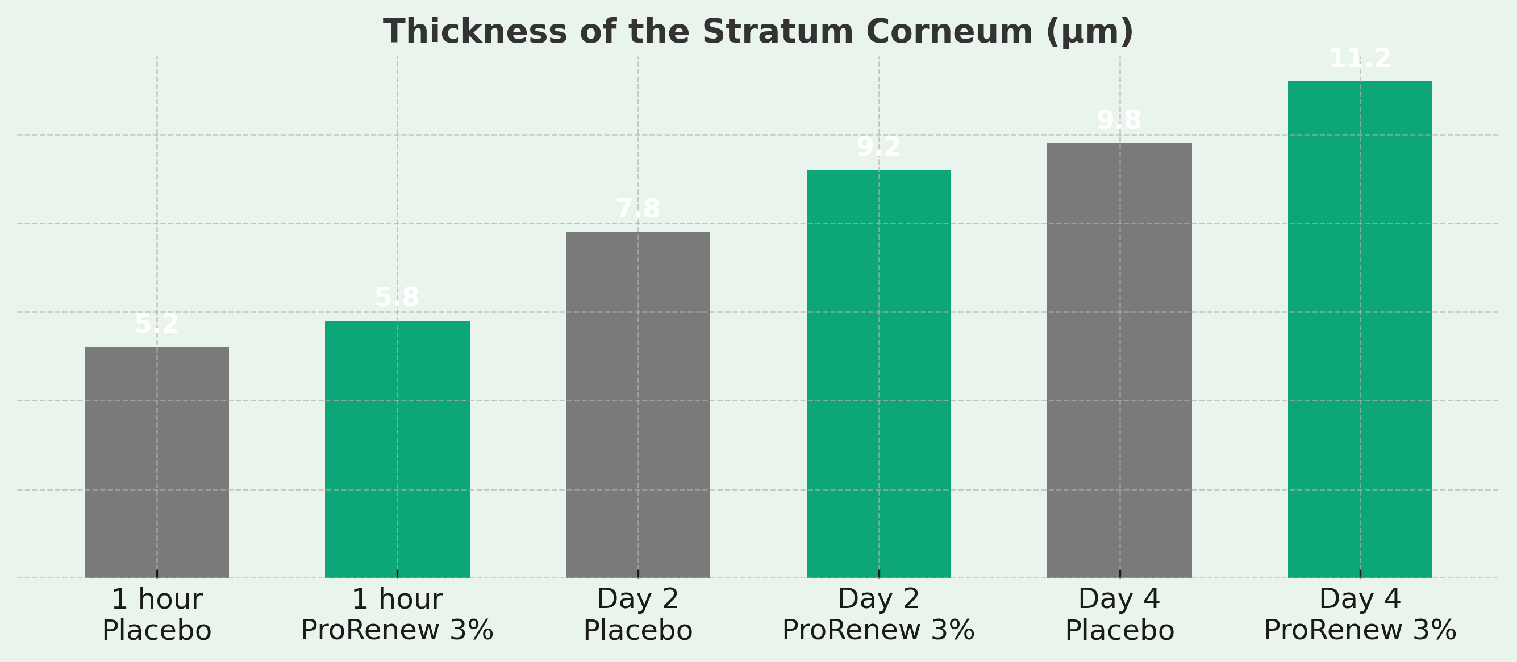
POSTBIOTIC: LACTOCOCCUS FERMENT LYSATE
Skin Renewal After Tape Stripping
Study with 5 volunteers (aged 47-63), application twice daily for 4 days after damage

Slide 13
POSTBIOTIC: LACTOCOCCUS FERMENT LYSATE
Improved barrier function (TEWL)
+17%
Improvement in barrier function vs placebo (Epidermal skin model)
+12
Increase in skin thickness (3-month study, 20 volunteers aged 55-64)
Microbiome balance
Species richness Day 7
Species diversity Day 7
68
Placebo
95
Lactococcus 3%
58
Placebo
87
Lactococcus 3%

Slide 14
Niacinamide: vitamin B3
The Multitasking Nature of Dermatological Cosmetics
Documented Mechanisms of Action:
Skin Barrier Reinforcement
Stimulates synthesis of ceramides, cholesterol and free fatty acids
Result: Reduction of TEWL by up to 24% in 4 weeks
Depigmenting and Unifying
Inhibits transfer of melanosomes to keratinocytes
Result: 35-68% reduction in hyperpigmentation in 8 weeks
Sebum and pore regulator
Reduces sebum production and visible pore size
Result: Improves the appearance of pores by 30% in 12 weeks
Anti-inflammatory
Inhibits pro-inflammatory cytokines and soothes sensitive skin
Benefit: Ideal for reactive skin with redness
The efficacy of topical niacinamide 2–5% has been documented in clinical trials published in the British Journal of Dermatology and the Journal of Cosmetic Dermatology, with improvements in barrier function, pigmentation, sebum/pores and inflammatory parameters.

Slide 15
Soy isoflavones
Liposomal Genistein - Natural Collagen Stimulator
Dual-action mechanism
Stimulates collagen production
Binds to oestrogen receptors that activate collagen synthesis Type IV: +53% in a complete 3D skin model
Prevents Degradation
Inhibits tyrosine kinase → reduces AP-1 → fewer MMPs
Protects existing collagen from enzymatic degradation
3-month study (20 volunteers aged 55-64) - 3% Lipobelle Soyaglycone
+12%
Skin thickness vs placebo
Ultrasonic measurement
Mibelle AG Biochemistry. Lipobelle™ Soyaglycone: Technical Documentation. Buchs, Switzerland: Mibelle Biochemistry; data on file.

Slide 16
COMPLEMENTARY SYNERGISTIC ACTIVE INGREDIENTS
New Generation Hyaluronic Acid: Deep Hydration - Advanced derivative that penetrates better and maintains hydration for longer.
Vitamin E: Powerful antioxidant that protects cell membranes. Synergy with green tea.
Sodium PCA: Natural moisturising factor that retains water in the skin. Intelligent hydration.
Lactic Acid: Gentle exfoliation that renews and improves texture. Smoother, more luminous skin.
Menthyl Lactate: Immediate refreshing sensation. Unique sensory experience.
Jojoba Esters: Biomimetic hydration and anti-pollution protection. Barrier reinforcement.
Kaolin (Clay): Mattifying effect - Regulates excess sebum without drying, ideal for the T-zone.
Soy Protein: Improves elasticity and firmness, natural tightening effect.

Slide 17
PRODUCTS

Slide 18
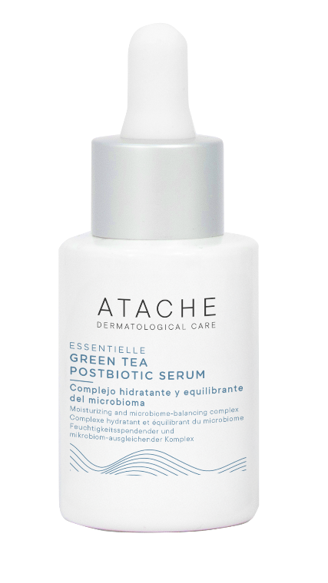
GREEN TEA POSTBIOTIC SERUM
NOW AVAILABLE
A complete serum that combines the best of nature (green tea) with scientific innovation (postbiotics) for radiant, protected and balanced skin.

Slide 19
GREEN TEA POSTBIOTIC SERUM
Deep Hydration + Radiance + Antioxidant Protection
Description
A concentrated serum with a light texture that combines the antioxidant power of green tea with advanced postbiotic technology. It intensely hydrates, evens out skin tone and protects the skin from oxidative stress while strengthening its natural microbiome.
Green Tea Extract: Key Antioxidant - Polyphenols and catechins neutralise free radicals, protect against premature ageing and provide natural radiance.
Postbiotics (Lactococcus Ferment Lysate): Microbiome Balance - Strengthens the skin barrier, stimulates cell renewal and improves the skin's defence capacity.
Niacinamide (Vitamin B3): Multi-action - Evens out skin tone, reduces dark spots, strengthens the barrier, controls shine and improves texture.

Slide 20
GREEN TEA POSTBIOTIC SERUM
New Generation Hyaluronic Acid: Provides intensive hydration: its advanced form achieves greater penetration and prolongs water retention in the skin.
Soy Isoflavones: Promote collagen synthesis, providing firmness and elasticity. Noticeable tightening effect.
Vitamin E: A powerful antioxidant that protects cells from damage. Works in conjunction with green tea.
Sodium PCA: Natural moisturising active ingredient that captures and locks water into the skin. Adaptive hydration.
Lactic Acid: A gentle exfoliant that regenerates and refines the skin's surface. More even and radiant skin.
Menthol Lactate: Provides instant freshness. Pleasant and revitalising sensation.
Jojoba Esters: Skin-friendly hydration and defence against pollution. Reinforces the skin's protective barrier.

Slide 21
GREEN TEA POSTBIOTIC SERUM
Visible benefits
Immediate
Instant intense hydration
Feeling of freshness
Smoother, more comfortable skin
Quick absorption, no residue
Perfect base for make-up
Short term (2-4 weeks)
Visibly brighter skin
More even tone
Smoother, softer skin
Reduction in redness
More rested appearance

Slide 22
GREEN TEA POSTBIOTIC SERUM
Long-term visible benefits
✓ Anti-ageing protection Prevents oxidative damage and premature signs
✓ More Resilient Skin Balanced microbiome and reinforced barrier
✓ Greater firmness Stimulation of natural collagen
✓ Balanced Skin Less sensitivity and better adaptation

Slide 23
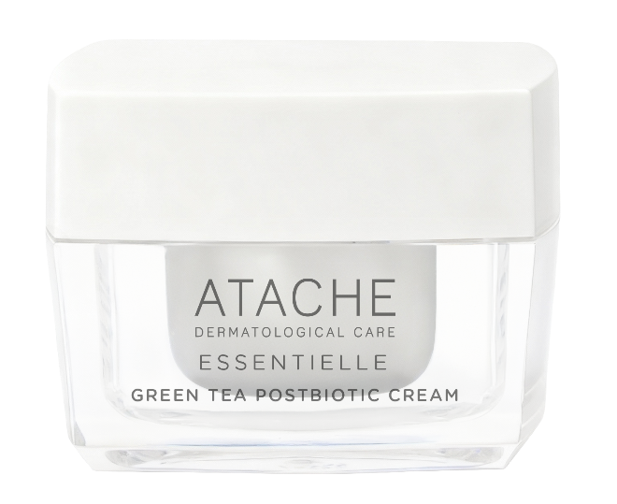
GREEN TEA POSTBIOTIC CREAM
COMING SOON
The perfect cream for those seeking real hydration without a greasy feel. Balances, protects and mattifies, perfectly suited to combination and young skin.

Slide 24
GREEN TEA POSTBIOTIC CREAM
Balanced Hydration + Daily Protection + Comfort
Description
A light facial emulsion that provides deep hydration without feeling greasy. Ideal for young, combination or dehydrated skin seeking balance, antioxidant protection and daily comfort. Its texture is quickly absorbed, leaving the skin soft, matte and protected.
Green Tea Extract: 360º Antioxidant Protection - Daily shield against pollution, UV rays, stress and free radicals.
Postbiotics: Healthy Microbiome - Maintains the skin's natural ecosystem in perfect balance.
Niacinamide: Control and Unification - Regulates shine, improves pores and unifies tone.

Slide 25
GREEN TEA POSTBIOTIC CREAM
Vitamin E: Antioxidant that enhances the action of green tea.
Hyaluronic acid: Deep, long-lasting hydration without feeling heavy.
Kaolin (clay): Mattifying effect - regulates excess sebum without drying, ideal for the T-zone.
Soy Protein: Improves elasticity and firmness, natural tightening effect.
Menthyl Lactate: Immediate freshness and soothing sensation.
Perfect texture
Light emulsion that melts into the skin · Non-comedogenic - Does not clog pores
Natural matte finish - No shine · Ideal base for make-up

Slide 26
GREEN TEA POSTBIOTIC CREAM
Benefits
Deep hydration without oiliness
Gentle mattifying effect
Daily antioxidant protection
Microbiome balance
Soothes and reduces redness
Strengthens the skin barrier
Unifies tone and texture
Feeling of freshness
Soft and comfortable skin
Suitable for sensitive skin
Problem-free daily use
Perfect makeup base
Ideal for urban living:
Anti-pollution protection + antioxidants + barrier reinforcement = Complete daily shield.

Slide 27
DIFFERENTIATING FEATURES
Feature | SERUM | CREAM
Texture | Very light, watery | Light, emulsion
Absorption | Immediate | Rapid
Finish | Fresh, invisible | Matte, smooth
Active ingredient concentration | Very high | High
Hydration | Deep, light | Deep, comforting
Ideal skin type | All, especially dehydrated | Combination, young, normal
Recommended use | Alone or under cream | As a single step or over serum
When | Morning and evening | Morning and/or evening

Slide 28
COMPLETE ROUTINE
MORNING ROUTINE
NIGHT ROUTINE
Cleansing – ESSENTIELLE MAKE UP REMOVER GEL
Toner ESSENTIELLE AQUA TONIC
SERUM – 2-3 drops, spread over face and neck
CREAM - Apply with gentle upward strokes
Eye contour LIFT THERAPY OR CVITAL
Sunscreen SPF BE SUN RANGE
Double cleansing - ESSENTIELLE TOTAL MAKE UP REMOVER + MAKE UP REMOVER GEL
ESSENTIELLE AQUA TONIC
Twice a week: ESSENTIELLE GREEN TEA MASK
SERUM - 2-3 drops, massage gently
CREAM - Apply generously for overnight treatment

