Slide 1



TRAINING

Slide 2
INDEX
PRESENTATION EXCELLENCE
MECHANISM OF ACTION
CELLULAR SENESCENCE
INGREDIENTS
PRODUCTS
PROTOCOL OF USE
PROESSIONAL PROGRAM
2

Slide 3
EXCELLENCE PRESENTATION

Slide 4
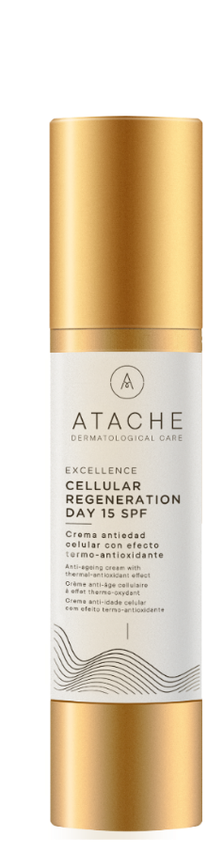
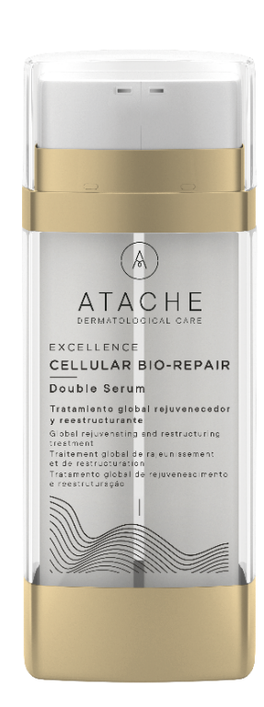
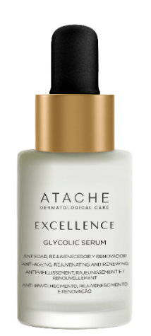
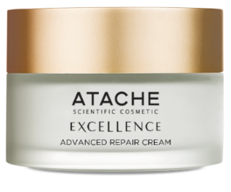
Excellence line
The Excellence line is indicated as a rejuvenating, renovating and restructuring global anti-aging treatment.
It is based on the concept of prolonging youth thanks to innovative ingredients that delay skin aging.
Both products work synergistically creating a Triple Action System of Global Anti-Aging, acting at the cellular level, improving the extracellular matrix and reinforcing the epidermis.
Designed to meet the needs of all types of skins. From mature skins, which require a rejuvenating, restructuring and renewing treatment, to younger ones, which seek to prolong and maintain the appearance and health of your face.

Slide 5
MECHANISM OF ACTION

Slide 6
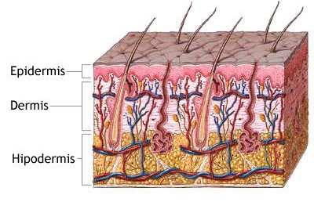
TRIPLE ANTI-AGING ACTION
The skin is made up of an outer layer of continually renewing epithelial cells, called epidermis and by an inner layer of connective tissue, called the dermis.
The main cell type in the dermis is the fibroblast., cell that synthesizes protein products such as extracellular matrix and the fibers of the connective tissue such as collagen, elastin and reticulin.
When we talk about triple anti-aging action overall excellence line, we mean that its active ingredients work in three levels:
Acts at the cellular level
Improves the extracellular matrix
Strengthens the epidermis

Slide 7
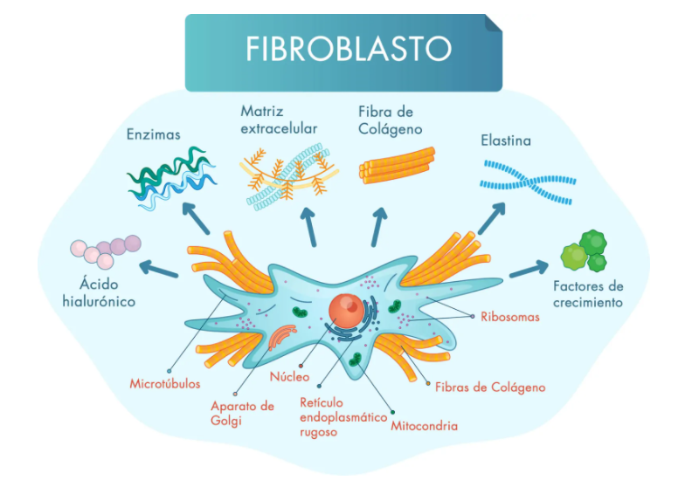
CELLS
FIBROBLASTS
They are the principal cells of the dermis, synthesize the structural components of the extracellular matrix such as collagen, elastin, reticulin and glucosaminoclucanes (hyaluronic acid).
These proteins are primarily responsible for the integrity, elasticity, firmness, smoothness and volume of the skin.
The Fibroblast senescence is linked to aging, since it involves alteration in the synthesis of the structural components of the extracellular matrix and therefore the loss of turgor, volume, elasticity and firmness of the skin.

Slide 8
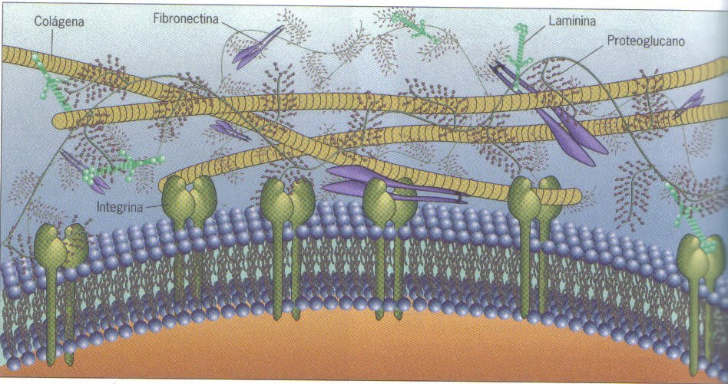
EXTRACELLULAR MATRIX
The extracellular matrix is a kind of network that connects cells, providing support and allowing interaction between them.
The extracellular matrix is ​​made up of:
Fibrous proteins: collagen, elastin and fibronectin;
Fundamental substance : gelatinous in appearance, includes macromolecules called proteoglycans, associated with long chains of hyaluronic acid.
Extracellular matrix
The extracellular matrix helps cells attach and communicate with nearby cells, and plays an important role in the cell multiplication function, cell movement and other cellular functions. It also participates in the repair of damaged tissue.

Slide 9
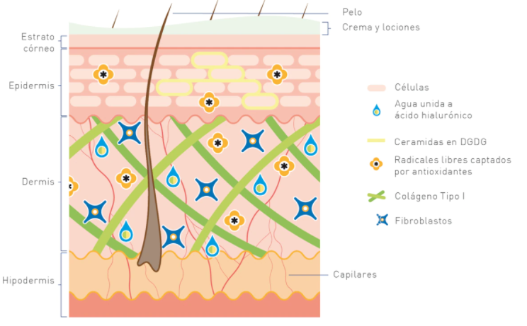
EPIDERMIS
The epidermis consists of different cell layers that form a protective barrier of epithelial cells.
The epidermis also contains a matrix of fatty substances, made up of 50% by ceramides, which protect the skin from water loss
In order to stimulate the activity and proliferation of fibroblasts, an active ingredient has to penetrate the epidermis until it reaches the papillary dermis.
Exfoliation of the upper layers of the epidermis (superficial peeling) produces a increased activity of fibroblasts and the production of collagen, hyaluronic acid and elastin

Slide 10
CELLULAR SENESCENCE

Slide 11
CELLULAR SENESCENCE
From the age of 30, the skin begins to change: its barrier protective function progressively weakens, the exchange of oxygen in the cells slows down, epidermis loses more and more moisture and its elasticity decreases.
But it is not only the epidermis the area affected by the process of skin aging; the dermis also suffers changes in its structural conditions that define more clearly the biological process of skin deterioration (lack of firmness, decomposition, paleness, etc.).
As the years pass, the metabolism of dermal cells becomes slower and slower, which influences the rate of collagen synthesis, so skin firmness and elasticity will be reduced.
The endogenous aging of the skin is genetically determined, in the same way as the senescence process of the other organs. This aging «from within» causes changes in the structure and appearance of the skin that cause the disorder of its functions.

Slide 12
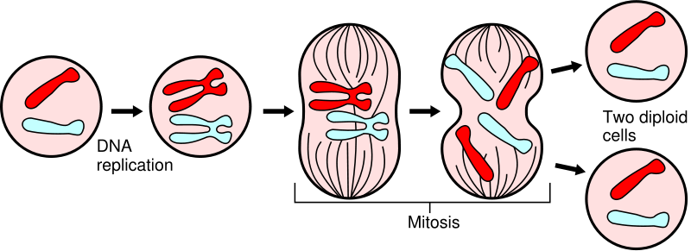
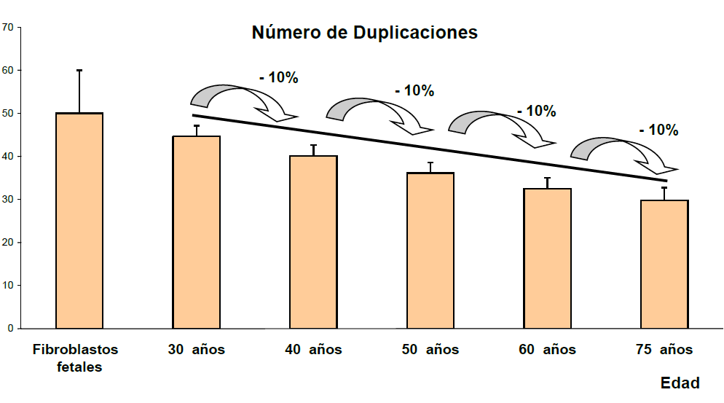
CELLULAR SENESCENCE
CELLULAR CYCLE:
The cells of our organism regenerate continuously.
The set of computer events that give rise to this phenomenon is called "Cell Cycle" and consists basically in the growth of the cell and its division into two daughter cells
The role of DNA in this process is vital, as it is the one who provides the genetic information needed to produce it. So before the cells divide, the DNA must divide, giving rise to two identical molecules.
During their lifetime the fibroblasts reproduce by mitosis up to a certain number of cell divisions, approximately 50. At the same time between division and division there is a deterioration of the functionality of the fibroblast, then they enter into senescence cell and die.
NUMBER OF REPLICATIONS OF A FIBROBLAST

Slide 13

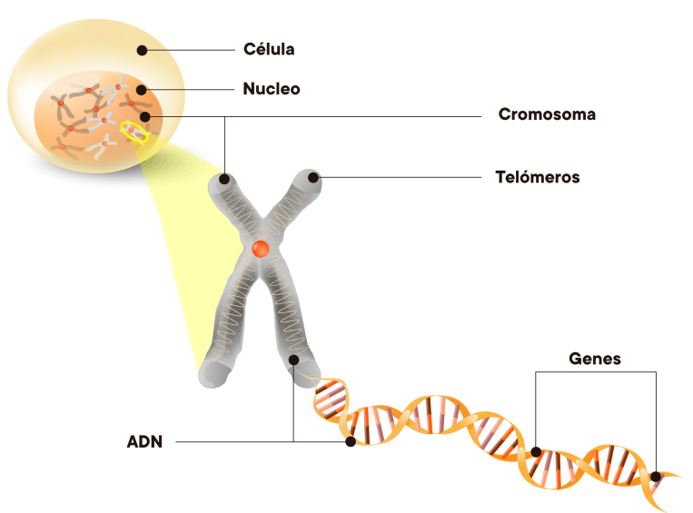
CELLULAR SENESCENCE
CHROMOSOMES AND TELOMERES
DNA is structured and organized into chromosomes. Telomeres are the ends of chromosomes and their function is the structural stability of chromosomes, cell division and cell life time
Telomeres are involved in numerous cellular functions related to chromosome stability and cell division.
As the cells replicate, the telomere becomes shorter by limiting the number of divisions and thereby limiting the functionality and life of the cell.

Slide 14
CELLULAR SENESCENCE
TELOMERASE
Adult cells shorten their telomeres in each division. This phenomenon is due to the activity of a enzyme called telomerase.
Telomerase gene expression is regulated at various levels. The best studied regulatory mechanism is that which takes place at the transcriptional level through the activity of the telomerase gene promoter, TERT.
In particular, various transcription factors and coregulators modulate TERT expression levels, often in a cell-specific manner. It is therefore suggested that the maintenance of telomere length is under the control of these coregulators.
Recent research has focused on molecules that can modify the activity of these coregulators and therefore cause changes in telomerase expression.

Slide 15
CELLULAR SENESCENCE
ZOMBIE CELLS
Cellular senescence is not only a process related only to endogenous aging, genetically conditioned by the reduction of the replicative capacity of cells.
This process can be accelerated by exogenous causes and triggers a cascade of cellular and extracellular events that lead to chronic skin degradation.
Environmental factors, sun exposure and other known factors, generate oxidation and inflammation of the skin; this results in an increase in proinflammatory markers and the accumulation of a toxic environment of cytoplasmic and mitochondrial ROS. From there begins to occur a cellular transformation towards senescence.
This process does not end there, but the senescent cells spread to other healthy cells through the exosomes and also intoxicate the extracellular matrix environment. The more senescent cells there are the faster the aging process of the other cells develops and the widespread impact. Hence the concept of "zombie cells", by the way in which some contaminate the others.

Slide 16
CELLULAR SENESCENCE
MARKERS OF SENESCENT CELLS
Aged cells show a series of markers that are increased, have accumulation of ROS and produce large amounts of pro-inflammatory cytokines and degrade collagen.
Cellular senescence implies the loss of the ability of cells to replicate to generate new young cells. Senescent cells undergo morphological changes and lose their functionality. These cells do not die inmediatelly, they remain atrophied damaging other cells and their environment.

Slide 17
EXCELLENCE ACTIVE INGREDIENTS

Slide 18
INGREDIENTS ACTION
The different active ingredients that are combined in the Excellence line, are indicated to work in three levels
CELLULAR:
Delay cellular aging by protecting the telomeres of the chromosome.
Protect and repair DNA, prolonging the proper functioning of skin cells
Reducing the impact of senescence multipliers
EXTRACELLULAR MATRIX:
Reinforce the extracellular matrix by stimulating collagen, elastin and hyaluronic acid.
Avoid the chronic degradation of ECM produced by senescent cells in their environment.
EPIDERMIS.
Stimulate cellular regeneration.
Restore skin lipid barrier function to slow water loss and maintain hydration..

Slide 19
TELOACTIVE (SCUTELARIA BAICALENSIS)
PROMOTES THE PRODUCTION OF TELOMERASE
Teloactive is the purified fraction of the extract of the roots of the Scutellaria baicalensis Georgi. Commonly known as Huangqin, it is widely used in Chinese medicine and Japanese Kambo medicine.
Several studies conclude that some of the flavonoids that make up this extract, such as baicaline, wogonine or oroxylin, induce expression of the human telomerase gene (TERT), so they can delay the aging of fibroblasts, increasing its ability to replicate, and regain the characteristics of young cells.
REDUCES THE MARKERS OF SENESCENCE
In vitro analyses of human fibroblast cultures treated with Teloactive show a clear decrease in the activity of SA-ß-galactosidase, the main marker of cellular senescence. In addition, reduced expression of proinflammatory cytokines, metalloproteinases, mitochondrial ROS and cytoplasmic, among others, that reveal the condition of senescence of cells.

Slide 20
HOLY HERB EXTRACT
CELLULAR SHIELD
It is the concentrated extract of the plant Eridictyon Californicum (Holy Herb). Its evergreen leaves are covered with a resin that protects the plant against the sun, thanks to its content rich in flavonoids, which is mainly composed of homoeriodictiol and eriodictiol.
The extract of this plant is considered protective and restorative of DNA, improving the functioning of the cell by receiving in perfect condition the inheritance transmitted in the cell division. In this way, it prolongs the proper functioning of skin cells.
DNA plays a fundamental role in cell function and renewal and is therefore essential for healthy skin. When damaged, the p53 protein, described as the guardian of the genome, is activated and its rapid action repairs DNA damage. The cell becomes viable once again and rejuvenates the skin from within by providing the energy necessary for its regeneration.
Studies show that Holy Herb extract protects and strengthens the natural mechanisms that repair DNA in cells exposed to ultraviolet stress, by activating the p53 protein.

Slide 21
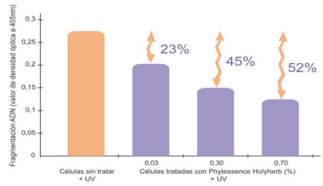
HOLY HERB EXTRACT
CELLULAR SHIELD
After sun exposure, the level of DNA fragmentation in cells caused by oxidative stress increases.
In this study, DNA fragmentation in cells treated with Holy Herb extract is reduced.
Under the same experimental conditions, Cellular Shield (Holy Herb extract) reduces the level of stress observed in keratinocytes.
This effect is demonstrated through microscopic observation of the levels activated by the p53 protein.
Cellular Shield Protective and Restorative Effect

Slide 22
EXTRACELLULAR MATRIX-ENHANCING ACTIVES
LOW MOLLECULAR WEIGHT HYALURONIC ACID: A Glycosaminoglycan type polysaccharide, synthesized by the fibroblasts. Its function is to contribute to the skin’s water balance and skin structure and is a fundamental component of the skin. Topical application of Hyaluronic Acid improves the skin’s moisturisation, elasticity and volume. It increases the skin’s firmness, by stimulating Collagen I synthesis.
SOLUBLE NATIVE COLLAGEN: Collagen is the most common and most important protein in the skin’s connective tissue. It counteracts progressive Collagen reticulation, which occurs with age, increasing the skin’s firmness and moisturisation.
SOYA GLYCOPEPTIDES: High purity Collagen I synthesis activators, which work by increasing the concentration of the same, bringing back smooth, firm young-looking skin.
MARINE ELASTIN: Protein with structural properties, which helps regain the elasticity of the skin, which is lost during aging. Restructuring, firming effect.

Slide 23
EXTRACELLULAR MATRIX-ENHANCING ACTIVES
ZINC: An essential mineral to regulate cell growth and regeneration. It inhibits collagenase production and provides the skin with a powerful anti-oxidant defence.
CALCIUM: Oligo-element which stimulates cell regeneration and regulates the skin’s protective lipid barrier. Modulates the proliferation of keratinocytes and their differentiation.
MAGNESIUM: A fundamental oligo-element to slow down the skin’s aging process. Stimulates the skin to ensure the best possible elasticity and moisturisation for younger looking skin.
PCA: Pyrrolidone Carboxylic Acid accounts for 15% of the skin’s Natural Moisturisation Factor. It plays an important role in helping recover and maintain the moisture balance in young skin.
CAVIAR EXTRACT: A nourishing phospholipid and phosphoprotein-rich complex, with energizing substances to stimulate cell regeneration, improving skin tone, firmness and elasticity.

Slide 24
EPIDERMIS-STRENGTHENING ACTIVE INGREDIENTS
HIGH MOLECULAR WEIGHT HYALURONIC ACID: Glycosaminoglycan type polysaccharide, synthesized by the fibroblasts. The high molecular weight offers an action on the upper layer, with powerful moisturisation and non-occlusive phylogenic qualities. It offers fast acting, short term and long term moisturisation, mainly of the epidermis.
VITALHEAT ANTI-OX: This biotech ferment is a powerful protector of oxidation that is activated by heat. It is a powerful photoactivated antioxidant that has proven to be highly efficient against infrared aging. It also increases the skin’s natural defense against ultraviolet damage, increases cell renewal rate and strengthens the stratum corneum.
When applied topically, VitalHeat Anti-ox has a proven ability to treat sun-damaged skin at the cellular level, increase hydration and stimulate collagen and elastin fibroblasts.
CERAMIDE COMPLEX: A concentrated restorative for the function of the skin’s lipid barrier, to prevent moisture loss, bringing back the comfort of well-balanced skin

Slide 25
EPIDERMIS-STRENGTHENING ACTIVE INGREDIENTS
GLYCOLIC ACID - ALPHA HYDROXY ACID (AHA)
Purifying and renewing active ingredient that helps to improve skin texture. Stimulates regenerative processes, helps to even skin tone and combat the complications of oily skin.
LACTOBIONIC ACID - POLY HYDROXY ACID (PHA)
Active ingredient with regenerating, antioxidant and moisturising power thanks to its galactose molecule that increases absorption and prevents transdermal water loss. It also boosts collagen synthesis, helping in epidermal restructuring and renewal.
SALICYLIC ACID - BETA HYDROXY ACID (BHA)
Active ingredient with high purifying and renewing power that acts in depth.
MALIC ACID - ALPHA HYDROXY ACID (AHA)
Malic acid is associated with a protein macromolecule derived from almonds that reduces its absorption rate, enhancing its renewing action in the superficial layers of the skin.

Slide 26
EPIDERMIS-STRENGTHENING ACTIVE INGREDIENTS
AMMONIUM HYDROXIDE: Active ingredient that adapts the pH of the hydroxy acids to the specific needs of the skin, allowing the serum to perform the desired function. It also increases the sensation of comfort after application.
ALOE VERA EXTRACT: Active ingredient with moisturising, soothing and refreshing properties. It also has antioxidant and anti-inflammatory activity and participates in the regenerative processes of the skin, enhancing the rejuvenating action of the formula.
AVENANTHRAMIDES: Found naturally in oats, these bioactive compounds can protect the skin from free radical damage. They also help reduce sensitivity, making them ideal for products targeting delicate skin, while their soothing properties help reduce redness in stressed skin. Avenanthramides are also proven to have a moisturising ability, as they penetrate deep into the skin and lock in moisture, helping to keep it soft and hydrated.
CARROT, SUNFLOWER, WHEAT GERM OILS: Stimulate cellular activity promoting faster and healthier growth, provide a protective action against environmental aggressions, have antioxidant properties and improve blood circulation in the hair follicles, which favours an optimal supply of nutrients to the eyelashes.

Slide 27
Epidermis action
HIDRÓXIDO DE AMONIO: Ingrediente activo que adapta el pH de los hidroxiácidos a las necesidades específicas de la piel, permitiendo que el suero realice la función deseada. También aumenta la sensación de comodidad después de la aplicación. EXTRACTO DE ÁLOE VERA: Ingrediente activo con propiedades hidratantes, calmantes y refrescantes. También tiene actividad antioxidante y antiinflamatoria y participa en los procesos regenerativos de la piel, potenciando la acción rejuvenecedora de la fórmula

Slide 28
Epidermis action
THERMAL SPRING WATER: Thermal spring water from the springs of Salies-de-Béarn in the Pyrenees has traditionally been used in hydrotherapy. Its high concentration of salts, minerals and trace elements such as calcium, magnesium, iron, copper and zinc decongest, repair and relax the skin to leave it glowing.
Thermal spring water is a moisturising agent that keeps skin soft and supple, helping to reduce the appearance of dry skin and flaking.
ALLANTOIN: Allantoin has a soothing and nourishing effect on the skin. It helps to maintain the skin's natural moisture levels and accelerate cell formation or regeneration. Allantoin also improves the skin structure for softer, smoother skin.
PANTHENOL: Panthenol is the precursor of vitamin B5 and has moisturising, soothing and regenerating properties. It also supports the skin's protective barrier function and improves elasticity, as well as promoting cell regeneration, reducing redness and providing comfort to the skin.
HYDROLYSED JOJOBA ESTERS: They condition the skin, maintaining its suppleness and softness thanks to their filmogenic properties, creating a protective shield and restoring the water balance.
They help to cleanse the skin without causing irritation or dryness, and they also hydrate and soften skin.

Slide 29
PRODUCTS

Slide 30
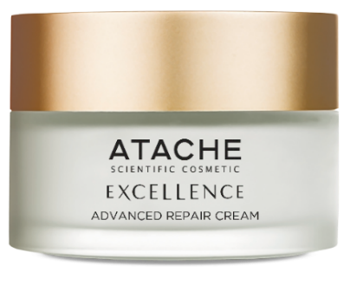
Advanced repair cream
Description:
Powerful rejuvenating treatment with a triple global anti-ageing action system. Firstly, it works intensively at cellular level, alongside the skin's renewal and repair cycle, delaying ageing thanks to its telomerase-promoting and DNA-protecting active ingredients. On the other hand, it improves the extracellular matrix, rejuvenating the structural cells of the dermis and stimulating collagen synthesis, which provides smoothness, volume and firmness. Finally, it reinforces the epidermis, intervening in the natural mechanisms of epidermal hydration, recovering elasticity, softness and skin balance.
Indications:
From mature skin, which needs a rejuvenating, restructuring and renewing treatment, to younger skin, which seeks to prolong and maintain the appearance and health of their face.
Ingredients:
Scutellaria baicalensis, Holy Herb extract, Ceramide Complex, Soya Glycopeptides and High Molecular Weight Hyaluronic Acid.
Tube Jar
50 mL

Slide 31
Advanced repair cream
BRIEF
Ingredients | Properties | Action
Scutellaria baicalensis | Activates telomerase | Cellular DNA
Holy Herb extract | Activates protein p53 | Cellular DNA
Soya glicopeptides | Activates collagen | Extracellular Matrix
AMW Hyaluronic Acid | Reinforces estructure | Extracellular Matrix
Ceramide Complex | Lipid Barrier | Epidermis

Slide 32
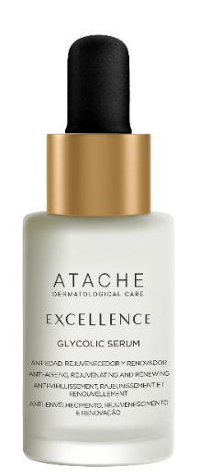
Glycolic serum
Description:
Powerful anti-ageing serum, formulated with an exceptional combination of alpha-, beta- and polyhydroxy acids, which rejuvenates the skin through a skin-renewing effect. Reduces imperfections, deeply cleanses impurities, revitalises and evens skin tone. It contains active ingredients that adapt the pH of the formula to 3.5, adjusting it to the specific needs of the skin, allowing the hydroxy acids to perform the desired function and increasing the sensation of comfort after applying the serum.
Indications:
Anti-ageing, rejuvenating and repairing treatment indicated for all skin types seeking both a rejuvenating effect and to fight against the first signs of ageing. The renewing, moisturising and purifying effect is visible from the first applications
Ingredients: Glycolic Acid, Lactobionic Acid, Salicylic Acid, Malic Acid, Ammonium hydroxide and Aloe Vera extract
Dropper Botlle
30 mL

Slide 33
GLYCOLIC SERUM
BRIEF
Ingredients | Properties | Action
Glycolic Acid | Renewing | Epidermis
Lactobionic Acid | Renewing | Epidermis
Salicilic Acid | Renewing | Epidermis
Malic Acid | Renewing | Epidermis
Amonium Hidroxide | Regulates PH | Epidermis
Aloe Vera extract | Moisturizing | Epidermis

Slide 34

CELLULAR REGENERATION DAY 15 SPF
REGENERATING CREAM
DESCRIPTION:
Exceptional day cream that incorporates in its formula two effective ingredients that help prolong the youth of the skin: The innovative TeloActive, which delays the signs of cellular senescence by activating telomerase, and the powerful Cellular Shield that protects and repairs DNA. With solar filters and thermoactive antioxidant.
INDICATION
Day cream designed to meet the needs of mature skin, which require a rejuvenating, restructuring and renovating treatment.
INGREDIENTS: Teloactive (Scutellaria baicalensis), Cellular Shield (Santa Grass Extract), Vitaheat Anti-Ox (Thermus Thermophilus)

Slide 35
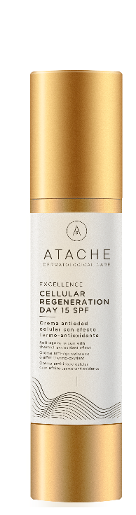
CELLULAR REGENERATION DAY
BRIEF
Ingredients | Properties | Action
Scutellaria baicalensis | Activates telomerase | Cellular DNA
Extracto de Hierba Santa | Activates protein p53 | Cellular DNA
Thermus Thermophillus | Antioxidant | Epidermis
Filtros solares | Sun protection | Epidermis

Slide 36
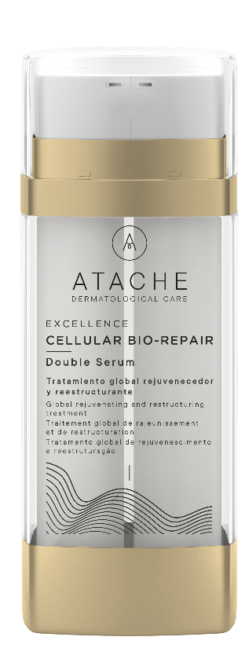
CELLULAR BIO-REPAIR DOUBLE SERUM
Description:
Double serum that fights the signs of the degeneration process of senescent fibroblasts and maintains the vitality of skin cells in optimal condition. It is combined with a formulation of essential bioelements that activate the biological mechanism of cell regulation and regeneration and delay skin aging. It also acts as an antioxidant, reinforces the lipid barrier and stimulates elasticity and collagen synthesis.
Indications:
For all skin types seeking to delay the signs of aging by slowing the spread of aging cells and minimizes the damage they cause thanks to its combination of active ingredients that maintain cellular metabolism in optimal condition.
Ingredients: Teloactive (Scutellaria baicalensis), Cellular Shield (Yerba Santa extract), Zinc, Calcium, Magnesium y Pirrolidin Carboxílic Acid
Doble Airless
30 mL

Slide 37
CELLULAR BIO-REPAIR DOUBLE SERUM
RESUMEN INGREDIENTES
Ingredients | Properties | Action
Scutellaria baicalensis | Activates telomerase | Cellular DNA
Extracto de Hierba Santa | Activates protein p53 | Cellular DNA
Bioelements | Cellular regeneration | Epidermis
Native Collagen | Firming | Extracellular Matrix
Marine elastine | Reestructuring | Extracellular Matrix
LMW Hialuronic acid | Firming | Extracellular Matrix

Slide 38
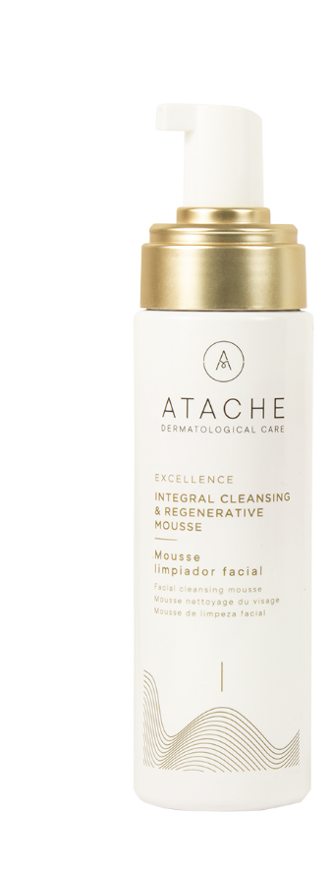
integral cleansing & regenerative mousse
Description:
Powerful facial cleansing mousse suitable for all skin types, including sensitive skin. Made with thermal spring water and enriched with cleansing active ingredients and a boosting complex with glycolic acid and lactic acid, it provides a comprehensive, express cleanse and achieves an immediate renewed skin effect.
The result is a mousse that turns cleansing into a pleasant experience and gently yet efficiently cleanses and moisturises the skin.
Indications:
Recommended for all skin types to achieve a gentle, deep cleansing effect, removing all traces of impurities and leaving skin feeling revitalised and hydrated.
Ingredients: Thermal Water, Surfactants,, Hydrolysed jojoba esters, glycolic acid, lactic acid.
Self-foaming
200 mL

Slide 39
ph balance & descongestive thermal mousse
Description:
Foaming facial toner for all skin types with thermal spring water, avenanthramides, allantoin, panthenol and Biocell Active Complex: an excellent combination of trace elements that activate cell metabolism. Each of these ingredients provides specific benefits that help keep the skin soft, soothed and hydrated. Together, they help cleanse, soothe and tone the skin while keeping it smooth, hydrated and rejuvenated.
Indications:
Recommended for all skin types to achieve a gentle, deep cleansing effect, removing all traces of impurities and leaving skin feeling revitalised and hydrated.
Ingredients: Thermal Water, Avenantramides, Alatoine, Panthenol, Zinc, Calcium, Magnesium
Self-foaming
200 mL

Slide 40
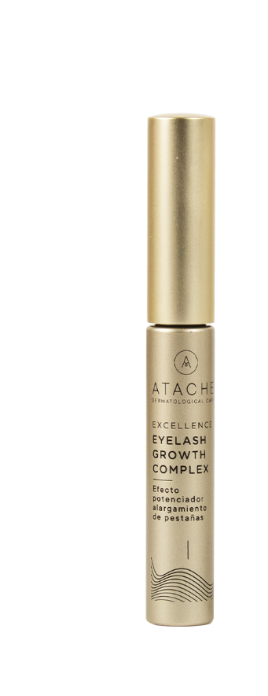
EXCELLENCE EYELASH GROWTH COMPLEX
Description :
Applicator brush with an exclusive eyebrow and eyelash lengthening and enhancing formula. dermatological and ophthalmological studies that confirm EXCELLENCE EYELASH GROWTH COMPLEX causes a length enhancing effect on eyelashes and a healthier appearance
- 85% of volunteers surveyed believe THEIR EYELASHES WERE LENGTHENED after continued use of the product.
- 65% of volunteers surveyed believe THEIR EYELASHES LOOKED HEALTHIER after continued use of the product.
Indications:
Treatment over 28 nights to enhance eyelash growth. . It is easily applied to clean, dry eyelids, helping to stimulate the roots of the eyelashes, encourage their growth and strengthen existing lashes.
Ingredients: Carrot, Sunflower, Wheat Germ Oils.
Brush
5 mL

Slide 41
PROTOCOL OF USE

Slide 42
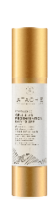
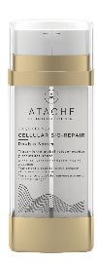
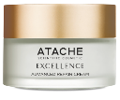

Protocol of use
1
Day: Apply the CELLULAR REGENERATION DAY 15 SPF in the morning after the double makeup remover system.
Night: CELLULAR BIO-REPAIR DOUBLE SERUM Take a small amount from each of the dispensers and warm the mixture in your hands. Apply with a pleasant massage to the face, neck and décolletage
2
2
Advanced Repair Cream: Then apply the cream to the face neck and neckline, performing a gentle massage with the fingertips until completely absorbed.
Glycolic serum: Apply a thin layer all over the face and leave for 10 minutes
3

Slide 43
PROFESSIONAL PROGRAMME

Slide 44
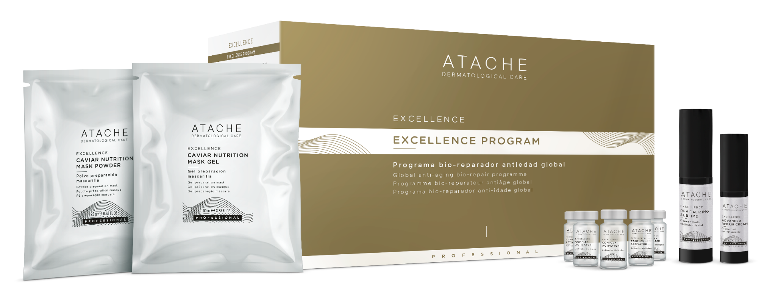
EXCELLENCE BIO REPAIR PROGRAM

Slide 45
EXCELLENCE BIO REPAIR PROGRAM
PROFFESIONAL TREATMENT
EXCELLENCE global anti-aging treatment has been conceived to meet the most demanding needs of mature skin. Its powerful formula is based on high concentrations of new ingredients, which work together and fight the skin’s aging process by means of diverse mechanisms.
At a deeper level, acts delaying skin cell aging, and leading to the recovery of better fibroblast function.
It protects and repairs the DNA, improving cell function, by ensuring the perfect transmission of hereditary qualities during cell division. In this way it prolongs better skin cell function.
Outside the cells, it reinforces the matrix, making the skin smooth, full, supple, moisturised and bright, qualities which are lost over time
On the epidermis, it helps maintain perfect moisturisation and the nourishment, bot so important for healthy, balanced skin.

Slide 46
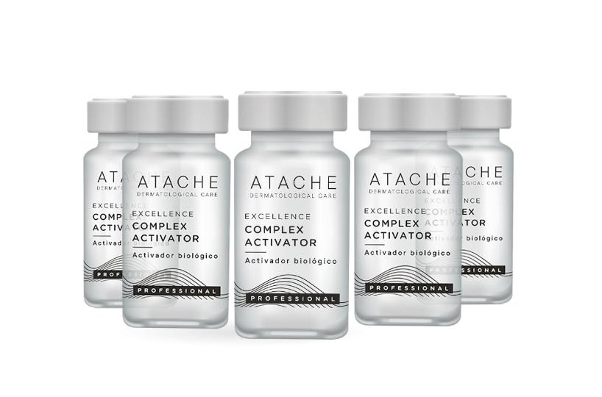
COMPLEX ACTIVATOR
DESCRIPTION
An efficient combination of essential oligoelements for cell regulation and regeneration, which delays skin aging. Its Zinc, Calcium and Magnesium content provides a powerful anti-oxidant defence to the skin, improving elasticity and providing excellent moisturisation.
INGREDIENTS:
Calcium, Magnesium, Zinc and Pyrrolidine Carboxylic Acid
PRESENTATION:
5 vials x 5 mL
HOW TO USE: Apply one vial using different optional techniques: manual, virtual mesotherapy, radiofrequency or lonization

Slide 47
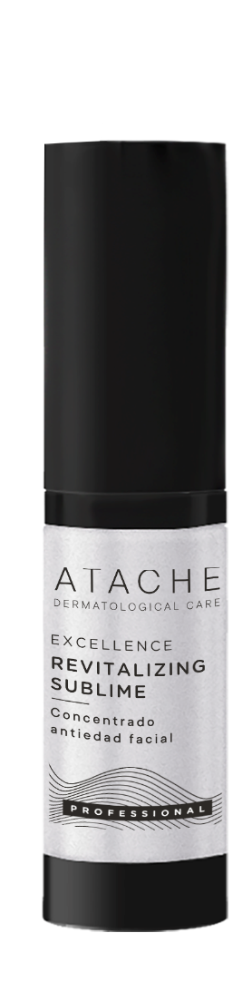
REVITALIZING SUBLIME
DESCRIPTION
An exceptional brand new formula anti-aging serum, which acts by delaying skin cell aging. Thanks to its restructuring properties, the face becomes visibly younger after the very first application. This delicate, silky-texture emulsion brings back all the skin’s elasticity and beauty.
INGREDIENTS:
Scutellaria baicalensis, Holy Herb extract, Native Soluble Collagen, Marina Elastin and Low Molecular Weight Hyaluronic Acid.
PRESENTATION:
Airless 30 mL
HOW TO USE: Apply 20 doses-pulsation, performing EXCELLENCE MASSAGE

Slide 48
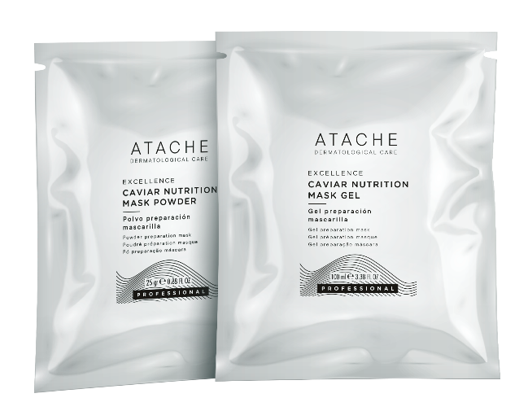
CAVIAR NUTRITION MASK
DESCRIPTION
An innovative two-step alginate mask with Caviar Extract, for optimum combination. Thanks to its Caviar content, it stimulates cell regeneration, helping toning, firming and elasticity of the skin. Its occlusive effect enhances the penetration of the ingredients provided during EXCELLENCE professional treatment.
INGREDIENTS:
Caviar Extract, Calcium and Magnesium.
PRESENTATION:
POWDER: 5 sachets x 25 gr. + GEL: 5 sachets x 100 ml
HOW TO USE: Mix the contents of both sachets and beat the mixture until it becomes a smooth paste. Then apply the mixture to the face, neck and d colletage and let it dry for 10 minutes

Slide 49
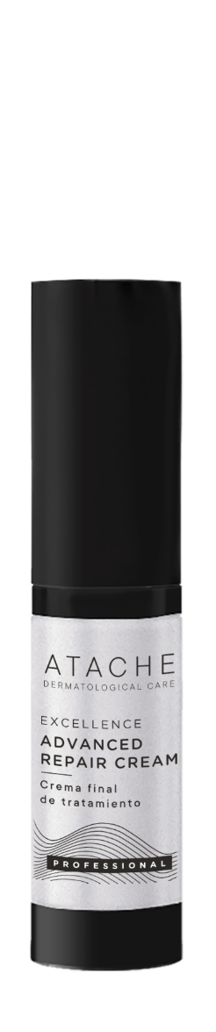
ADVANCED REPAIR CREAM
DESCRIPTION
An exceptional all round anti-aging treatment for thorough regeneration through its intensive action. Its exclusive formula works by delaying skin cell aging. The face becomes firm and smooth, like younger skin. Its enveloping texture leaves you with a unique sensation, as the final touch of the treatment.
INGREDIENTS:
Scutellaria baicalensis, Holy Herb extract, Ceramide Complex, Soya Glycopeptides and High Molecular Weight Hyaluronic Acid.
PRESENTATION:
Airless 15 mL
HOW TO USE: Apply 10 doses-pulsation, performing GEISHA ANMA massage until it is fully absorbed.

