Slide 1



TRAINING

Slide 2
INDEX
PRESENTATION LIFT THERAPY
SKIN AGING: FLACIDITY
INGREDIENTS
HOME CARE PRODUCTS
PROESSIONAL PROGRAM
2

Slide 3

PRESENTATION

Slide 4
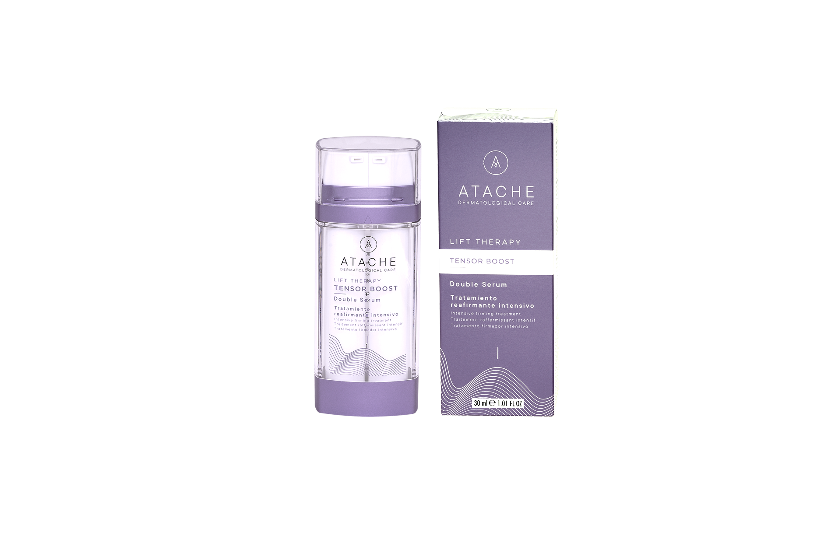
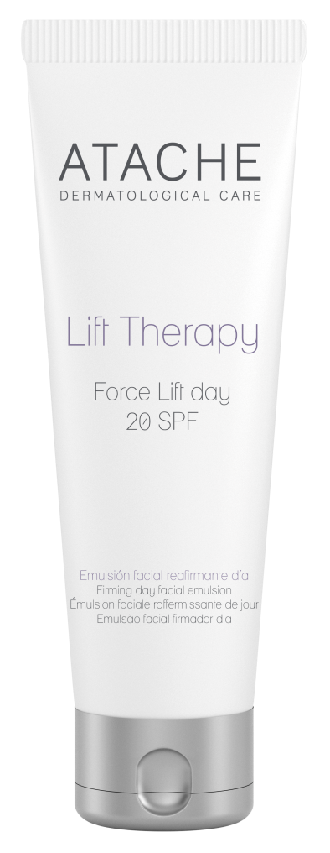
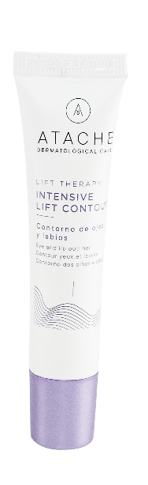
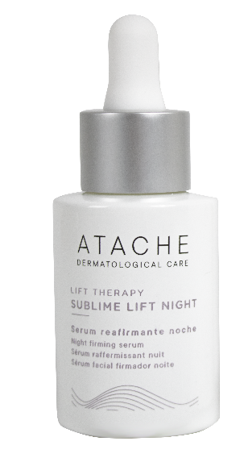
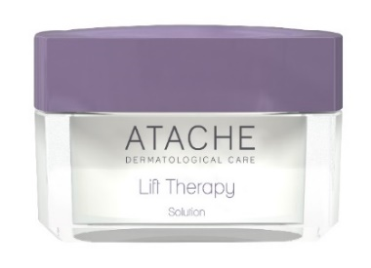
LIFT THERAPY - PRESENTATION
The LIFT THERAPY line combines an effective combination of firming, moisturizing and regenerating active components whose cosmetic lifting effect is evident throughout the skin of the face and neck.
The powerful synergy of its active ingredients: HYALURONIC ACID, TensorPep 8 (the alternative to BOTOX) and SnakePep 3 (SNAKE VENOM) and SOY ISOFLAVONES, provides firmness, elasticity and hydration to the skin.

Slide 5
SKIN AGING: FLACIDITY

Slide 6
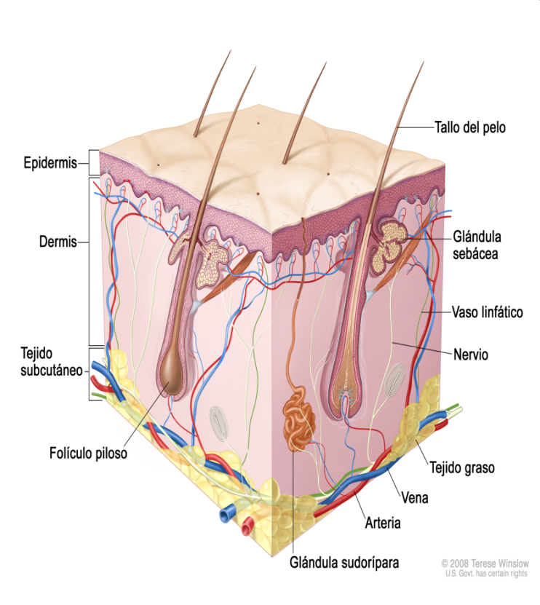
DERMIS
The dermis is the middle layer of the skin, found under the epidermis, and above the hypodermis.
On the back is the maximum thickness. The dermis sends the nutrients to the epidermis.
In the dermis we find, cells, elastic collagen and reticulin fibers, fundamental substance, vascular network, nervous, lymphatic and skin attachments.
The dermis is 20-30 times thicker than the epidermis, in it are the skin attachments, which are of two types: corneas (hairs and nails); glandulars (sebaceous and sweat glands).

Slide 7
DERMIS FIBRES AND COMPONENTS
The collagen fibers are distributed in all directions, however they are predominantly oriented oblique to the epidermis.
Elastic fibres: similar to the previous ones, they differ from them because they are thinner, shiny and homogeneous. They branch into networks. They are endowed with remarkable elasticity, they have a characteristic protein called elastin.
Reticulin fibers: They are very thin, resistant, branched. They are formed by transversely striated fibrils. They are more resistant than collagen fibers.
Hyaluronic acid is a molecule that is naturally present in all living organisms. It is generated by our body from birth to promote and regulate the hydration of the epidermis. It has the ability to absorb and retain large amounts of water in the skin.

Slide 8
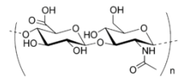
HIALURONIC ACID
The amount of Hyaluronic Acid that we synthesize naturally determines the elasticity and firmness of our skin.
At an early age, we generate high quantities; over the age of 40, their production is halved and at 60, barely reaches the 10% of what our body produced at birth.
The most visible effects of this reduction of Hyaluronic Acid in our body are the appearance of the first wrinkles of expression, alterations in the elasticity and flexibility of the skin, decrease in turgidity, greater roughness to the touch and dryness.

Slide 9
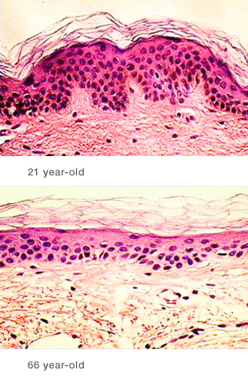
Change in bio-chemical and structural parameters
Degeneration of collagen and elastic fibers.
Degeneration of the microvascular system.
Reduction of hair density.
Reduction in the capacity of metabolism.
Increased dryness, caused by the degradation of glycosaminoglycans.
Microscopic view through the skin of a 21-year-old and a 66-year-old.

Slide 10
LIFT THERAPY PROPERTIES
It reactivates and balances cellular metabolism and protein synthesis.
Moisturizes and strengthens the skin’s ability to retain water.
Prevents and delays skin aging.
Protects and reaffirms the contour of the facial oval. Wrinkles are blurred.
Corrects sagging neck and double chin.
The skin regains its softness, smoothness and splendor.

Slide 11
INGREDIENTS

Slide 12
MAIN INGREDIENTS
Hyaluronic acid
Hyaluronic acid has the ability to retain water by a percentage equivalent to thousands of times its weight. That is why it is used for hydration of the epidermis as it reconstitutes the fibers that support the skin tissues. At an early age, we generate high quantities; over the age of 40, their production is halved and at 60, barely reaches the 10% of what our body produced at birth.
Hydration of the skin and improvement of fluid absorption of cells.
It serves as a collagen support and encourages its production.
Prevents premature aging of the skin.
Helps in the recovery of connective tissue, strengthens ligaments and tendons.
It creates volume and is the perfect structure to perform facial fillings with natural results.
High molecular weight Hyaluronic acid: has action at the surface level, high hydrating power,
Low molecular weight hyaluronic acid: it is able to penetrate the skin, reaching deep levels of the epidermis to the basal layer.

Slide 13
MAIN INGREDIENTS
The molecular mechanism involved in skin aging is directly related to:
•Changes in conformation of the collagen triple helix.
•Degradation of elastin polypeptides.
•Disorder in the packaging of the skin’s lipid matrix.
These can be significantly avoided by modulating repeated contraction of facial expression muscles.
TensorPep 8 and SnakePep 3 are Botox-Like peptides, which act by attenuating muscle contraction and relaxing facial muscles, preventing the formation of wrinkles and reducing the appearance of fine lines. The mechanisms of action of these two ingredients are complementary and the action of fight against expression wrinkles is enhanced.
Octapeptide prevents the release of acetylcholine from nerve termination.
Tripeptide: prevents reception by its receptors located in the muscle.

Slide 14
MAIN INGREDIENTS
TensorPep 8 In vivo test of anti-wrinkle activity
Trial with 17 volunteers applied a cream containing 10% TensorPep 8 around the eyes, twice a day for 28 days.
•Silicone molds were obtained from the treated area before treatment and after 28 application days.
•The molds were analyzed by laser confocal microscopy to study the evolution of the skin before and after treatment.
RESULTS
Maximum reduction -63.23%
Average reduction 34.98 per cent

Slide 15
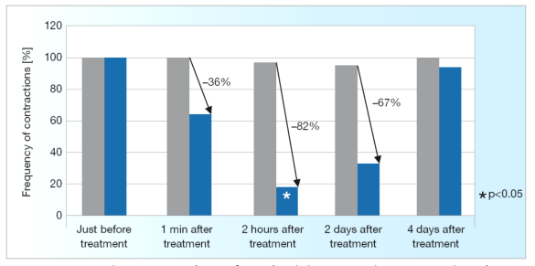
MAIN INGREDIENTS
SnakePep 3 In Vitro Efficacy
Contraction of muscle and innervated cells.
• it reduces muscle cell contraction.
• Its action is fast, durable and fully reversible.
Frequency of contraction as a function of post-incubation time
(Peptide Concentration: 0.5 mM)

Slide 16
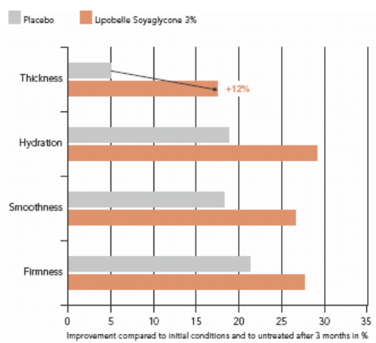
Main ingredients
Soy isoflavones
Genistein, the most abundant biological asset of Soy Isoflavones is a powerful collagen enhancer. It has an estrogenic effect and is an inhibitor of the protein tyrosine kinase, which can positively influence the collagen content.
It has re-densifying effect. According to in vivo studies, increased skin thickness 12% after 3 months. This indicates a stimulation of the production of extracellular matrix components such as collagen, elastin and proteoglycans. In addition, an overall improvement in skin firmness, softness and hydration was observed.

Slide 17
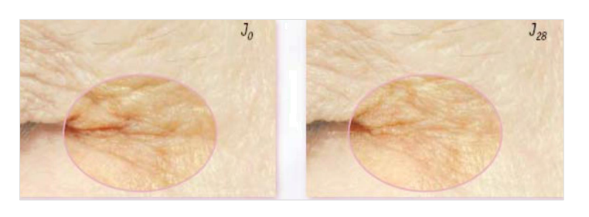
Main ingredients
Spillanctes Acmella
Spilantes Acmella extract is a new concentrated firming and anti-wrinkle active that stimulates the natural firming capacity of the skin that has been shown to reorganize and recover the fabric of collagen fibers.
Its action on the support tissue allows to quickly reorganize collagen fibers and visibly smooth the skin. Allows to attenuate the set of wrinkles and reduce the most striking signs of aging, the wrinkled appearance of the skin
.
Clinical Trial
28 women aged 45-65 years, application twice /day for 28 days.
Before/after photos show
Smoothing action of the Spillanctes Acmella
Visible decrease of wrinkled skin appearance

Slide 18
MAIN INGREDIENTS
Nicotinamide
Niacinamide is a derivative of vitamin B3 that has multiple properties, including moisturizing action and improved skin barrier function. It is a water-soluble and stable molecule, which has a high penetration capacity in the skin at a neutral pH.
Stimulates the production of lipids and the formation of collagen and elastin in the body. The result is a firmer and softer complexion that gains elasticity.

Slide 19
Main ingredients
Marine collagen
Collagen is the major and most important protein in the connective tissue of the skin. It counteracts the progressive cross-linking of collagen that occurs with age, increasing the skin's firmness and water content and has a superficial physical effect on the epidermal layer that significantly smoothes small wrinkles.
Organic silicon
Organic silicon is an essential trace element that has very powerful effects against skin ageing and flaccidity. It is a mineral that, among other properties, has the ability to generate collagen in a natural way.
Organic silicon has a profound activity in the skin's connective tissue and therefore has a restructuring and cellular regeneration effect.

Slide 20
Main ingredients
Beeswax
Beeswax has a unique composition, with non-occlusive, non-comedogenic, antioxidant and very low irritant properties. It is moisturising and nourishing: it has the ability to trap natural moisture and create a protective layer on the skin, which prevents skin dehydration and dryness. It protects the skin from damage caused by external agents and keeps it well hydrated and extremely soft.
Jojoba esters
It is a vegetable protein extracted from jojoba seeds with a great moisturising power without giving a greasy sensation, it has very good penetration into the skin, it also has antioxidant properties and prevents wrinkles and neutralises free radicals. It creates a light and smooth texture for younger, radiant and hydrated skin. It also protects the skin from environmental aggressions.

Slide 21
HOME CARE PRODUCTS

Slide 22
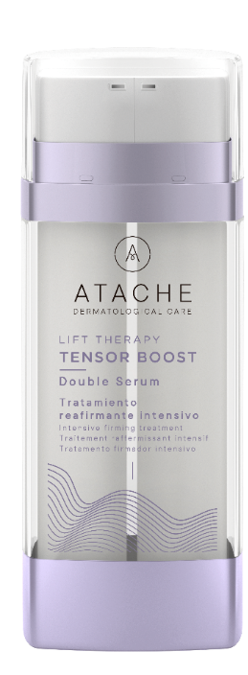



Products LIFT THERAPY LINE
Reestructuring and tensor serum
Firming
serum
Volumizing cream against flaccidity
Redensifying cream that improves elasticity
Eye and lip contour, tensor effect
TENSOR BOOST
SUBLIME LIFT NIGHT
LIFT THERAPY SOLUTION
FORCE LIFT DAY
INTENSIVE LIFT CONTOUR

Slide 23
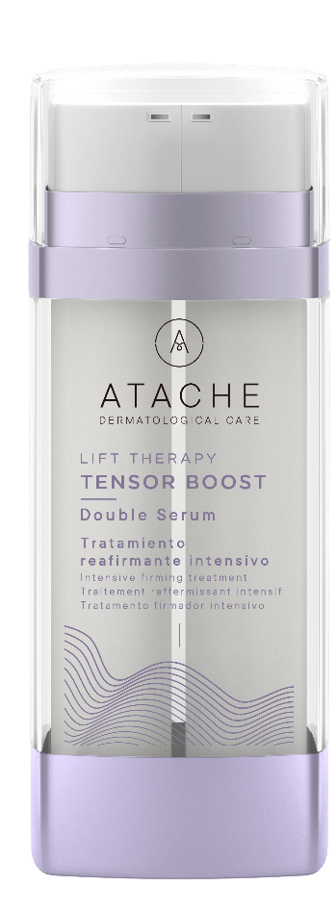
TENSOR BOOST
SERUM 30ml Restructuring Tightening SERUM
DESCRIPTION: Double intensive firming serum that acts on the deepest layers of the epidermis and on the skin's extracellular matrix. It combines the restructuring action of organic silicon with the immediate smoothing effect of marine collagen. Together with tensor peptides, which attenuate wrinkles, and low molecular weight hyaluronic acid, it manages to combat loss of firmness.
INDICATIONS: Helps prevent sagging and combat the signs of ageing by reinforcing the structure of the dermis, targeting cellular dynamism and stimulating the biomechanical functions of the fibroblast.
INGREDIENTS: High and low molecular weight hyaluronic acid, marine collagen, organic silicon, tensor peptides, Spillantes acmella extract, jojoba esters and beeswax.
DIRECTIONS FOR USE: Night: Apply 2 pumps of product (depending on face size and skin type) to cleansed face in the evening.

Slide 24
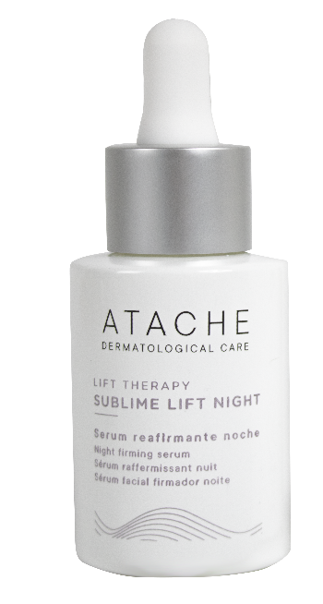
Sublime lift night
SERUM 30ml Moisturizing and firming action
INDICATION:
Skins that show flaccidity or dehydration due to aging. Ideal from the age of 20.
ACTION:
DSH CN (Acid Hyaluronic of high molecular weight) bonded to organic silicon: it has action at the surface level, high moisturizing power, with cytostimulant activity on fibroblasts, enhancing the hydration and firming.
RENOVHYAL, With a lower molecular weight, it is capable of penetrating the skin, reaching deep levels of the epidermis up to the basal layer, being able to retain and provide 70% water, hydrating the entire skin structure. The firmness of the skin is enhanced by the stimulation of type I collagen production in the dermis.
HOW TO USE:
Night: Apply 5-10 drops of product at night (depending on the size of the face and skin type), on the face after cleaning
TYPE OF SKIN: All

Slide 25
Sublime lift night
FEATURES:
  Container:
  Body: Glass bottle with dispenser dropper
  Colour: Transparent serum
  Touch: Immediate absorption that generates a fresh sensation and immediate hydration
INGREDEINTES:
Spillantes Acmella - Soya Isoflavones – HMW Hialuronic Acid - LMW Hialuronic Acid – Octapeptide - Tripeptide

Slide 26
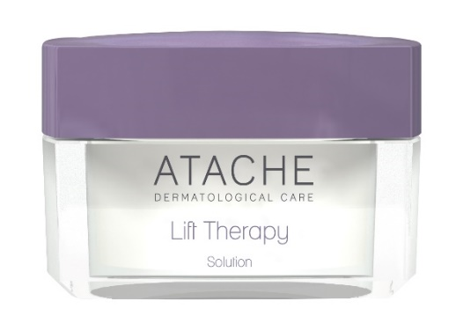
LIFT THERAPY SOLUTION
CREAM 50ml Firming action (Fluid and silky texture)
INDICATION: Firming treatment indicated especially for mature skin that seeks to combat the loss of firmness and elasticity of the skin.
DESCRIPTION:
The combination of tensing and structuring actives increases firmness, reduces skin flaccidity and fights volume loss, reducing wrinkles and expression lines, through a visible filler effect. Its silky texture and easy extension provide deep smoothness and skin comfort.
INGREDIENTS: Spillantes Acmella – Nicotinamide - HMW Hialuronic Acid - LMW Hialuronic Acid – Octapeptide - Tripeptide
HOW TO USE:
Apply in the morning and at night, after sublime lift night
TYPE OF SKIN: All

Slide 27
Force lift day
DAY CREAM 50ml Firming action (Fluid and silky texture)
INDICATION: Hydration of skins that show flaccidity or dehydration due to aging.
ACTION:
Silky fluid texture formula with an immediate tightening effect that provides protection against UVB (SPF20) and UVA radiation. Activates the biomechanical functions of collagen and elastin fibroblasts, increasing the elasticity of the skin.
INGREDIENTS: Spillantes Acmella - Soya Isoflavones - UVB (SPF 20) and UVA sun filters.
HOW TO USE: Day: Apply in the morning, after cleaning.
TYPE OF SKIN: All
* Spillantes Acmella : It is a new firming concentrated active ingredient that stimulates the skin's own natural firming capacity.

Slide 28

Intensive lift contour
Eye and lip contour cream 15ml Firming action
INDICATION: Sagging skin around the eyes and lips.
ACTION:
Formula based on an exceptional combination of principles that intervene naturally and in synergy, firming the area around the eyes and lips. The results are increased due to its complementary anti-wrinkle action, by relaxing the facial muscles and filling and hydrating the wrinkle furrow.
INGREDIENTS Spillantes Acmella– HMW Hialuronic Acid - Octapeptide - Tripeptide
HOW TO USE: Day: Apply in the morning, after cleaning.
TYPE OF SKIN: All
*TensorPep 8: Reduces the depth of facial wrinkles caused by shrinkage
of the muscles of facial expression,
* SnakePep 3: It's a tripeptide synthetic that acts against expression lines by relaxing the facial muscles.

Slide 29
PROFESSIONAL PROGRAM

Slide 30
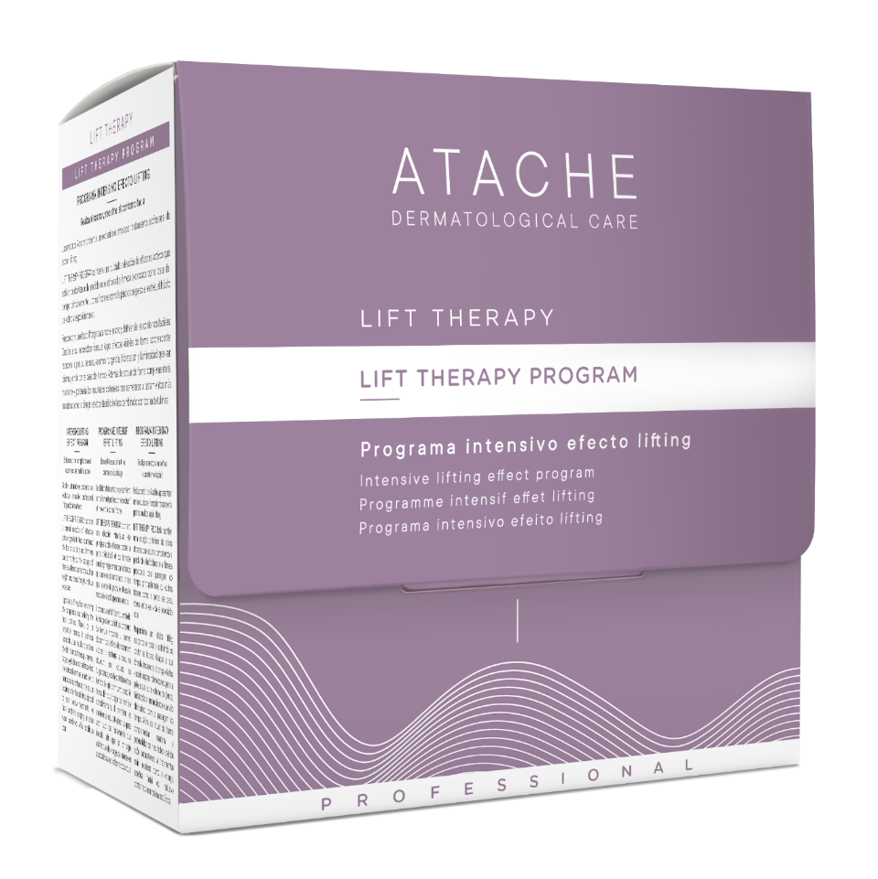
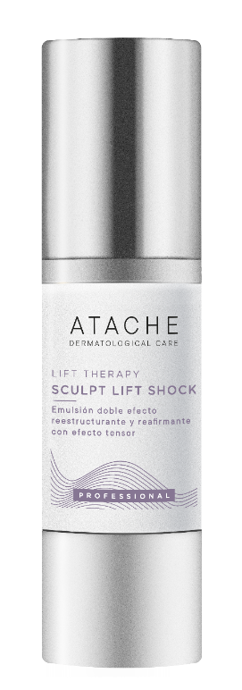
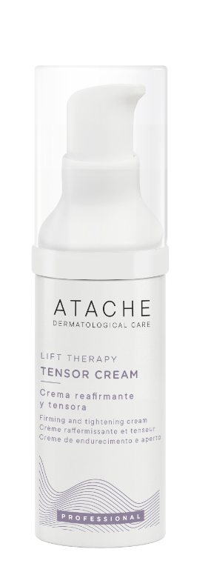
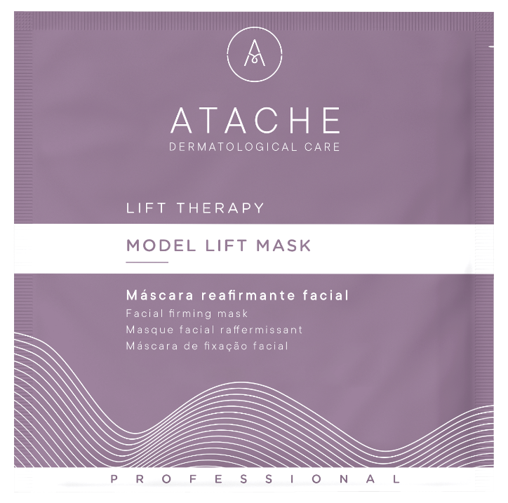
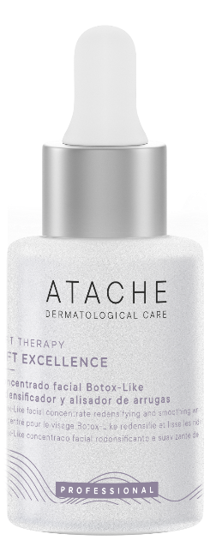
PROFESSIONAL PROGRAM

Slide 31
LIFT THERAPY FIRMING PROGRAM
PROFFESIONAL TREATMENT
A new professional treatment concept for facial lifting, the alternative to cosmetic surgery. The revolutionary formula combines Hyaluronic Acid, Soya Isoflavones, Essenskin® and Spillantes Acmella to fight against the loss of volume and firmness.
LIFT THERAPY PROGRAM, acts on the architecture of the dermis, naturally activating and reorganising collagen and elastin. Increases the skin’s moisture content, density and adds firmness, making it visibly smoother and adding surprising redefinition to the facial outline
RECOMMENDED TO:
Combat the loss of elasticity and firmness caused mainly by the passage of time, alongside other important factors such as weight loss, lifestyle and exposure to the sun.

Slide 32

SCULPT LIFT SHOCK
SCULPT LIFT SHOCK: Restructuring and firming emulsion with tightening effect
Presentation 30 ml airless
Description:
Double restructuring and firming emulsion capable to reorganise collagen fibres thanks to an innovative organic bioingredient that has a profound activity on the cutaneous connective tissue.
Ingredients:
Spillantes Acmella, High Molecular Weight Hyaluronic Acid, Collagen and Silicium.
Instructions for use: Apply 20 doses-pulsation massage always upwards in direction, until completely absorbed.

Slide 33
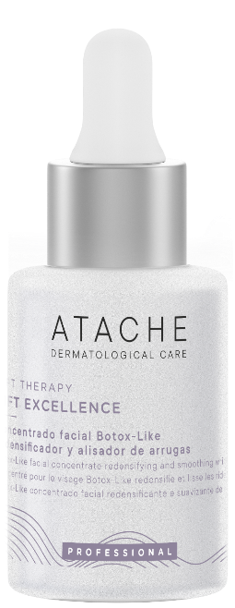
LIFT EXCELLENCE
LIFT EXCELLENCE: Wrinkle smoothing and redensifying "botoxlike" face concentrate
Presentation: 30 ml dropper
Description: Redensifying and wrinkle-smoothing "BotoxLike" facial concentrate with low-molecular-weight hyaluronic acid and tensor peptides to combat loss of firmness and restore the skin's natural lifting properties.
Ingredients: Low Molecular Weight Hyaluronic Acid, tensor peptides, niacinamide, jojoba esters and beeswax.
Instructions for use: Apply 12 pippetes and massage always upwards in direction, until completely absorbed.

Slide 34
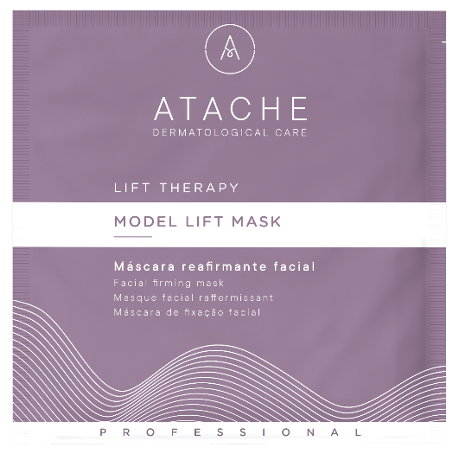
Model fit mask
MODEL LIFT MASK: Facial Firming Mask
Presentation: 5 units x 30 grams
Description: A brand new Peel Off mask, with firming properties, thanks to its high silicon content, enhancing both skin tone and texture. Redefines outlines and prevents flaccidity, whilst simultaneously promoting the absorption of the product’s active ingredients
Ingredients: Silicon
Instructions for use: Mix with water until you have a smooth paste. Then apply to the face , neck and décolletage for between 15-20 minutes. After this time, remove

Slide 35
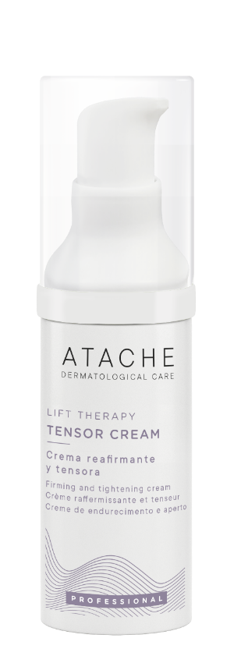
TENsOR CREAM
TENSOR CREAM: Firming and tightening finishing cream
Presentation: 30 ml airless
Description: Finishing cream with tensing and structuring active ingredients; increases firmness, reduces skin flaccidity and fights volume loss, providing a silky texture and easy spreading as the end of treatment.
Ingredients: Spillantes Acmella, Hyaluronic Acid, tensing peptides, niacinamide.
Instructions for use: Apply 20 doses-pulsation massage always upwards in direction, until completely absorbed.

