Slide 1


PRO MESO

Slide 2
INDEX
MESOTHERAPY
DERMIC + PRO MESO
RADIANT ANTIOXIDANT BLEND
BIOACTIVE REJUVENATING COCKTAIL
NEW GENERATION OF ANTIOXIDANTS
TIGHT & TONE REVITALIZER
BRIGHTENING ACNE
CLARITY SHIELD
2

Slide 3
MESOTHERAPY

Slide 4
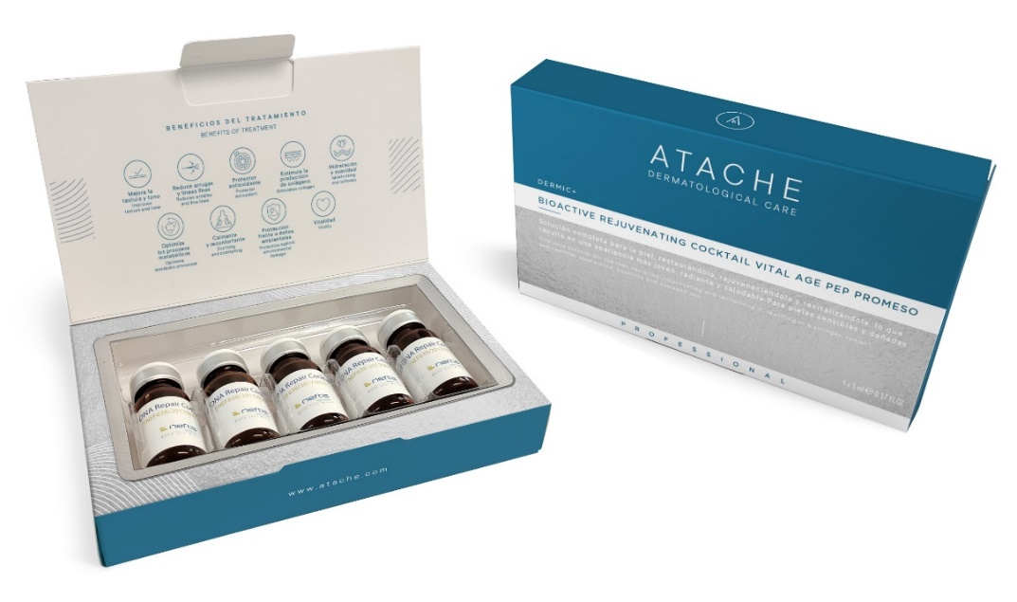
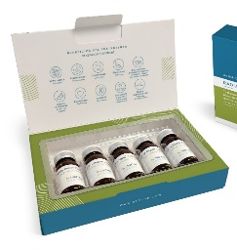
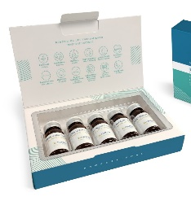
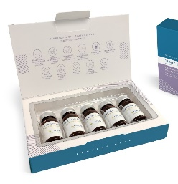
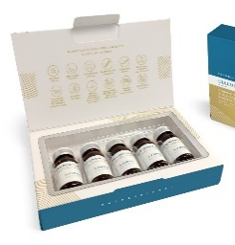
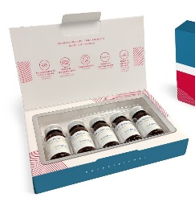
DERMIC + PRO MESO
Atache strengthens its dedication to skincare excellence with the Dermic+ line.
This range, designed exclusively for professional use, is distinguished by its meticulous selection of active ingredients chosen for specific needs.
Dermic+ Pro Meso is an innovative collection comprising six mesotherapy programmes, meticulously formulated with mimetic peptides, vitamins and amino acids.

Slide 5
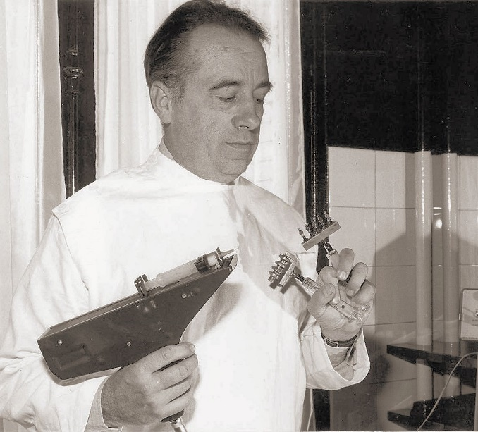
ORIGIN OF MESOTHERAPY
Mesotherapy in aesthetic medicine emerged in the 1950s.
It was pioneered by French doctor Michel Pistor, who aimed to address various medical conditions locally and with minimal medication doses. Pistor introduced the technique of injecting small medication amounts directly into the skin’s superficial layer to achieve targeted therapeutic effects while minimising systemic side effects.
Over time, mesotherapy has evolved and refined for application in aesthetic medicine, where it effectively addresses concerns like cellulite, hair loss, skin ageing and other aesthetic issues. Since then, it has garnered popularity and become a staple technique in aesthetic medicine.

Slide 6
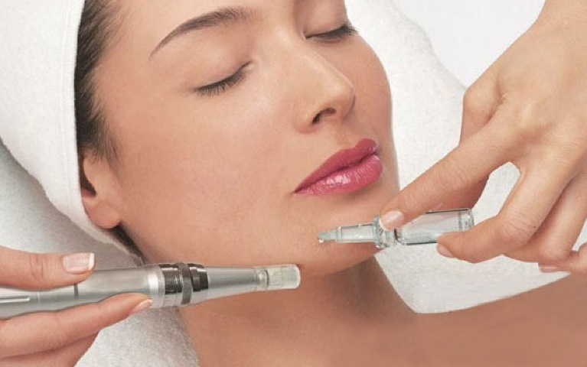
FACIAL MESOTHERAPY
Facial mesotherapy is an aesthetic treatment that involves applying small amounts of biocompatible substances, such as vitamins, minerals, antioxidants, peptides and hyaluronic acid, directly into the superficial layer of facial skin. These substances can be administered through micro-injections, usually with a very fine needle, or a needle-free mesotherapy device, targeting specific areas of the face.
The objectives of mesotherapy may include:
Improving skin hydration and suppleness.
Reducing fine lines and wrinkles.
Enhancing skin radiance and vitality.
Addressing facial flaccidity.
Minimising enlarged pores.
Diminishing scars and blemishes.
Treating irregular pigmentation and dark spots.

Slide 7
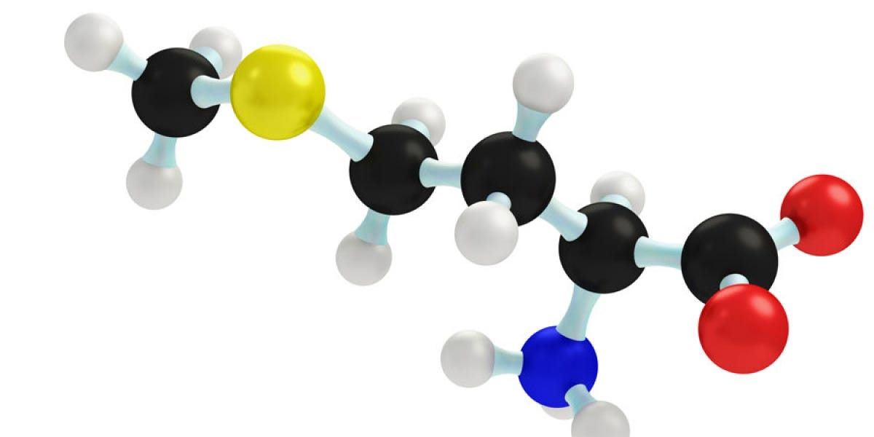
MESOTHERAPY COCKTAILS
Mesotherapy cocktails typically include ingredients with low molecular weight, such as vitamins, minerals, amino acids and peptides. These components are selected for their ability to effectively penetrate the skin and deliver specific benefits.
Amino acids
Peptides:
Nucleotides
Vitamins
Minerals
Coenzymes
Other biomolecules

Slide 8
INGREDIENTS IN MESOTHERAPY
Amino acids
- They form the fundamental building blocks of proteins.
- Essential for protein synthesis and cellular function.
- They may serve individual roles in the skin, such as hydration, tissue repair and stimulation of collagen production.
Peptides
- Consist of short chains of amino acids linked by peptide bonds.
- Possess more specific functions than amino acids.
- In skincare, they can offer hydrating, anti-wrinkle, antioxidant and collagen-stimulating properties.
- Peptides can be categorised into natural peptides, which are naturally produced by living organisms, and synthetic or mimetic peptides, which may have an identical amino acid composition to natural peptides or may be structurally modified to improve their stability, bioavailability or other characteristics.

Slide 9
INGREDIENTS IN MESOTHERAPY
Nucleotides
- They are the structural units of nucleic acids (DNA and RNA).
- They play crucial roles in transmitting genetic information and generating cellular energy.
- In skincare, they may offer repairing and antioxidant effects.
Vitamins
- They are essential organic compounds required by the body in small amounts.
- They regulate metabolism, protect against oxidative stress and bolster the immune system, among other functions.
- In skincare, they can boost radiance, defend against free radicals and stimulate collagen production.

Slide 10
INGREDIENTS IN MESOTHERAPY
Minerals
- They are indispensable inorganic elements for human health and function.
- They regulate physiological processes, bone structure and muscle function, among other roles.
- In skincare, they can enhance hydration, protect against sun damage and maintain mineral balance.
Coenzymes
- They are non-protein organic molecules that aid enzymes in specific chemical reactions.
- They function as cofactors and facilitate the transfer of functional groups between enzymes.
- In skincare, they may possess antioxidant, reparative and hydrating properties.

Slide 11
DERMIC + PRO MESO

Slide 12

DERMIC + PRO MESO
Dermic+ Pro Meso is a collection of six mesotherapy programmes aimed at significantly enhancing skin health and appearance.
In line with Atache’s comprehensive range, we introduce a cocktail of bioactive ingredients for each specific treatment:
BRIGHTENING ACNE-PRONE
RADIANT ANTIOXIDANT BLEND
TIGHT & TONE REVITALIZER
OILY SK PEP PROMESO
CVITAL PEP PROMESO
LIFT THERAPY PEP PROMESO
CLARITY SHIELD
ENERGY BIO-REPAIR
BIOACTIVE REJUVENATING COCKTAIL
DP3 PEP PROMESO
EXCELLENCE PEP PROMESO
VITAL AGE PEP PROMESO

Slide 13

CLARITY SHIELD DP3 PEP PROMESO
Associated with the Line: DESPIGMEN P3
Presentation: 5 vials x 5 ml (sterile) Topical use
Recommended for: Melasma & Post-Inflammatory Hyperpigmentation
Ingredients: Tranexamic acid

Slide 14
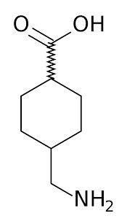
CLARITY SHIELD DP3 PEP PROMESO
CLARITY SHIELD DP3 PEP PROMESO is an exceptionally formulated product that centres on a single active ingredient: 1.8% tranexamic acid. This formula, focused on the purity and potency of this component, offers a direct and effective solution for tackling skin hyperpigmentation.
TRANEXAMIC ACID 1.8%
Clarity Shield is distinguished by its simple yet powerful approach. By focusing solely on tranexamic acid as its active ingredient, this product offers a concentrated and specialised solution for hyperpigmentation concerns.
With an almost 2% concentration of tranexamic acid, it excels in reducing excessive pigment production in the skin, enhancing skin tone uniformity and restoring its luminosity.

Slide 15
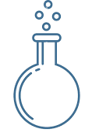
Tranexamic acid
Tranexamic acid is a medication known for its ability to promote blood clotting, thereby aiding in the prevention of bleeding. This has made it a widely used component in medicine for preventing excessive bleeding.
Recently, it has gained recognition in the fields of cosmetics, dermatology and aesthetic medicine due to an additional benefit supported by clinical studies: its ability to regulate the formation of dark spots on the skin.
Several clinical studies and reviews have evaluated the efficacy and safety of tranexamic acid in various concentrations for treating skin hyperpigmentation, including melasma.
Although the exact dosage may vary depending on the patient and the specific condition being treated, concentrations ranging from 1.5% to 5% have been observed to be effective in achieving significant results in reducing pigmentation and improving skin appearance.

Slide 16
Tranexamic acid
Tranexamic acid presents a promising solution for addressing skin pigmentation.
Regulates the activity of melanocytes, the cells responsible for melanin production: By adjusting the cellular mechanisms involved in excessive melanin production, tranexamic acid aids in preventing and reducing dark spot formation.
Intervenes in the inflammatory process linked to skin pigmentation: Chronic inflammation can trigger melanocyte activation and excessive melanin production, leading to the development of dark spots on the skin. By inhibiting this inflammatory process, tranexamic acid diminishes dark spot formation and intensity, particularly following external aggressions or skin injuries like acne.
Influences skin vascularisation: Melasma and other types of hyperpigmentation often correlate with increased local vascularisation, contributing to their persistence and resistance to treatment. Tranexamic acid’s reduction of excessive vascularisation helps improve the appearance of dark spots and prevent their recurrence.

Slide 17

RADIANT ANTIOXIDANT BLEND CVITAL PEP PROMESO
Associated with the Line: CVITAL
Presentation: 5 vials x 5 ml (sterile) Topical use
Recommended for: Revitalisation, Antioxidant, Anti-Ageing
Ingredients: Vitamins, Amino Acids, Peptides, Hyaluronic Acid

Slide 18
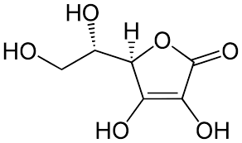
RADIANT ANTIOXIDANT BLEND CVITAL PEP PROMESO
The formula of RADIANT ANTIOXIDANT BLEND CVITAL PEP PROMESO combines a variety of meticulously selected peptides and vitamins to deliver potent antioxidant protection.
VITAMIN C
HYALURONIC ACID
GLUTATHIONE
NIACINAMIDE
VITAMIN A AND OTHER B-COMPLEX VITAMINS
AMINO ACIDS AND PEPTIDES
In this blend, OLIGOPEPTIDE-24 and OLIGOPEPTIDE-34, alongside vitamins like vitamin C, glutathione and niacinamide, effectively neutralise free radicals and protect the skin from oxidative stress. Moreover, its illuminating capability bestows a radiant and revitalised appearance upon the skin. Additionally, its anti-ageing properties aid in diminishing the appearance of fine lines and wrinkles, promoting smoother, firmer and more youthful-looking skin.

Slide 19
INGREDIENTS
Antioxidants: Ingredients such as vitamin C (sodium ascorbate), glutamine and glutathione serve as potent antioxidants that help to combat free radicals.
Vitamins: Besides vitamin C, other vitamins found in the product, like niacinamide (vitamin B3) and cyanocobalamin (vitamin B12), also possess antioxidant properties and contribute to enhancing the overall health of the skin by stimulating cell renewal and collagen production.
Amino acids: Many of the amino acids present, such as arginine, alanine and histidine, contribute to fibroblast synthesis for collagen and elastin production in the skin.
Peptides: The peptides present, such as SH-polypeptide-1 and SH-oligopeptide-2, possess regenerative and reparative properties that can aid in reducing the appearance of wrinkles and fine lines.
Moisturisers and Brighteners: Ingredients like hyaluronic acid and taurine provide intense hydration to the skin, which can enhance its radiance and overall appearance.

Slide 20
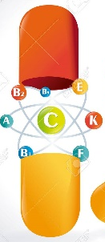
VITAMINS
Vitamin C (Sodium Ascorbate):
As an antioxidant, it contributes to collagen production, tissue repair and neurotransmitter synthesis. Additionally, it helps brighten the skin and even out its tone.
Vitamin A (Retinyl Palmitate):
It boosts cell renewal, enhances skin suppleness and stimulates collagen production. It also helps control keratinisation and prevents connective tissue degeneration.
Vitamin B3 (Niacinamide):
It aids in evening out the tone and suppressing melanin production, safeguarding the skin from damage caused by ultraviolet radiation. It also contributes to enhancing the skin barrier function.
B-complex vitamins:
These vitamins, such as B1 (thiamine), B2 (riboflavin), B5 (calcium pantothenate), B6 (pyridoxine hydrochloride), B7 (biotin), B9 (folic acid) and B12 (cyanocobalamin), play various roles including energy production, protein synthesis, and may help promote hydration, cell renewal and tissue regeneration.

Slide 21
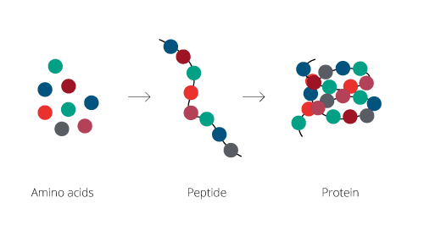
AMINO ACIDS
Antioxidant properties:
Glutamine, arginine and glycine act as antioxidants in the skin, protecting cells from damage caused by free radicals and fostering a healthier, more resilient complexion.
Depigmenting properties:
Glutathione and tyrosine possess depigmenting properties that aid in reducing excessive melanin production, thereby promoting a more uniform skin tone and diminishing dark spots.
Collagen-stimulating properties:
Glutamine, alanine, lysine, glycine and serine stimulate collagen production in the skin, while valine and histidine contribute to fibroblast synthesis, encouraging firmer, suppler skin and reducing the appearance of wrinkles and fine lines.
Moisturising and regenerating properties:
Moreover, amino acids such as threonine and methionine may exhibit hydrating properties, while proline can aid in skin repair and regeneration.

Slide 22
PEPTIDES
Antioxidant action:
Glutathione is a peptide composed of three amino acids: cysteine, glutamine and glycine. It is an antioxidant molecule that plays a crucial role in protecting cells against oxidative damage. Glutathione helps neutralise free radicals and other oxidative compounds that can cause cellular damage.
Other antioxidant peptides present in the formula, such as SH-POLYPEPTIDE-1, SH-OLIGOPEPTIDE-2, OLIGOPEPTIDE-34, SH-POLYPEPTIDE-11 and SH-OLIGOPEPTIDE-1, work synergistically to protect the skin from oxidative stress. These peptides assist in neutralising free radicals and reducing cellular damage, thereby contributing to maintaining healthier and more radiant skin.
Anti-ageing action:
On the other hand, peptides like OLIGOPEPTIDE-24 and SH-POLYPEPTIDE-9 are designed to promote collagen synthesis in the skin. These peptides help improve skin suppleness and firmness, diminish the appearance of wrinkles and fine lines, and refine skin texture and appearance.

Slide 23

BIOACTIVE REJUVENATING COCKTAIL VITAL AGE PEP PROMESO
Associated with the Line: VITAL AGE
Presentation: 5 vials x 5 ml (sterile) Topical use
Recommended for: Anti-Ageing, Anti-Wrinkles
Ingredients: Vitamins, Amino Acids, Peptides, Nucleotides

Slide 24
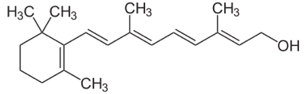
BIOACTIVE REJUVENATING COCKTAIL VITAL AGE PEP PROMESO
BIOACTIVE REJUVENATING COCKTAIL VITAL AGE PEP PROMESO is formulated with a unique blend of peptides and nucleotides, specifically designed to address signs of skin ageing.
VITAMIN A
NIACINAMIDE
OTHER B-COMPLEX VITAMINS
NUCLEOTIDES
AMINO ACIDS AND PEPTIDES
Its powerful ingredients work together to stimulate cell regeneration, boost collagen and elastin production and protect the skin from oxidative stress. With its anti-ageing properties, this product helps diminish the appearance of wrinkles and fine lines, enhances skin firmness and suppleness and encourages a more radiant and youthful complexion.

Slide 25
INGREDIENTS
The ingredients of this cosmetic product aid in tissue growth, particularly those that promote fibroblast and collagen synthesis, along with healing and antioxidant properties.
Amino acids: Numerous amino acids found in the product contribute to fibroblast synthesis, crucial for collagen and elastin production in the skin.
Peptides: Certain peptides within the product can stimulate collagen and elastin synthesis, fostering tissue growth and skin regeneration.
Vitamins: Specific vitamins present in the product, such as vitamin A (Retinyl Palmitate), have the ability to stimulate cell renewal and collagen synthesis.
Nucleotides: They play a role in increasing protein synthesis, boosting cellular energy and repairing DNA.

Slide 26
VITAMINS
Vitamin A (Retinyl Palmitate):
Retinol, the active form of vitamin A, stimulates cell renewal, accelerating the skin’s regeneration process and refining its texture. Additionally, retinol promotes collagen production, aiding in diminishing the appearance of wrinkles and improving skin suppleness.
Vitamin B3 (Niacinamide):
Niacinamide, a form of vitamin B3, is well-known for its anti-ageing benefits. It helps even out the skin tone, protects the skin from damage caused by ultraviolet radiation and strengthens the skin’s barrier function, improving its ability to retain moisture.
Vitamin C (Sodium Ascorbate):
Vitamin C, renowned for its anti-ageing properties, plays a crucial role in collagen production, enhancing skin firmness and suppleness.
The B-complex vitamins in this product (B1, B6, B9, B7, B8 and B12) contribute to cellular energy production, promote protein synthesis and participate in cell renewal and tissue regeneration processes, ensuring the skin remains rejuvenated over time.

Slide 27
AMINO ACIDS
Contribution to fibroblast synthesis:
Many of these amino acids contribute to fibroblast synthesis, crucial for collagen and elastin production in the skin. Among them are glutamine, aminobutyric acid, alanine, arginine, lysine HCL, valine, leucine, histidine, threonine, tryptophan, isoleucine, phenylalanine, tyrosine, glycine, serine, aspartic acid, cysteine, glutamic acid, asparagine, ornithine HCL and proline.
Contribution to protein synthesis:
Numerous amino acids, including leucine, phenylalanine, tyrosine and others, directly contribute to protein synthesis in the skin, which is crucial for maintaining its proper structure and function.
Skin hydration and suppleness:
Amino acids like glycine contribute to skin hydration and collagen production, enhancing skin suppleness and diminishing the appearance of fine lines and wrinkles. Additionally, lysine HCL acts as a skin softener.
Antioxidant effect: Moreover, arginine and glutamine possess antioxidant properties.

Slide 28
PEPTIDES
Copper Tripeptide-1: Stimulates collagen and elastin synthesis.
Reverses the effects of ageing by reducing both small and large wrinkles, enhances suppleness and boosts keratinocyte and fibroblast production. Furthermore, it acts as an antioxidant, protecting against free radicals and facilitating healing.
SH-Polypeptide-2: Antioxidant and promotes cell renewal.
Stimulates cell renewal and protects against oxidative stress.
SH-Polypeptide-1: Repairs and regenerates.
Stimulates collagen and elastin synthesis and fosters cell regeneration.
SH-Oligopeptide-1 (EGF - Epidermal Growth Factor): Repairs and rejuvenates.
Stimulates cellular regeneration and rejuvenates the skin.
SH-Oligopeptide-2: Rejuvenates and firms.
Rejuvenates the skin and improves firmness and suppleness.

Slide 29
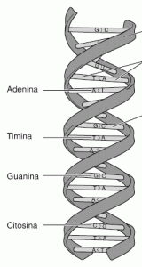
NUCLEOTIDES
Nucleotides are fundamental components for storing, transmitting and expressing genetic information in living organisms. They play a crucial role in cellular regeneration by facilitating the synthesis of DNA and RNA, which in turn drives cell replication and skin renewal. Additionally, they stimulate protein production and cellular metabolism.
Cytosine, Guanosine, Adenosine and Thymine: These nucleotides form the basic building blocks of DNA and RNA. They aid in the repair of damaged DNA, promote protein synthesis and contribute to cell renewal.
Cyclophosphate is instrumental in regulating various cellular processes, including cell proliferation and response to growth factors.
Adenine Dinucleotide: This nucleotide possesses antioxidant and energetic properties. It may serve as a cofactor in metabolic reactions such as ATP synthesis, which provides cellular energy.

Slide 30

ENERGY BIO-REPAIR EXCELLENCE PEP PROMESO
Associated with the Line: EXCELLENCE
Presentation: 5 vials x 5 ml (sterile) Topical use
Recommended for: Anti-ageing
Ingredients: DNA and RNA Hydrolysate, Hyaluronic Acid and Peptides

Slide 31
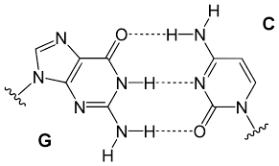
ENERGY BIO-REPAIR EXCELLENCE PEP PROMESO
ENERGY BIO-REPAIR EXCELLENCE PEP PROMESO offers a potent anti-ageing solution aimed at enhancing skin texture and radiance through profound hydration and balance.
HYALURONIC ACID
DNA AND RNA HYDROLYSATE
PEPTIDES
Hyaluronic acid delivers deep hydration and balance, visibly diminishing fine lines and wrinkles. Glutathione, renowned for its antioxidant properties, brightens the skin while protecting it from environmental stress. Moreover, Carnosine stimulates collagen synthesis, enhancing skin firmness and suppleness. In addition, DNA and RNA hydrolysates boost skin hydration and cellular regeneration, smoothing out expression lines and bestowing a rejuvenated, luminous complexion with a youthful appearance.

Slide 32
INGREDIENTS
Hyaluronic acid provides deep hydration and helps plump and reduce the appearance of fine lines and wrinkles, leaving the skin smoother and suppler.
Additionally, it contains Glutathione, an antioxidant that not only protects the skin from environmental oxidative stress but also has brightening properties by deactivating tyrosinase, which can enhance skin radiance and tone.
Carnosine is an antioxidant dipeptide that stimulates collagen synthesis, promoting skin firmness and suppleness, thus aiding in reducing signs of ageing.
Moreover, the product includes DNA and RNA hydrolysates, both nucleotides that boost skin hydration and help diminish the appearance of fine lines and wrinkles, resulting in softer and rejuvenated skin.

Slide 33
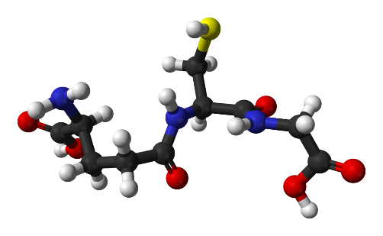
PEPTIDES
Glutathione:
Glutathione is a peptide composed of three amino acids: glutamine, cysteine and glycine. It is renowned as the body’s “master antioxidant” because of its vital role in cellular detoxification and neutralisation of free radicals.
Besides its antioxidant function, Glutathione is crucial for maintaining a healthy immune system and cellular repair process. Regarding the skin, Glutathione can help illuminate the complexion and protect it from damage caused by UV rays and other environmental factors.
Carnosine:
Carnosine is a dipeptide composed of the amino acids beta-alanine and histidine. It possesses antioxidant and anti-inflammatory properties and has demonstrated efficacy in safeguarding cells against oxidative damage and inflammation. Moreover, Carnosine has been associated with stimulating collagen synthesis, a key protein for skin firmness and suppleness. Thus, Carnosine aids in preserving youthful and healthy skin by protecting it from oxidative stress and promoting cellular regeneration.

Slide 34

NUCLEOTIDES
DNA and RNA hydrolysates are obtained through hydrolysis, a process in which short sequences of these nucleotides, or smaller fragments, are produced, making them more easily absorbed by the skin.
Hydrolysed DNA aids in stimulating skin cellular regeneration. By supplying the essential basic components for new DNA synthesis, such as nucleotides and nitrogenous bases, it can support cellular repair and renewal processes. Moreover, it protects against oxidative damage caused by free radicals and prevents premature ageing.
RNA plays a crucial role in protein synthesis within cells. Hence, hydrolysed RNA fragments can provide the necessary precursors for synthesising new proteins in the skin, thereby enhancing skin structure and function.
Through the stimulation of protein synthesis and other cellular components, hydrolysed RNA can facilitate cellular regeneration and repair damaged skin.

Slide 35

BRIGHTENING ACNE OILY SK PEP PROMESO
Associated with the Line: OILY SK
Presentation: 5 vials x 5 ml (sterile) Topical use
Recommended for: Acne Sequelae and Post-Inflammatory Pigmentation
Ingredients: Vitamins, Peptides, Natural Extracts, Alpha-Arbutin

Slide 36
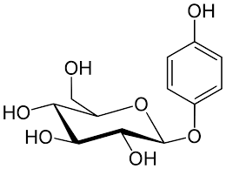
BRIGHTENING ACNE OILY SK PEP PROMESO
BRIGHTENING ACNE OILY SK PEP PROMESO is a mesotherapy solution specifically designed to address concerns related to acne and its sequelae.
ARBUTIN
GLYCYRRHIZA GLABRA EXTRACT
TRICHOLOMA MATSUTAKE EXTRACT
NIACINAMIDE
VITAMIN C
GLUTATHIONE
PEPTIDES
This blend of active ingredients targets the lightening of dark spots resulting from acne-related inflammation processes and stimulates cellular regeneration to repair the marks and irregularities left on the skin. Additionally, the selection of ingredients aims to maintain the sebum balance of skin that has experienced this exacerbated condition.

Slide 37
INGREDIENTS
Depigmenting agents:
Alpha-arbutin and extracts from Glycyrrhiza glabra root inhibit melanogenesis, reducing the appearance of dark spots and scars left by acne. They offer skin-lightening and tone-unifying properties, along with anti-inflammatory and antioxidant benefits.
Antioxidants:
Vitamin C, along with Glutathione, provides significant antioxidant action, stimulating collagen synthesis, improving skin texture and reducing the appearance of acne scars. This action is complemented by the effect of peptides Oligopeptide-34 and SH-polypeptide-2, which also act as potent antioxidants, reducing free radicals and preventing skin ageing.
Acne adjuvants:
Tricholoma matsutake extract possesses antimicrobial properties, aiding in combating acne-causing bacteria, thereby reducing inflammation and preventing the formation of new acne spots. Niacinamide, on the other hand, is notable for its multifunctionality, particularly its capacity to diminish dark spots while regulating sebum production.

Slide 38

DEPIGMENTING AGENTS
Arbutin:
By impeding melanin biosynthesis through the inhibition of the enzymatic oxidation of tyrosine and DOPA, it contributes to lightening and evening out the skin tone.
Glycyrrhiza glabra extract:
This formula features a dual concentration of Glycyrrhiza glabra root extract, sourced from both the common European liquorice plant and a specific variety from the Ural Mountains. Both extracts possess depigmenting properties, aiding in skin lightening and the reduction of irregular pigmentation. Moreover, they provide anti-inflammatory and antioxidant benefits.
Peptides:
Oligopeptide-34 has demonstrated properties in inhibiting melanin synthesis. It reduces tyrosinase activity, preventing the transfer of melanosomes from melanocytes to keratinocytes, thus aiding in reducing hyperpigmentation and brightening the skin.
Niacinamide: Also known as vitamin B3, contributes to skin lightening and evening out the tone. It suppresses melanin to prevent it from reaching the skin’s surface.

Slide 39
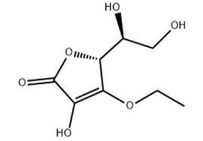
ANTIOXIDANTS
Vitamin C:
3-O-ethyl ascorbic acid is a specific and stabilised form of vitamin C that provides several benefits for mesotherapy application. It is considered one of the most stable forms of vitamin C with enhanced skin penetration, enabling it to reach deeper layers of the skin.
Glutathione:
Glutathione acts as a potent antioxidant and helps inhibit melanin production. Additionally, glutathione is renowned for its skin detoxification capabilities by eliminating toxins and harmful compounds. This can aid in eliminating impurities, unclogging blocked pores and promoting cleaner and healthier skin.
Peptides:
SH-polypeptide-2 offers various benefits for the skin. It is a potent antioxidant, reducing free radicals and inhibiting ageing skin cells. Reinforces the skin’s defences. Diminishes and prevents lines and wrinkles by generating new skin cells.

Slide 40
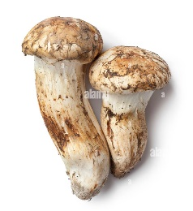
ACNE ADJUVANTS
Tricholoma matsutake extract is derived from an edible fungus known as matsutake, which is native to Asia and is particularly found in regions like Japan, Korea and China. It has antimicrobial properties, meaning it can help combat bacteria and other microorganisms that may cause skin infections, such as acne.
Among its properties is the ability to balance the endocrine system, which in turn can influence sebum production. Additionally, it contains a variety of antioxidants, such as polyphenols, which can help reduce the appearance of dark spots and pigmentation on the skin.
Other ingredients with various functions play an adjuvant role in acne-prone skin:
Glycyrrhiza glabra root extract, which has anti-inflammatory properties and can help regulate sebum production in the skin. Niacinamide can regulate sebum production and help keep pores clear. Lecithin improves dry or damaged skin by reducing flakiness and restoring its flexibility.

Slide 41

TIGHT & TONE REVITALIZER LIFT THERAPY PEP PROMESO
Associated with the Line: LIFT THERAPY
Presentation: 5 vials x 5 ml (sterile) Topical use
Recommended for: Firming
Ingredients: Hyaluronic Acid, Vitamins, Amino Acids, Peptides

Slide 42
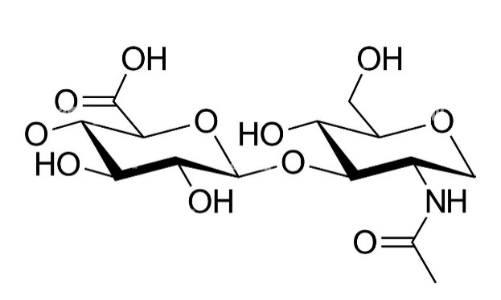
TIGHT & TONE REVITALIZER LIFT THERAPY PEP PROMESO
TIGHT & TONE REVITALIZER LIFT THERAPY PEP PROMESO is an advanced formula that combines a variety of active ingredients, including peptides, vitamins and hyaluronic acid, designed to provide a firming and tightening action on the skin.
HYALURONIC ACID
VITAMIN A
NIACINAMIDE
OTHER B-COMPLEX VITAMINS
AMINO ACIDS AND PEPTIDES
These ingredients work together to improve skin firmness, suppleness and tone.
The peptides in the formula boost collagen and elastin production. Moreover, hyaluronic acid deeply hydrates, enhancing the skin’s overall appearance by plumping wrinkles and fine lines. This combination promotes firmer, more toned and rejuvenated skin, diminishing flaccidity and improving facial definition.

Slide 43
INGREDIENTS
Hyaluronic acid:
The primary ingredient in this firming cocktail is hyaluronic acid, which deeply hydrates the skin by retaining significant amounts of water in the epidermis and providing a volumising effect on the face.
Amino Acids and Peptides:
The amino acids and peptides in this product are vital for fortifying the skin’s structure and stimulating collagen and elastin production, essential for firm and supple skin.
Vitamins:
Vitamin B3 and vitamin A, found in this formula, aid in evening out the skin tone and enhancing luminosity, fostering cellular regeneration and collagen production, thus promoting firmer and more youthful skin.
Lastly, soyabean oil offers moisturising and nourishing benefits for the skin.

Slide 44
HYALURONIC ACID
Hyaluronic acid is a polysaccharide with the ability to retain significant amounts of water, giving it hydrating and plumping properties. In mesotherapy, it is typically presented as a sterile, viscous gel of non-animal origin.
Benefits of mesotherapy with hyaluronic acid:
- Deep skin hydration: Hyaluronic acid retains water in the dermis, offering intense and long-lasting hydration.
- Wrinkle and fine line plumping: Hyaluronic acid fills the gaps between skin cells, reducing the appearance of wrinkles and fine lines.
- Stimulation of collagen production: The presence of hyaluronic acid in the skin can stimulate collagen synthesis, enhancing skin firmness and suppleness.

Slide 45
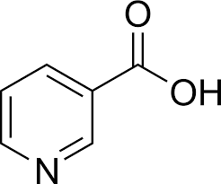
VITAMINS
Retinyl Palmitate (Vitamin A):
Retinyl palmitate stimulates cell renewal and promotes collagen production, aiding in diminishing the appearance of wrinkles and improving skin suppleness, thereby restoring firmness.
Niacinamide (Vitamin B3):
Niacinamide has shown its effectiveness in maintaining skin firmness and suppleness by boosting collagen production. Moreover, it reinforces the skin’s barrier function, enhancing moisture retention.
Sodium Ascorbate (Vitamin C):
Sodium ascorbate also plays a crucial role in collagen production, enhancing skin firmness and suppleness.
The B-complex vitamins found in this product (B1, B6, B9, B7, B8 and B12) contribute to cellular energy production, promote protein synthesis and participate in cellular renewal and tissue regeneration processes, ensuring the skin remains rejuvenated over time.

Slide 46
AMINO ACIDS
Contribution to fibroblast synthesis:
Many of these amino acids contribute to fibroblast synthesis, crucial for collagen and elastin production in the skin. Among them are glutamine, aminobutyric acid, alanine, arginine, lysine HCL, valine, leucine, histidine, threonine, tryptophan, isoleucine, phenylalanine, tyrosine, glycine, serine, aspartic acid, cysteine, glutamic acid, asparagine, ornithine HCL and proline.
Contribution to protein synthesis:
Numerous amino acids, including leucine, phenylalanine, tyrosine and others, directly contribute to protein synthesis in the skin, which is crucial for maintaining its proper structure and function.
Skin hydration and suppleness:
Amino acids like glycine contribute to skin hydration and collagen production, enhancing skin suppleness and diminishing the appearance of fine lines and wrinkles. Additionally, lysine HCL acts as a skin softener.
Antioxidant effect: Moreover, arginine and glutamine possess antioxidant properties.

Slide 47
PEPTIDES
Copper tripeptide plays a vital role in stimulating collagen and elastin synthesis in the skin. By boosting the production of these proteins, it helps diminish the appearance of wrinkles and fine lines, thereby enhancing skin firmness and tone.
SH-Polypeptide-1 is recognised for its capacity to stimulate collagen and elastin synthesis in the skin, assisting in the restoration of lost firmness and suppleness due to ageing and environmental damage.
SH-Oligopeptide-2 is used for its firming properties. By stimulating collagen and elastin production, this peptide aids in revitalising the skin’s support structure, improving its firmness and suppleness.
Peptides like SH-Polypeptide-2 and SH-Oligopeptide-1 can prompt cellular renewal. The latter, also referred to as Epidermal Growth Factor (EGF), facilitates skin renewal by eliminating dead and damaged cells and replacing them with new ones.

