Slide 1



TRAINING

Slide 2
index
  THE SENSITIVE SKIN.
  SOFT DERM LINE.
  PROFESSIONAL PRODUCTS.
  TREATMENT PROTOCOL.
  PRODUCTS FOR HOME TREATMENT.
  TREATMENT ROUTINE

Slide 3
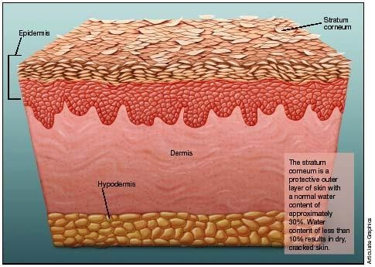
The skin
There are people who "in appearance" lack external symptoms and who, however, when applying a cream "have a terrible sensation of burning and discomfort".
This is the result of having "the thinnest layer of skin than usual" .
EXOGENOUS FACTORS
Climate and environmental influences.
Skin contact with chemical agents
such as cleaning agents or solvents.
The UV exposure .
Preparations for skin care and therapy, such as medications (topical and internal).
ENDOGENOUS FACTORS
Genetic predisposition
The biological skin aging
Hormonal influences
Certain dermatological and systemic diseases (atopic dermatitis, psoriasis, ichthyosis, diabetes).

Slide 4
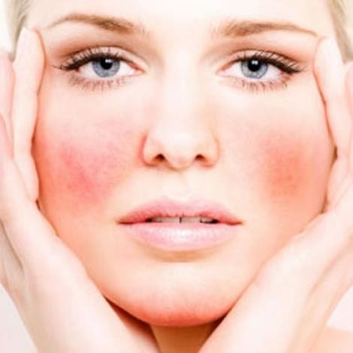
The Six Symptoms of Sensitive Skin
Inflammation
Dryness
Itching
Flaking
Tight skin
Redness

Slide 5
Characteristics of sensitive skin
Very fine, delicate and white skin, as the stratum corneum is extremely thin.
Fragile skin appearance .
Dry or dry-prone skin (is prone to fat and moisture deficiency).
Cuperosis often occurs (because blood vessels are more reactive than normal skin ).
Non-uniform texture: flakes, slight thickening (keratosis), rashes.
Prone to spots, erythema, itching, heat and tension.
He has no propensity for comedones and pustules.
Faster aging, premature appearance of wrinkles.

Slide 6
Cosmetic targets on sensitive skin
Avoid irritation
TREAT REACTIVITY
For this reason, cosmetic products for sensitive skin should have a content of soothing, repairing, protective and relaxing active ingredients in order to:
Decrease the feeling of tension.
Relieve the itching characteristic of these skins.
Get a calm, protected and smooth skin .

Slide 7

Ingredients: thermal water
This water comes from the hot springs of Salies de Béarn located in the French Atlantic Pyrenees considered highly effective in rheumatology, gynaecology and pediatrics.
It is classified as "hypothermal" by the temerature of its source at 23ºC. It is sodium chloride water highly concentrated in minerals, approximately 1:1000, with notable presence of calcium, magnesium and sulfates that offers therapeutic and relaxing effects.
It generally has calming, decongestant and anti-inflammatory properties.
Composition:
Calcium and magnesium.
Iron.
Manganese.
Zinc
Copper.

Slide 8
Ingredients: thermal water
Composition:
Calcium and magnesium: Promote the metabolism of fibroblasts, essential for the manufacture of collagen and elastin. Low levels cause premature aging of the skin and an anti-inflammatory reaction.
Iron: essential for oxygen transport and the oxygenation of tissues so it is very important for the immune system of the skin.
Manganese: helps to fix vitamins in the thermal connective tissue .
Zinc: intervenes at the level of the skin helping the synthesis of keratin and collagen. It contributes to the healing of skin lesions .
Copper: participates in the redox reactions of skin cells and contributes to the development of melanin by carrying out an antioxidant and anti-inflammatory action .

Slide 9
ingredients
Enteromorpha compressa seaweed extract:
Contains high protein, lipids, vitamins B, C and E; minerals, polysaccharides and carotenoids. These vitamins and nutrients help maintain a healthy skin barrier and help replenish and maintain skin hydration, reducing flaking of sensitive skin.
Has anti-pruritic and soothing action. Inhibits the binding of neuromediators that activate the itch sensation to their receptors on keratinocytes and fibroblasts. Studies show that it reduces the intensity and duration of itching and delays its onset.
Capparis spinosa extract:
Has anti-inflammatory properties due to its capaprenol content. It reduces the secretion of pro-inflammatory mediators (IL-8 and TNF-alpha) and reduces the signs of inflammation, such as itching, tightness and redness. Improves the comfort of sensitive and hyper-reactive skin by increasing the suppleness and softness of the skin.

Slide 10
ingredients
Milk proteins:
They prevent damage from oxidative stress and premature ageing. They act as a powerful anti-ageing active ingredient as they provide vitality and energy to the cells and induce collagen synthesis, thus improving skin firmness and smoothness and is effective as a skin brightening active ingredient.
Stimulates cell regeneration
Promotes ATP synthesis (the primary energy carrier molecule for all life forms) and collagen production.
Protects against external pro-inflammatory impacts: Effectively calms and soothes the skin and accelerates the reduction of redness and irritation.
Decreases melanin synthesis
Dihydroavenanthramide D solution.
Avenanthramides are polyphenols found almost exclusively in oats. According to scientific studies, these antioxidants fight cellular oxidation, and have an anti-inflammatory effect. Avenanthramides also help to reduce skin irritation and reduce itching due to their antihistamine properties.

Slide 11
ingredients
Allantoin: Increases the soothing action and promotes and accelerates the processes of natural skin repacation.
Provitamin B5: anti-inflammatory properties, improves cell regeneration and leaves skin soft and elastic.
Kaolin: used for centuries for its excellent purifying properties, removes impurities, toxins and excess fat.
Zinc oxide: protector, antiirritant and soothing.
Aloe vera gel: purifying, regenerating, soothing, moisturizing and protective.

Slide 12
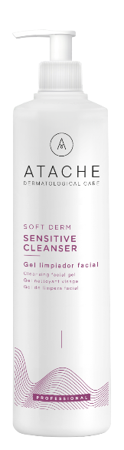
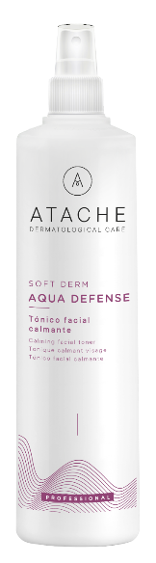
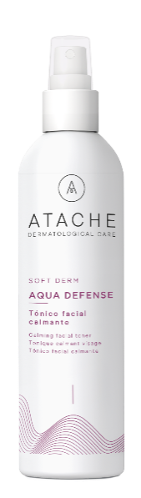
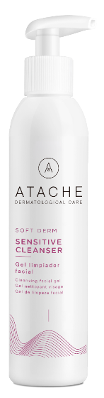
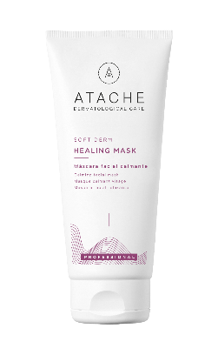
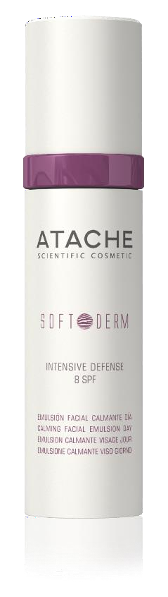
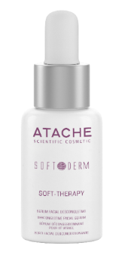

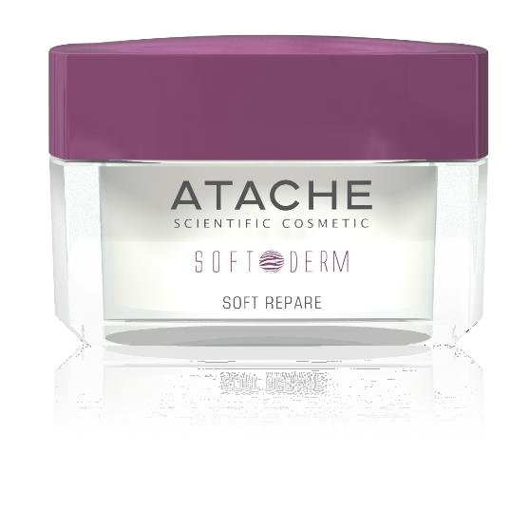
Hydration and care for sensitive skin
PROFESSIONAL TREATMENTS
Home treatments
ATACHE’s line of sensitive skins, Soft Derm, is a solution that provides soothing, restorative, protective and relaxing products that restore balance to the most sensitive skins from their daily cleaning and care.
With thermal water as the basis of the formulation, thanks to its products, the basic needs of sensitive skin are covered: daily cleaning, hydration and protection

Slide 13
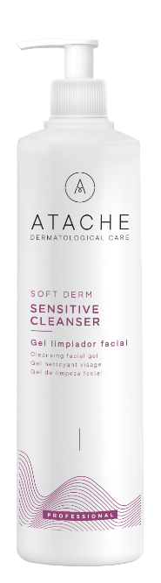
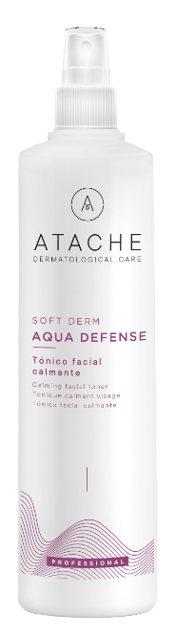
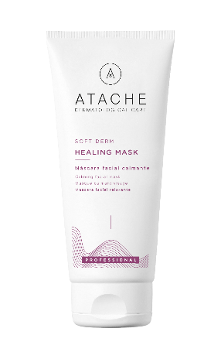



Professional products
Cleaning gel with soothing action, decongestant and repair
Soothing facial tonic, restorative and relaxing
Facial mask
soothing
Facial serum with normalizing effect, ultra-soothing and moisturizing
Volume: 500 ml
Code: 0640853
Volume: 500 ml
Code: 0640852
Volume: 200 ml
Code: 0640851
Volume: 24 x 4 ml
Code: 0640850
Sensitive Cleanser
Aqua defense
Healing mask
Soft Therapy

Slide 14
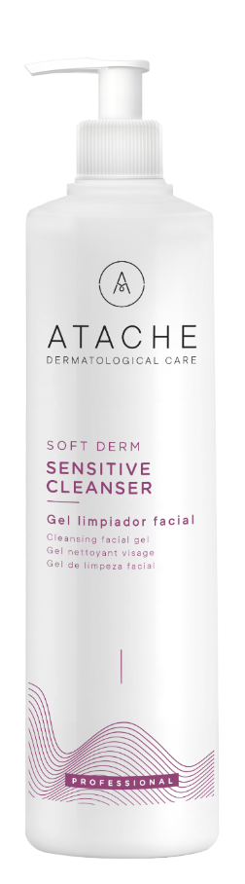

Professional products
Facial cleansing gel 500 ml
Ingredients: thermal water, Glucamate and miracare ( Gentle cleaning agents ).
Cleansing gel with a soft texture, with a soothing, decongestant and restorative action, formulated with thermal water and enriched with careful cleaning assets, which respect to the maximum the integrity of sensitive skin.
How to use: apply on face, neck and neckline doing a makeup removal or cleaning drawing circles with fingertips moistened in warm water, and dry with cellulose towels preferably.
Combine with other products: For double Japanese makeup removal on sensitive skin combined with total make up remover gel, with aqua defense on a regular basis and especially in those places where water quality is low, as a basic cleaning before any other treatment
Sensitive Cleanser

Slide 15


Professional products
Soothing facial tonic 500 ml
Ingredients: thermal water, Enteromorpha compressa seaweed extract, Allantoin, panthenol or provitamin B5.
Soothing, restorative and relaxing solution that gives sensitive skin a pleasant sensation of freshness and comfort, leaving it soft and elastic.
How to use: apply directly on face completing its absorption with slight touches.
Combine with other products: as a complement in the double Japanese make-up remover, as a substitute for water to emulsify other products, especially those places where water is of low quality
Aqua defense

Slide 16

Professional products
Soothing facial mask 200 ml
Ingredients: thermal water, Kaolin, zinc oxide, Enteromorpha compressa seaweed extract, Capparis spinosa extract, jojoba oil .
Soothing mask, which forms a protective film that prevents the appearance of signs of skin stress. Its exclusive formula protects the skin and leaves it flexible and comfortable
How to use:: Moisten a sterile gauze in aqua defense, and attach it to the face and neck. With the help of a brush, apply the mask. Leave on for 20 minutes, first remove the gauze, then remove the remains with sponges and warm water.
Healing mask
Healing mask

Slide 17
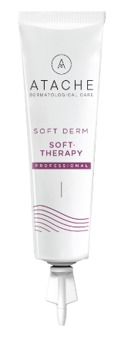

Professional products
Decongestant facial serum 24 x 4 ml
Ingredients: thermal water, Kaolin, Enteromorpha compressa seaweed extract, Capparis spinosa extract, milk protein.
Serum with normalizing and ultra-soothing effect developed exclusively so that sensitive skin regains its comfort leaving it soft and smooth.
How to use: Apply the contents of a SOFT-THERAPY tube, performing a massage until its complete absorption.
Soft Therapy

Slide 18
protocol
 | PASSING | PRODUCT | TIME
MAKE-UP REMOVER | Eye makeup removal | Total Make up remover
 |  |  | 5 min
 | Make-up removal of lips | Make up remover gel
PREPARE THE SKIN | Face, neck and neckline cleaning | Sensitive Cleanser
 | Exfoliation | Exfoliating Scrub | 6-8 min
 | Toning | Aqua defense
ACTIVATION | Decongestant serum | Soft Therapy | 5 min
Occlusion - penetration | Mask | Healing Mask | 20 min
Protecting | Protecting | Aqua Tonic + Hydrocream | 2 min

Slide 19
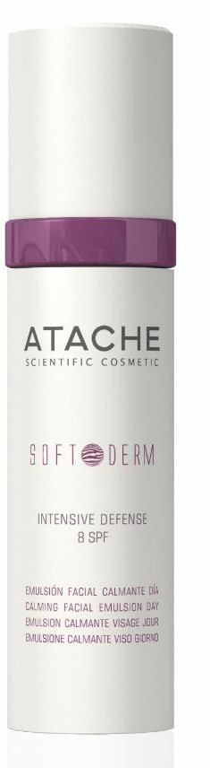
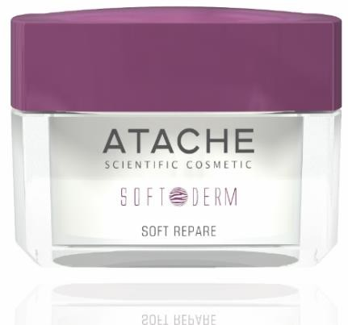

Products for home treatment
Cleansing gel with soothing, decongestant and repairing action
Soothing facial tonic,
restful and relaxing
Facial emulsion with calming effect, decongestant, repairing and protector.
Restorative facial cream, decongestant and soothing with anti-aging effect
Ultra-soothing, repairing and moisturizing for sensitive skins
Volume: 115 ml
Code: 640862
Volume: 200 ml
Code: 640865
Volume: 50 ml
Code: 640861
Volume: 50 ml
Code: 640860
Volume: 30 ml
Code: 640866
Sensitive Cleanser
Aqua defense
Intensive defense 8 SPF
Soft repair
Soft Therapy

Slide 20

Products for home treatment
Facial cleansing gel 115 ml
Ingredients: thermal water, Gglucamate and miracare. (Gentle cleaning agents).
Cleansing gel with a soft texture, with a soothing, decongestant and restorative action, formulated with thermal water and enriched with careful cleaning active ingredients, which respect to the maximum the integrity of sensitive skin.
How to use: apply sensitive cleanser with the fingertips moistened in water, by circular movements. Rinse with water.
Combine with other products: For double makeup removal on sensitive skin combined with total make up remover gel, with aqua defense on a regular basis and especially in those places where water quality is low, as basic cleaning before any other treatment
Sensitive Cleanser
Sensitive Cleanser

Slide 21
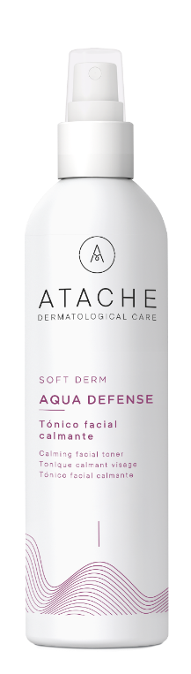
Products for home treatment
Soothing facial tonic 200 ml
Ingredients: thermal water, Enteromorpha compressa seaweed extract, Allantoin, panthenol or provitamin B5.
Soothing, restorative and relaxing solution that gives sensitive skin a pleasant sensation of freshness and comfort, leaving it soft and elastic.
How to use: apply directly on face completing its absorption with slight touches.
Combine with other products: as a complement in the double makeup removal, as a substitute for water to emulsify other products, especially those places where water is of low quality
Aqua tonic
Aqua defense

Slide 22
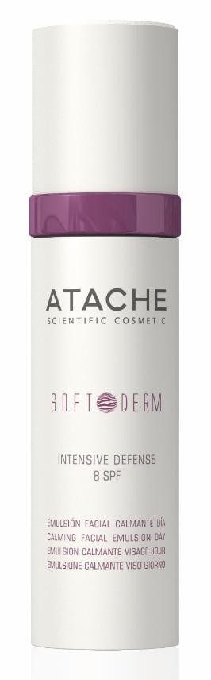
Products for home treatment
Soothing facial emulsion 50 ml
Ingredients: thermal water, Enteromorpha compressa seaweed extract, Capparis spinosa, aloe vera gel and sunscreen.
Balanced facial emulsion created specifically for the care of sensitive skin with soothing, decongestant, repairing and protective effect .
How to use:: extend with a gentle massage the soothing facial emulsion of day intensive defense, until its complete absorption
Combine with other products: As a main treatment after cleaning with sensitive cleanser or double makeup removal, as a complete treatment with soft repair.
Intensive defense 8 SPF
Intensive defense 8 SPF

Slide 23
Products for home treatment
Anti-aging and calming night facial cream 50 ml
Ingredients: thermal water, Enteromorpha compressa seaweed extract, Capparis spinosa and jojoba oil .
Anti-aging cream especially soft, fresh and delicate aroma, source of softness and hydration. Specially formulated to apply at night, ideal time for the renewal of the skin, and achieve a restorative, decongestant and relaxing action, which provides the sensitive skin with a sensation of immediate comfort
How to use: extend with a gentle massage the night soothing facial cream, until its complete absorption
Combine with other products: it is recommended to apply after cleaning with sensitive cleanser or applying the complete double make-up removal routine to take advantage of all its properties. It can be applied alongside intensive defense in parallel or on alternate days.
Soft Repair
Soft repare

Slide 24
Products for home treatment
Antiageing Serum with ultra calming effect
Description: Serum with anti-aging, moisturizing and repairing effect. It has properties that induce collagen synthesis and reorganize fibroblasts that repair the architecture of the dermis, providing smoothness, vitality and softness. In addition, it has antioxidant, anti-stress and protective properties.
Indications: Indicated in all types of skins between 20 and 35 who want to recover vitality, firmness and provide hydration and protection to their skin. In addition, it is suitable for dry, stressed or reddish and/or inflamed skin.
Ingredients: Milk Proteins, Capparis spinosa fruit extract, Avenantramides and thermal water.
Soft Repair
Soft THERAPY

